Slide 1
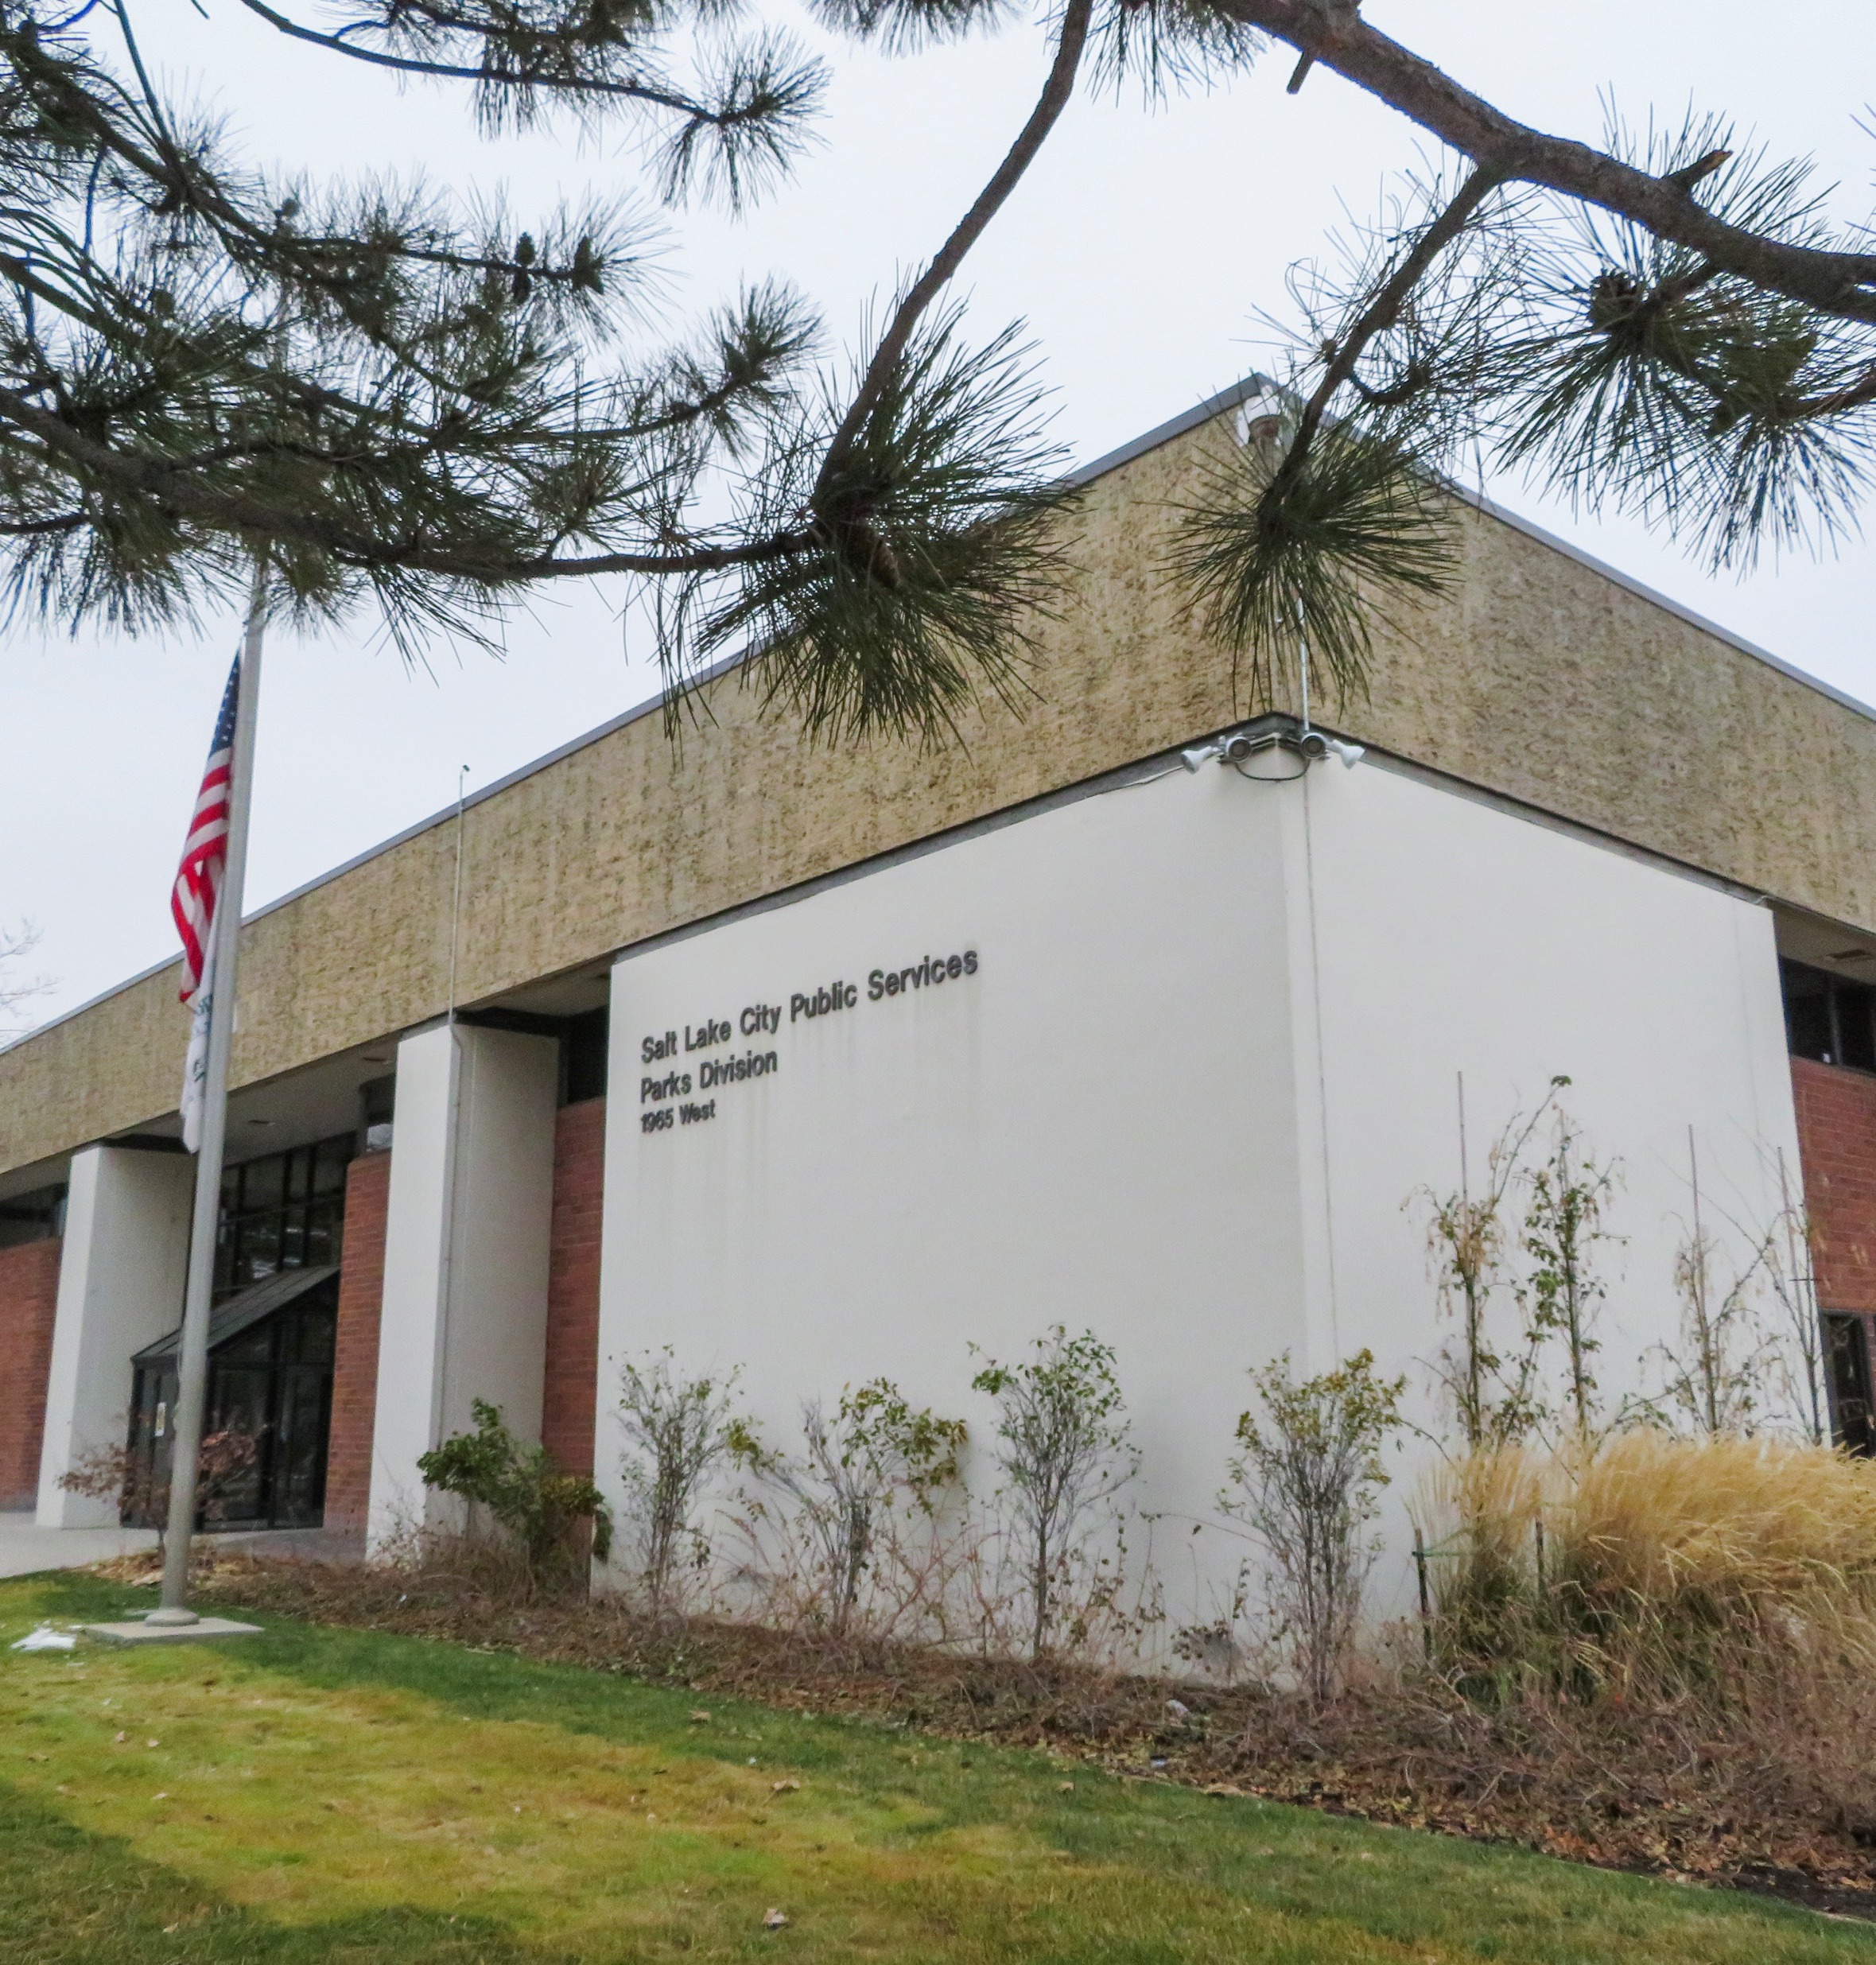


SLC Parks HVAC Replacement
Jarrett Capstick, P.E.

Slide 2
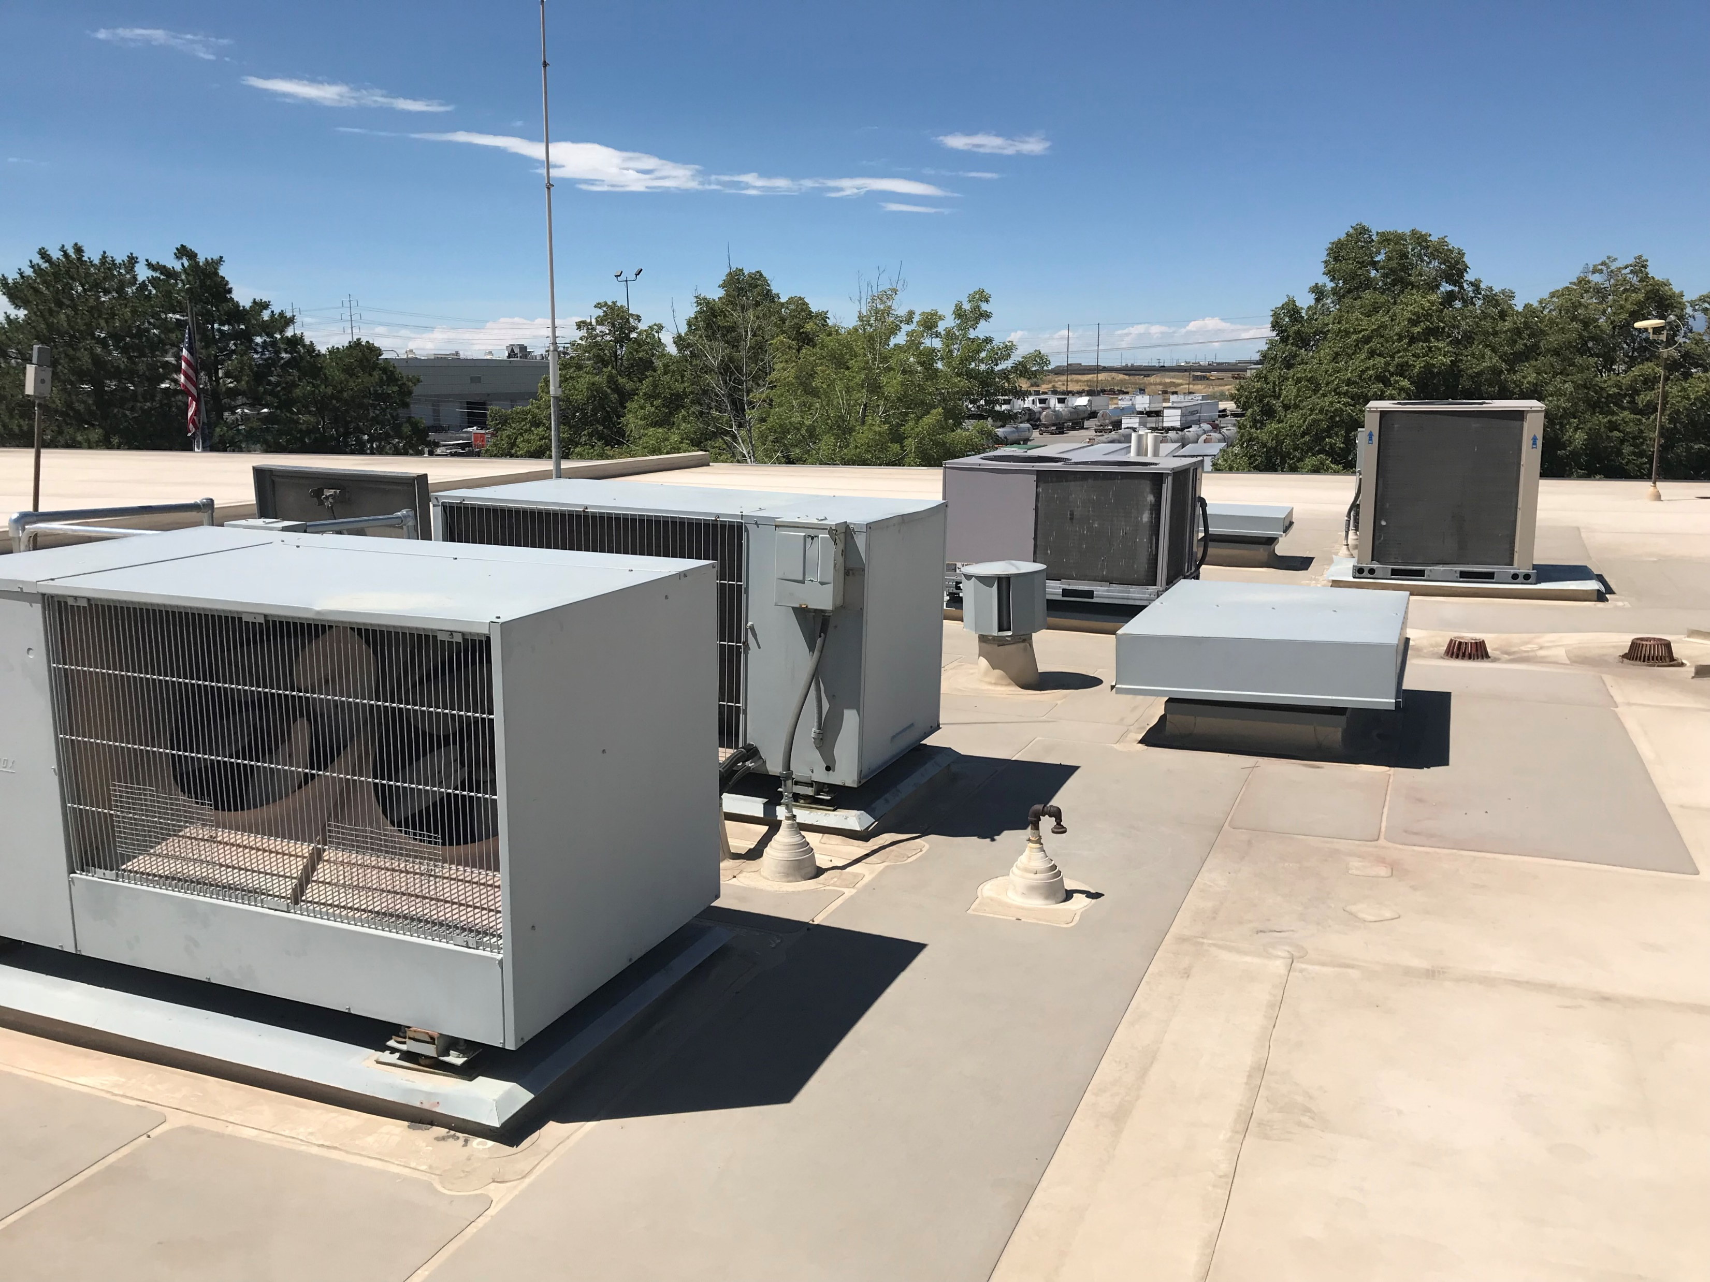
Old Slc Parks building
~40,000 SF BUILDING
    12,000 SF OFFICE (FURNACE / CONDENSING UNIT)
    28,000 SF WAREHOUSE (UNIT HEATERS)
HVAC SYSTEMS PAST EXPECTED USEFUL LIFE
ZONING AND OCCUPANT COMFORT ISSUES ASSOCIATED WITH MULTIPLE REMODELS.
DESIGN STARTED SPRING 2018.
PROJECT BID (#1) SPRING 2019.
COMPLETED SPRING 2022.

Slide 3
HVAC System Evaluation
INITIAL SYSTEM EVALUATION:
GROUND SOURCE w/ ZONE LEVEL WATER-AIR HEAT PUMPS
BOILER / COOLING TOWER w/ ZONE LEVEL WATER-AIR HEAT PUMPS
BOILER / CHILLER w/ ZONE LEVEL 4-PIPE FAN COILS
BEST VALUE WAS DETERMINED TO BE OPTION 1 WITH A 1-PIPE CONDENSER WATER LOOP DISTRIBUTION SYSTEM.
*EACH OPTION INCLUDED A DEDICATED OUTDOOR AIR SYSTEM (DOAS) FOR VENTILATION AIR

Slide 4
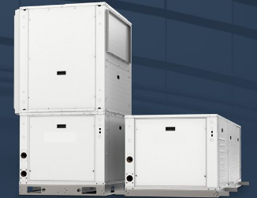
HEAT PUMP SYSTEMS
WATER-TO- AIR HEAT PUMPS:
VERTICAL OR HORIZONTAL CONFIGURATION
INTERNAL COMPRESSOR, COIL, FAN, FILTER
DUCTED TO ZONE
CONDENSER WATER SUPPLY AND RETURN PIPING
OPERATION:
HEATING MODE (EWT > LWT)
ABSORB HEAT FROM CONDENSER WATER + HEAT OF COMPRESSION (~25%)
COOLING MODE (EWT < LWT)
REJECT HEAT TO CONDENSER WATER + HEAT OF COMPRESSION
CONDENSER WATER:
IDEAL TEMPERATURE IS 55°F - 85°F (EXTENDED RANGE EQUIPMENT IS AVAILABLE)

Slide 5
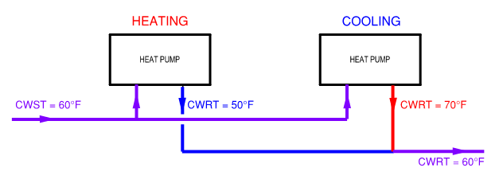
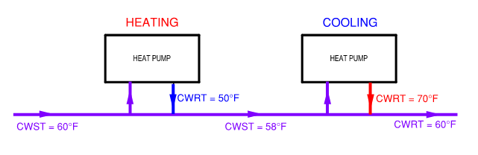
HEAT PUMP SYSTEMS
PIPING STRATEGIES
2-PIPE:
EACH UNIT GETS THE SAME TEMPERATURE CONDENSER WATER.
CONTROL VALVE PER UNIT
SYSTEM PUMP(S) MAINTAIN DIFFERENTIAL PRESSURE.
1-PIPE:
EACH UNIT GETS VARYING TEMPERATURE CONDENSER WATER.
PUMP PER UNIT
SYSTEM PUMP(S) MAINTAIN LOOP TEMPERATURE.

Slide 6
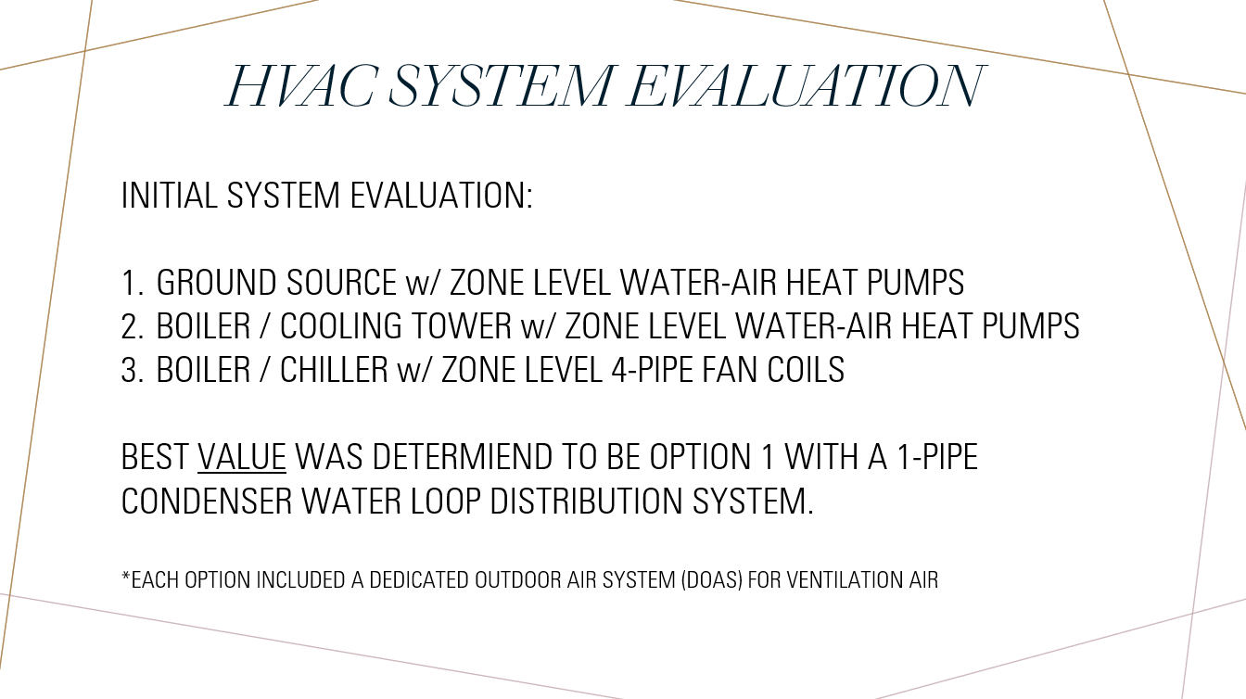
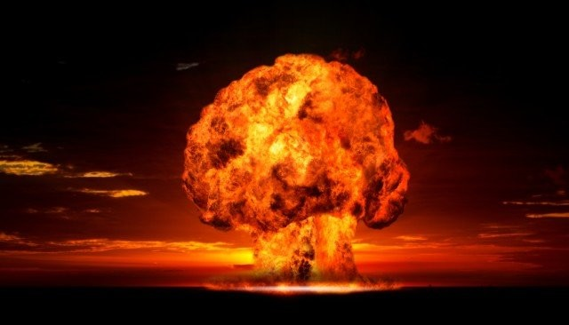
…BACK TO THE PARKS PROJECT
THE RESULT…
BUDGET
THE SOLUTION…
CHANGE FROM CONVENTIONAL TO BULLDOG HEAT PUMPS w/ 2-PIPE DISTRIBUTION
ELIMINATE GROUND SOURCE BOREFIELD
  HEAT CONDENSER WATER WITH BOILER
  REJECT HEAT WITH DRY-COOLER

Slide 7

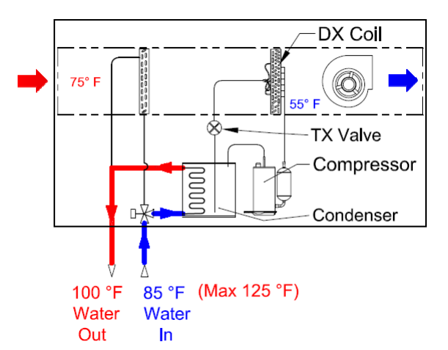
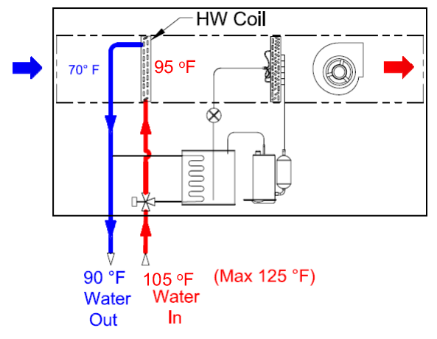
HEAT PUMP COOLING / HYDRONIC HEATING
COMPRESSOR OPTIMIZED FOR ELEVATED CONDENSER WATER TEMPERATURE
HEATING WATER COIL OPTIMIZED FOR LOW HEATING WATER TEMPERATURE
(HIGH CONDENSER WATER TEMPERATURE)

Slide 8
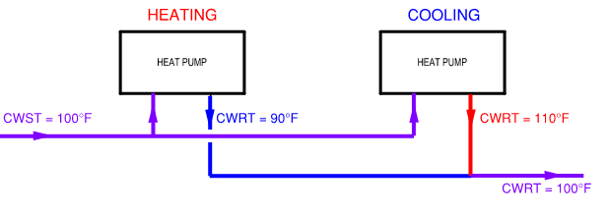
2-PIPE:

Slide 9
POTENTIAL ADVANTAGES
LESS COMPRESSOR RUN TIME = LONGER EQUIPMENT LIFE
QUIETER OPERATION IN HEATING MODE (NO COMPRESSOR)
GAS HEATING = LOWER OPERATING COST
LOW “HEATING WATER TEMPERATURE” = HIGHER BOILER EFFICIENCY
MODULATING HEATING CAPACITY
  *HELPFUL WHEN EQUIPMENT IS SIZED FOR COOLING CAPACITY

Slide 10
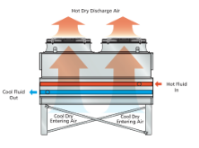
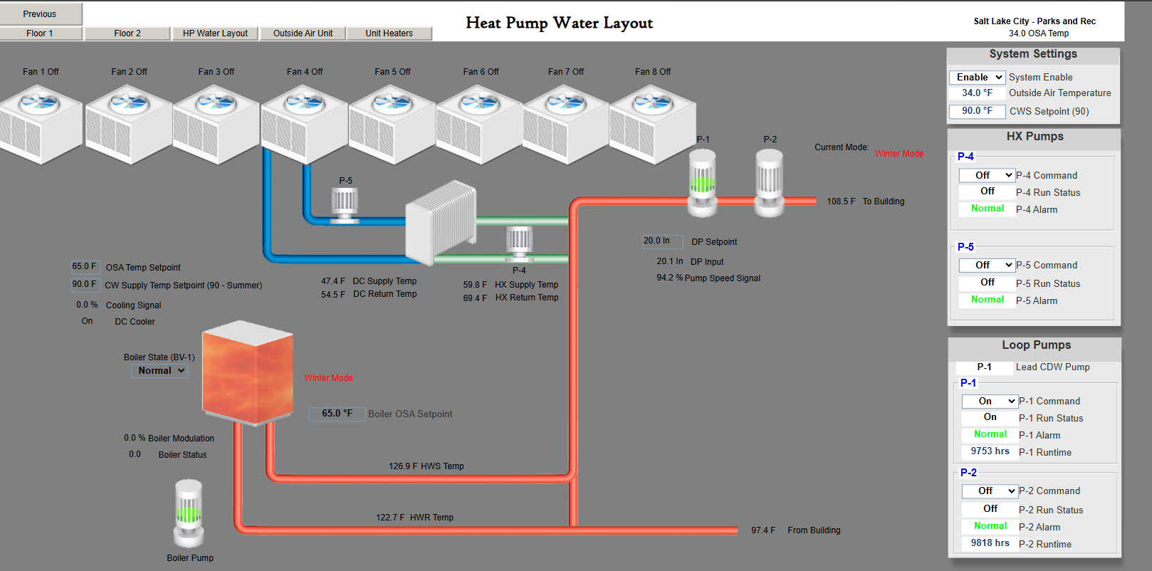
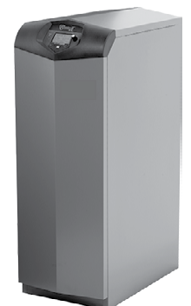
BOILER / DRY COOLER

Slide 11
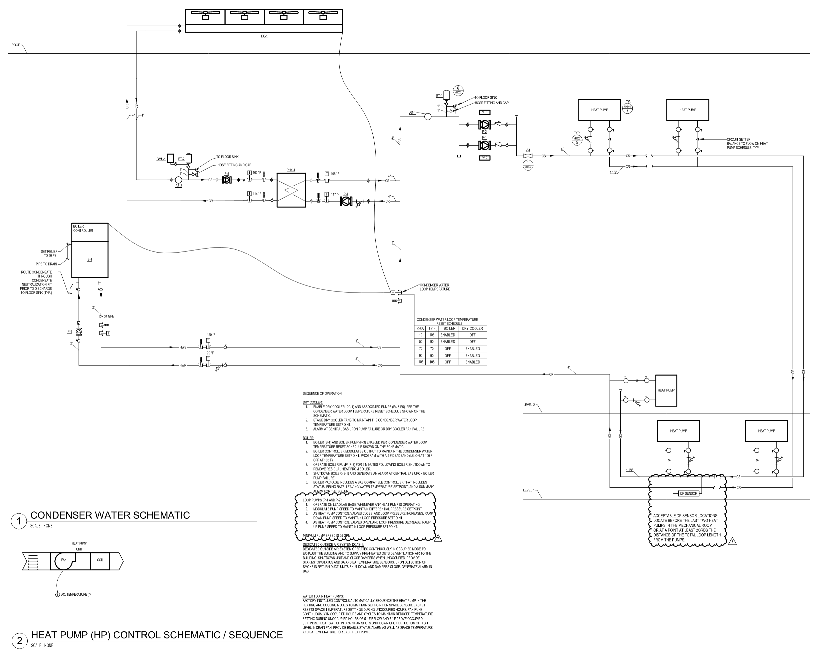
DESIGN PIPING SCHEMATIC

Slide 12
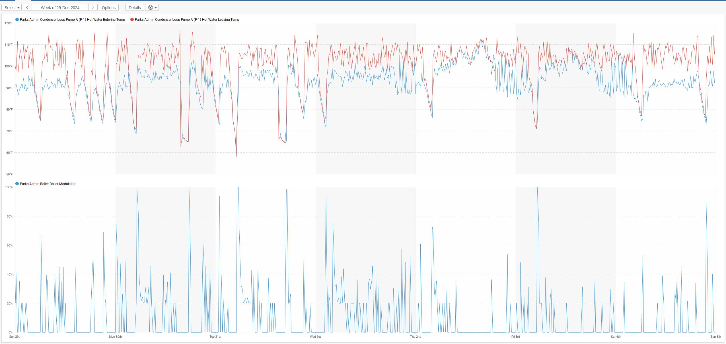
Heating Operation
LOOP MODULATED FROM 100°F – 110°F
BOILER MODULATED UP TO 40% FIRING RATE

Slide 13
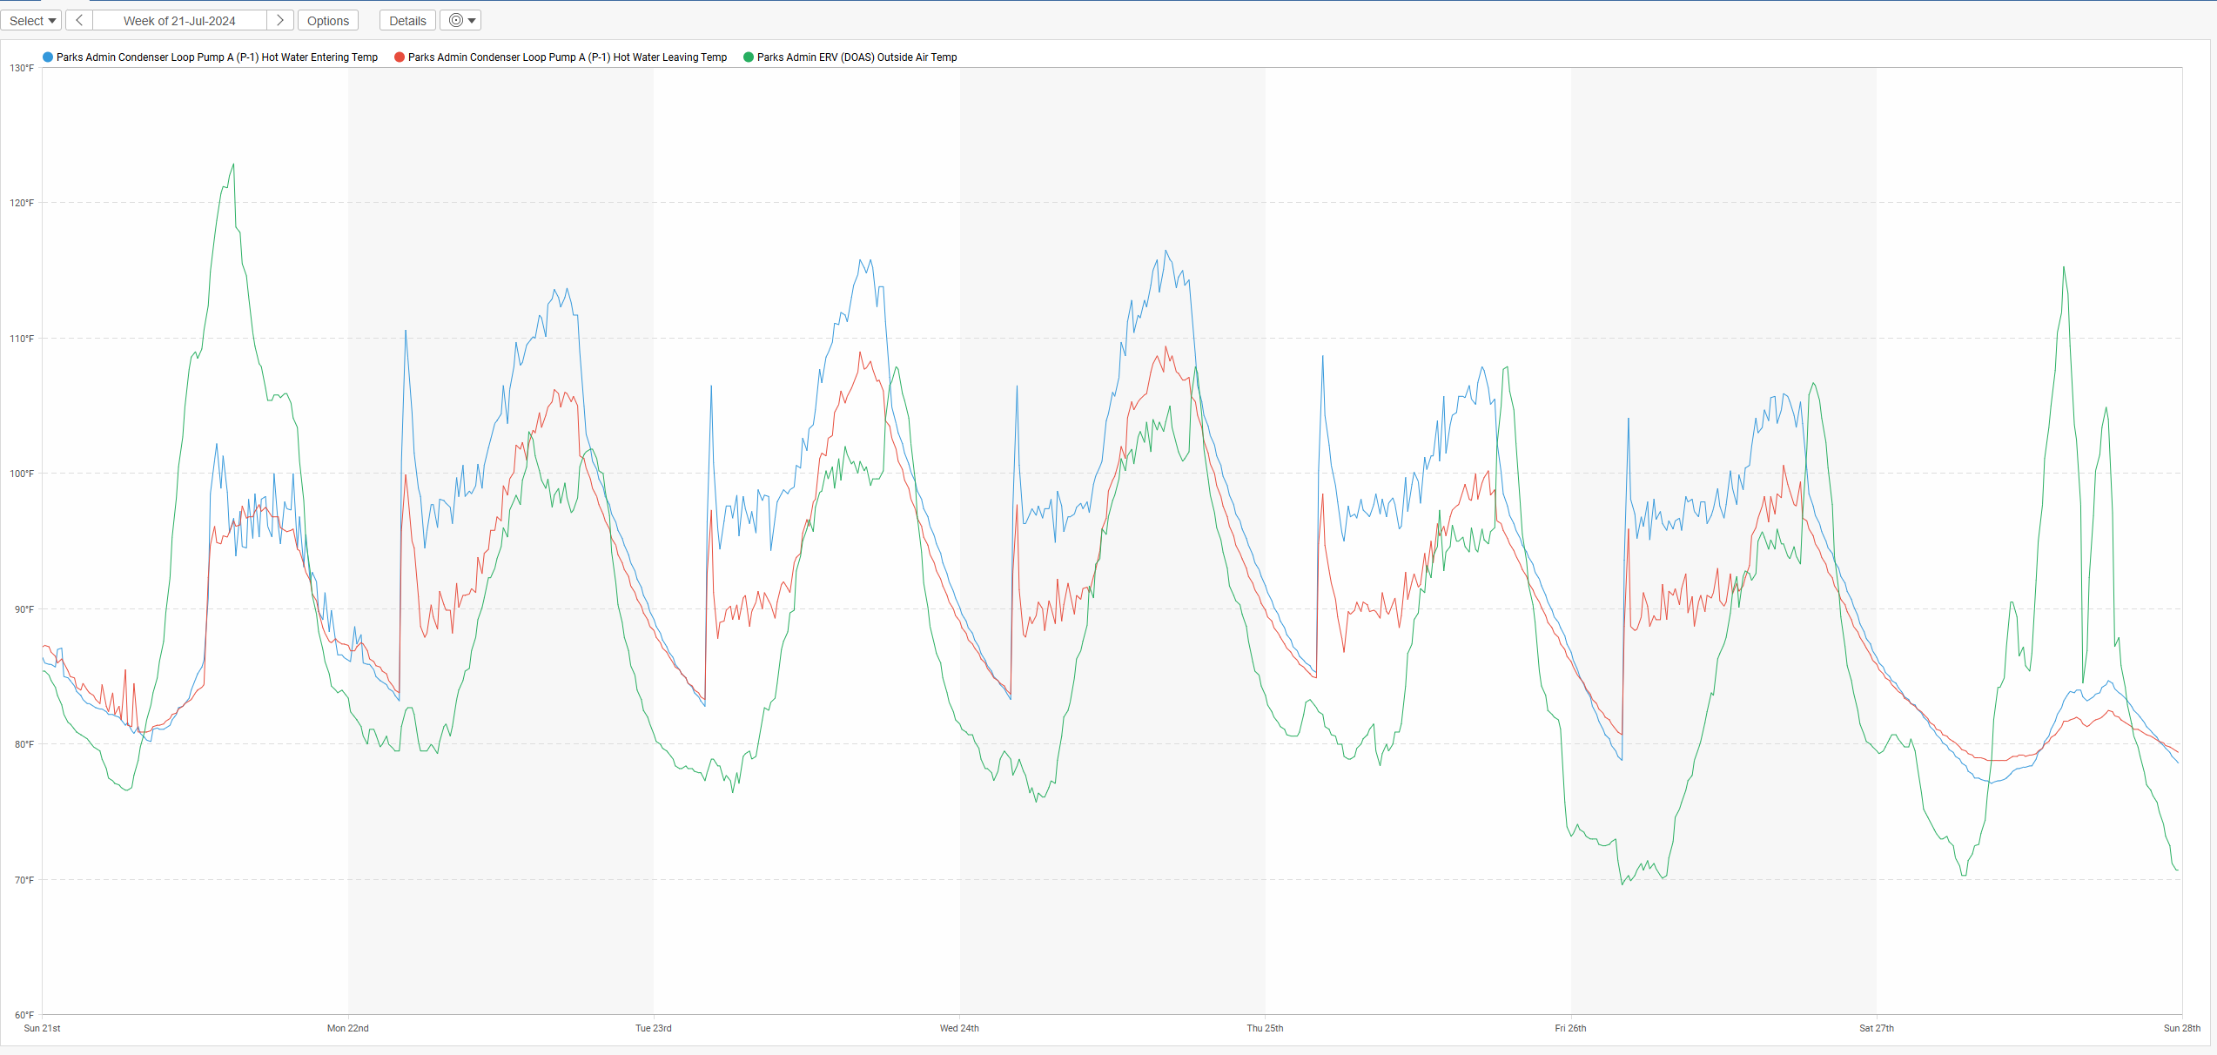
Cooling operation
OUTSIDE AIR TEMPERATURE REACHED 108°F
LOOP TEMPERATURE MODULATED BETWEEN 115 °F -90°F
TERMINAL UNITS WERE ABLE TO PROVIDE COOLING

Slide 14


QUESTIONS?
THANK YOU
Jarrett Capstick
801-505-5390
jcapstick@cea-ut.com

