Slide 1

Fleet Charging
Lessons From the Field

Slide 2
Agenda
Who is McKinstry?
Sample projects
How to be an active driver of fleet electrification.
What really matters?

Slide 3






National leader in designing, constructing, operating and high-performing infrastructure.
Founded in 1960, privately held
$950 million annual revenue
Climate Pledge Signatory
2,500 employees
25 regional offices
27 union partnerships
SEATTLE
SPOKANE
PORTLAND
MISSOULA
BILLINGS
PASCO
MINNEAPOLIS
MADISON
BOZEMAN
RENO
CHICAGO
DENVER
ST. LOUIS
SALT LAKE CITY
LAS VEGAS
ATLANTA
Corporate Headquarters
PHOENIX
LITTLE ROCK
Regional Headquarters
DALLAS
McKinstry Offices
AUSTIN
TAMPA
Pre-qualified energy services company
SAN ANTONIO
HOUSTON
Qualified to do business
^{BUILDING & MANUFACTURING}
Our teams continuously seek out improvements that result in driving waste out of the construction process and better financial outcomes
^{SMART AND CONNECTED}
From wireless ecosystems to energy management, McKinstry's industry-leading expertise offers a new approach to designing, engineering and monitoring buildings in unique and more effective ways
ENERGY OPTIMIZATION AND RENEWABLES
Our work often leads to substantial breakthroughs in energy savings, helping maintain and futureproof built environments to perform at the highest possible levels
^{Facility Services}
Through real-time monitoring, analytics and responsive mobile services teams, we reduce downtime, lower the total cost of building operations and optimize system performance every day
^{Engineering & Consulting}
McKinstry's unique breadth of services gives us the ability to impact and optimize every aspect of the total building system
Notes:
Ric

Slide 4
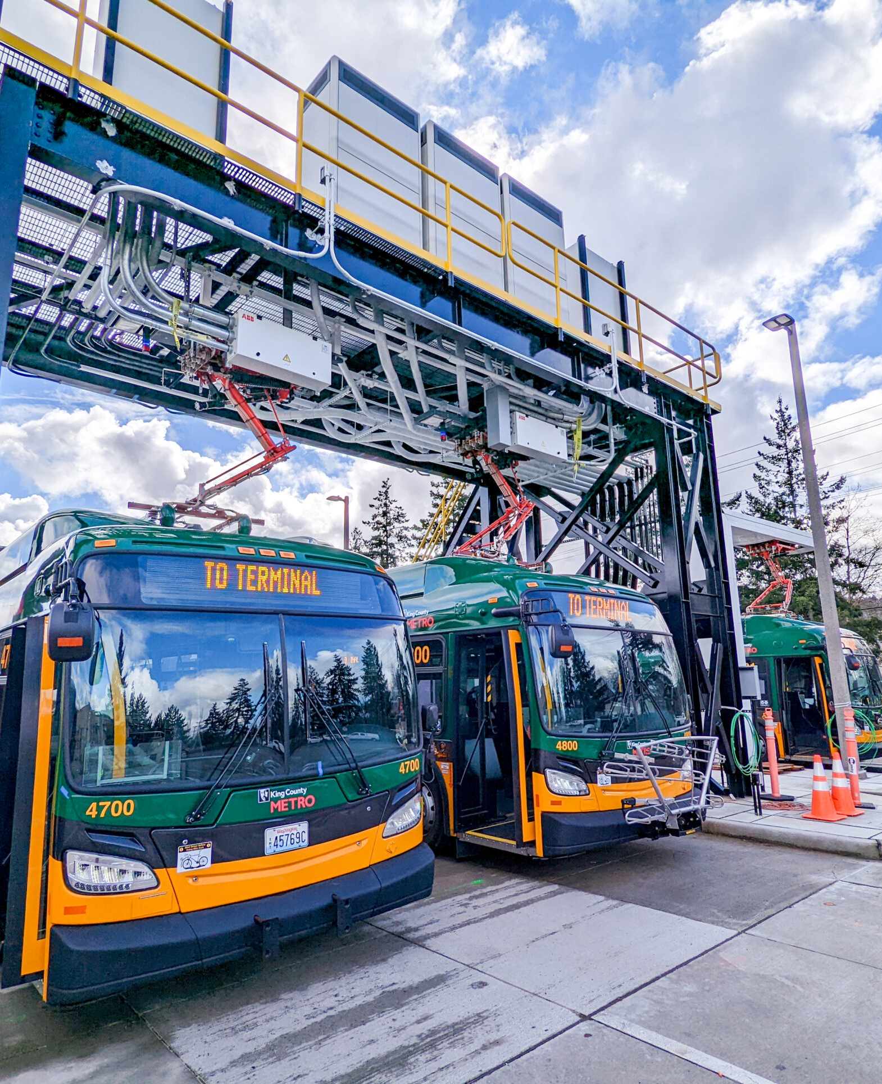
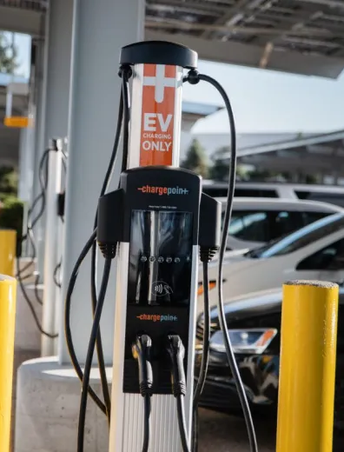
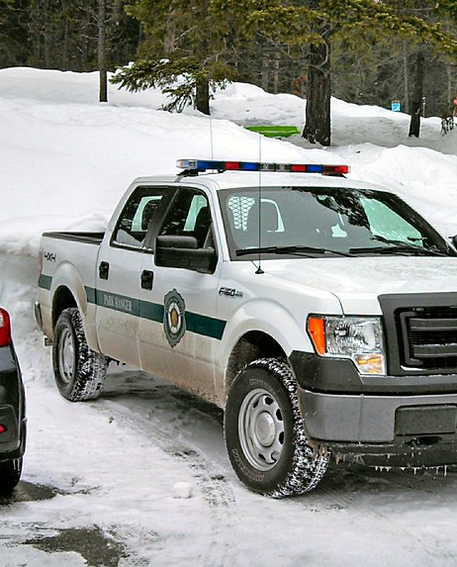
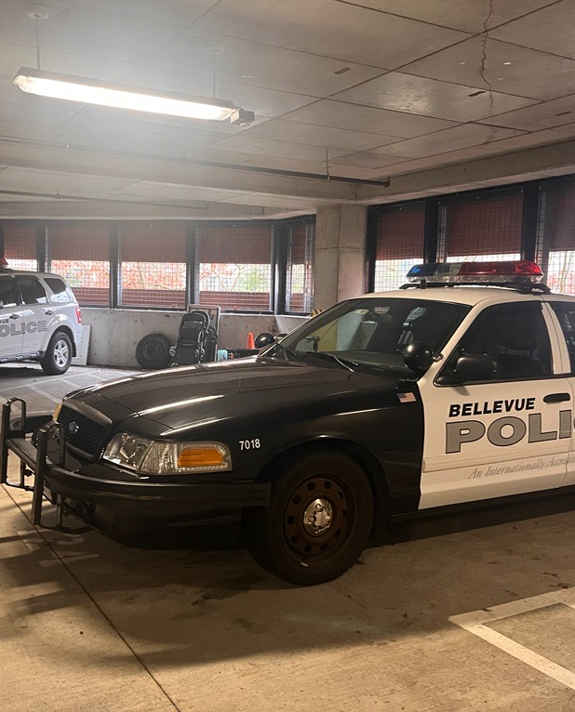
Sample EV Projects
King County
City of Denver
Washington Parks
City of Bellevue
Fleet
90 sites, 100-200 chargers
Transit
2 sites, 120 chargers
Fleet
9 sites, 150 chargers
Fleet/employee
1 sites, 100 chargers

Slide 5
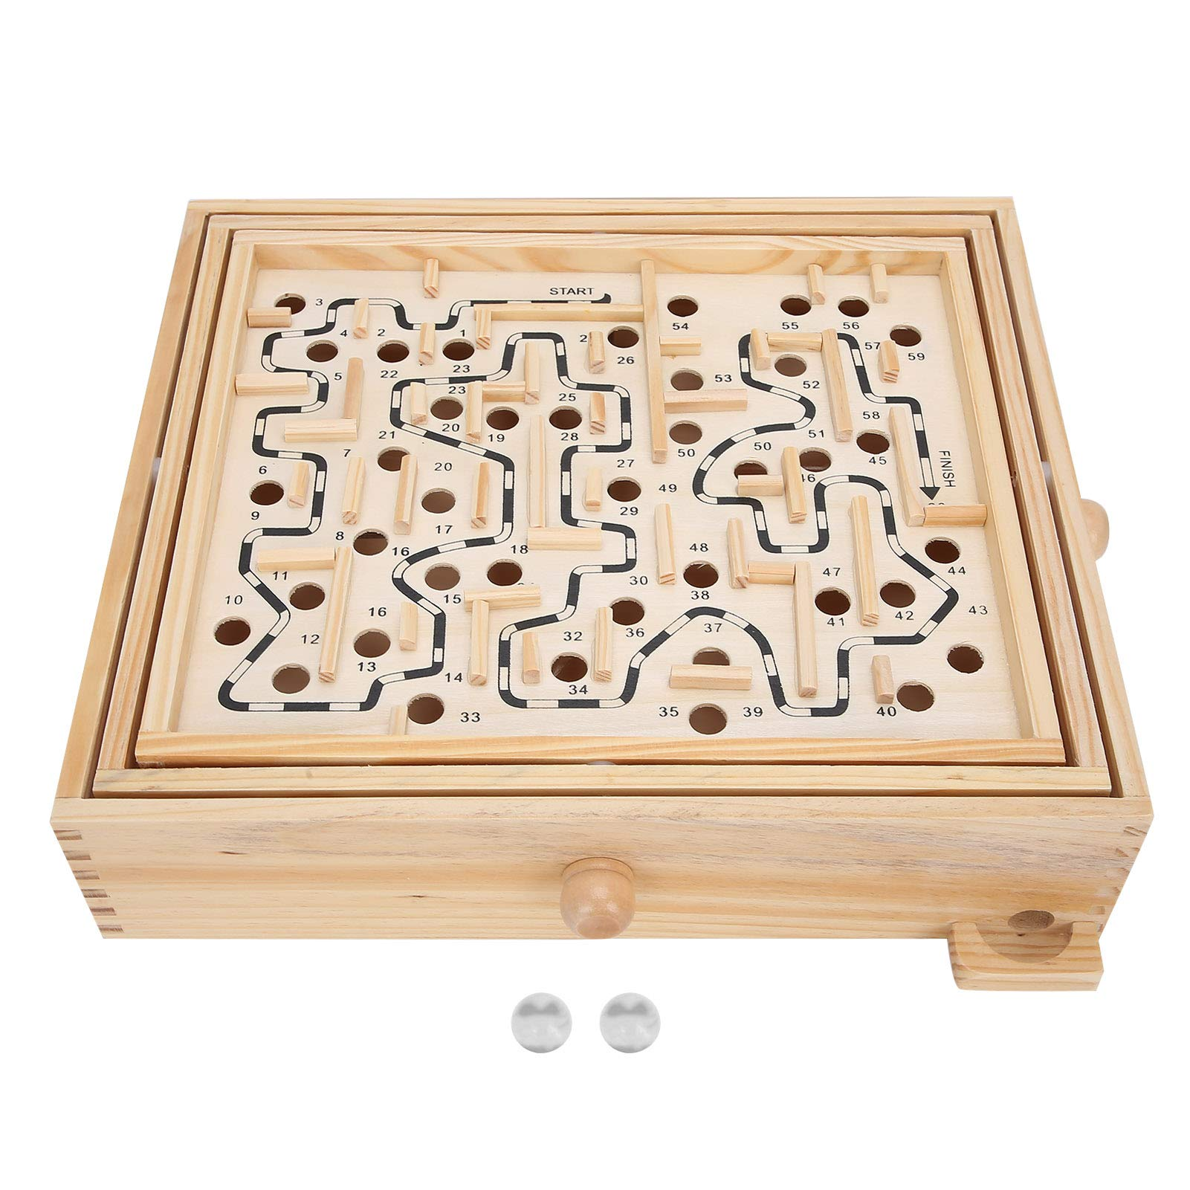
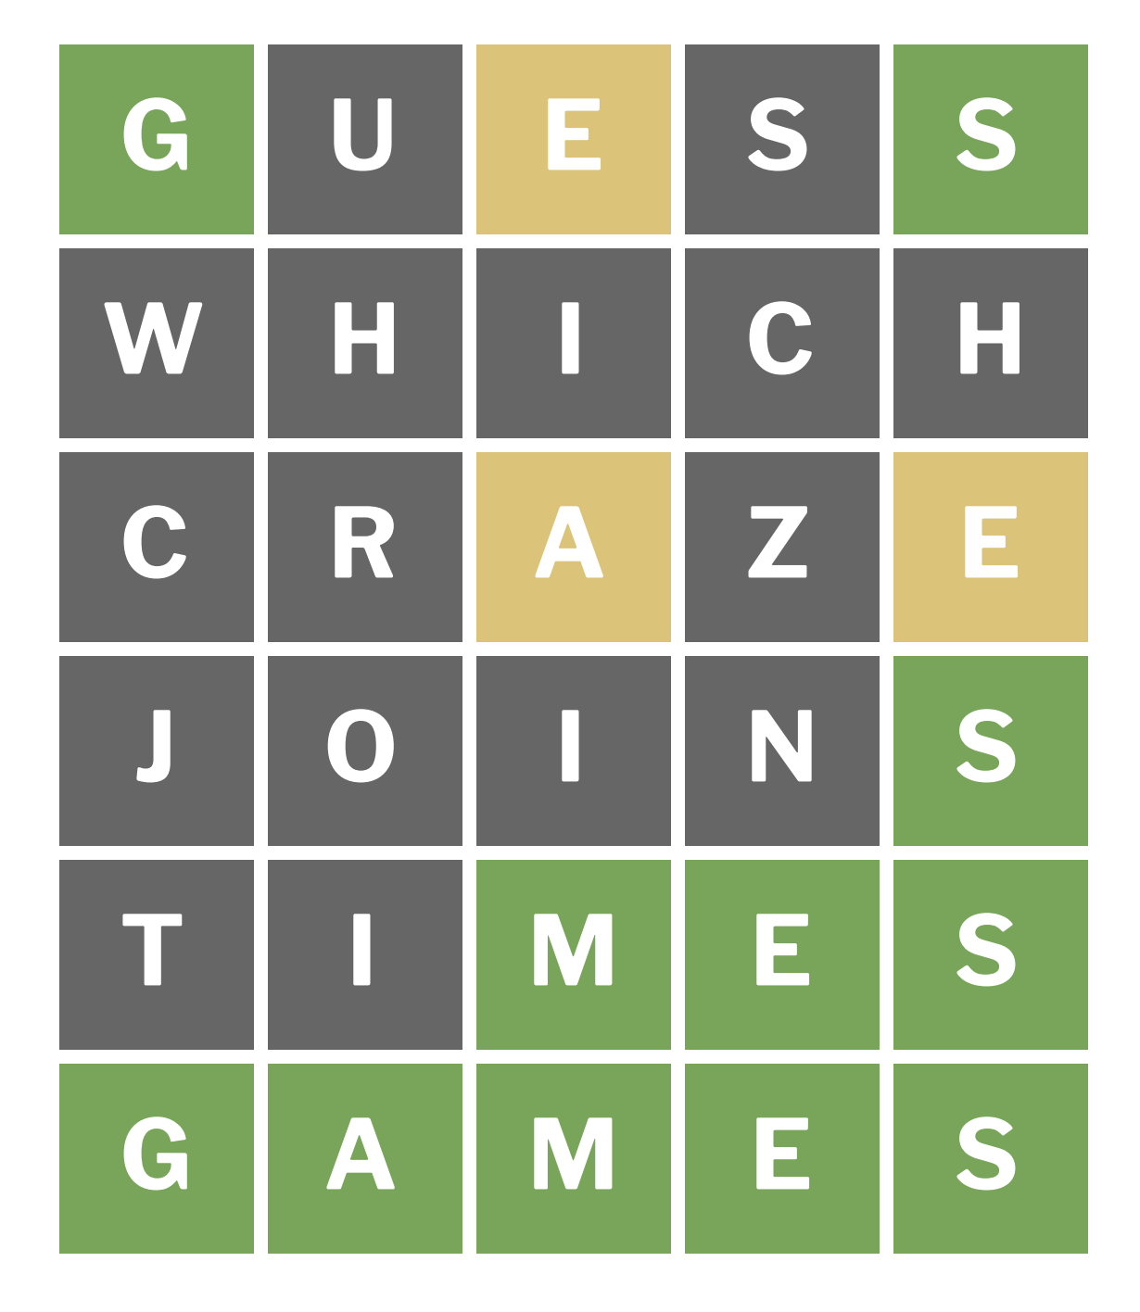
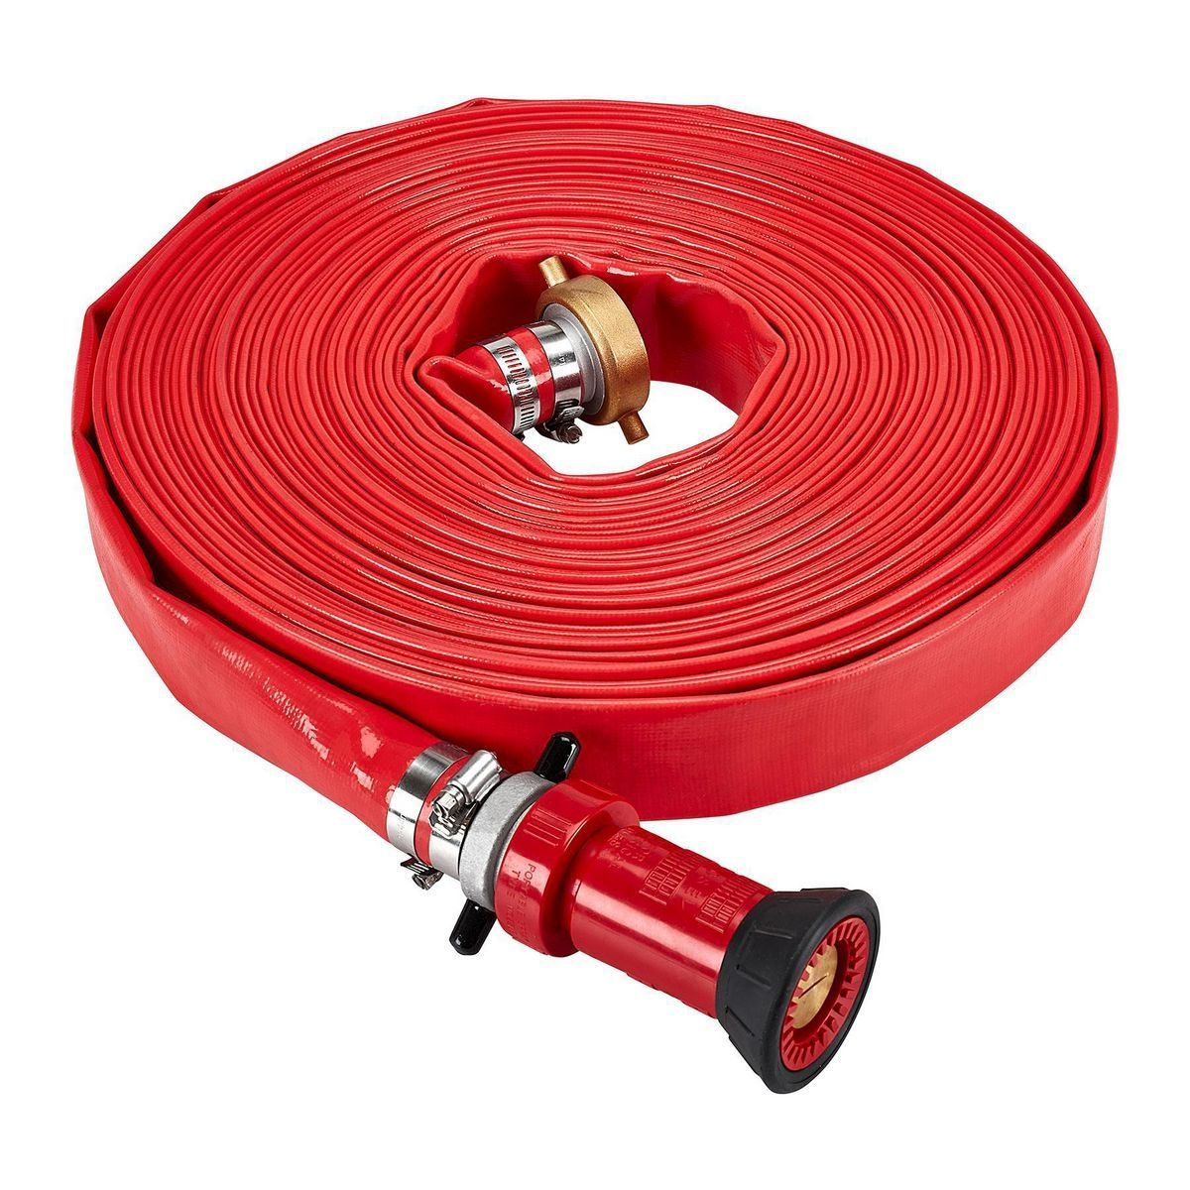

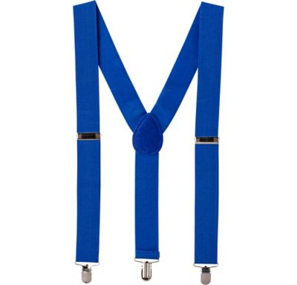

Slide 7
Make a Plan
Think details, think long term…but it doesn’t need to be perfect
Notes:
Under Implications, detail what will happen in 6-12 months as a result of their response to COVID-19 and a pending recession. Consider:
How did the market react to the recession in 2008?
What strategies were implement in 2009 and what was the result?
What unintended consequences could you predict?
Under Opportunities determine if McKinstry is in a position to benefit from their response. Consider:
Strategic hires
New Partnerships
Project support
Competitive account capture
This slide is reserved for you to explain the competitive landscape. Use this space to share what is unique about your competitors and if there is anything that stands out as important to capture, track or share with other regions.

Slide 8
Site Design
Focus on operational decisions and requirements
  What vehicles?
  Replacement timing
  Upfit + use requirements
  Dwell location and duration
This doesn’t have to be firm
  But needs to capture the range of operations and get ops buy in!
Let’s you create a long term, EV-Ready site design

Slide 9
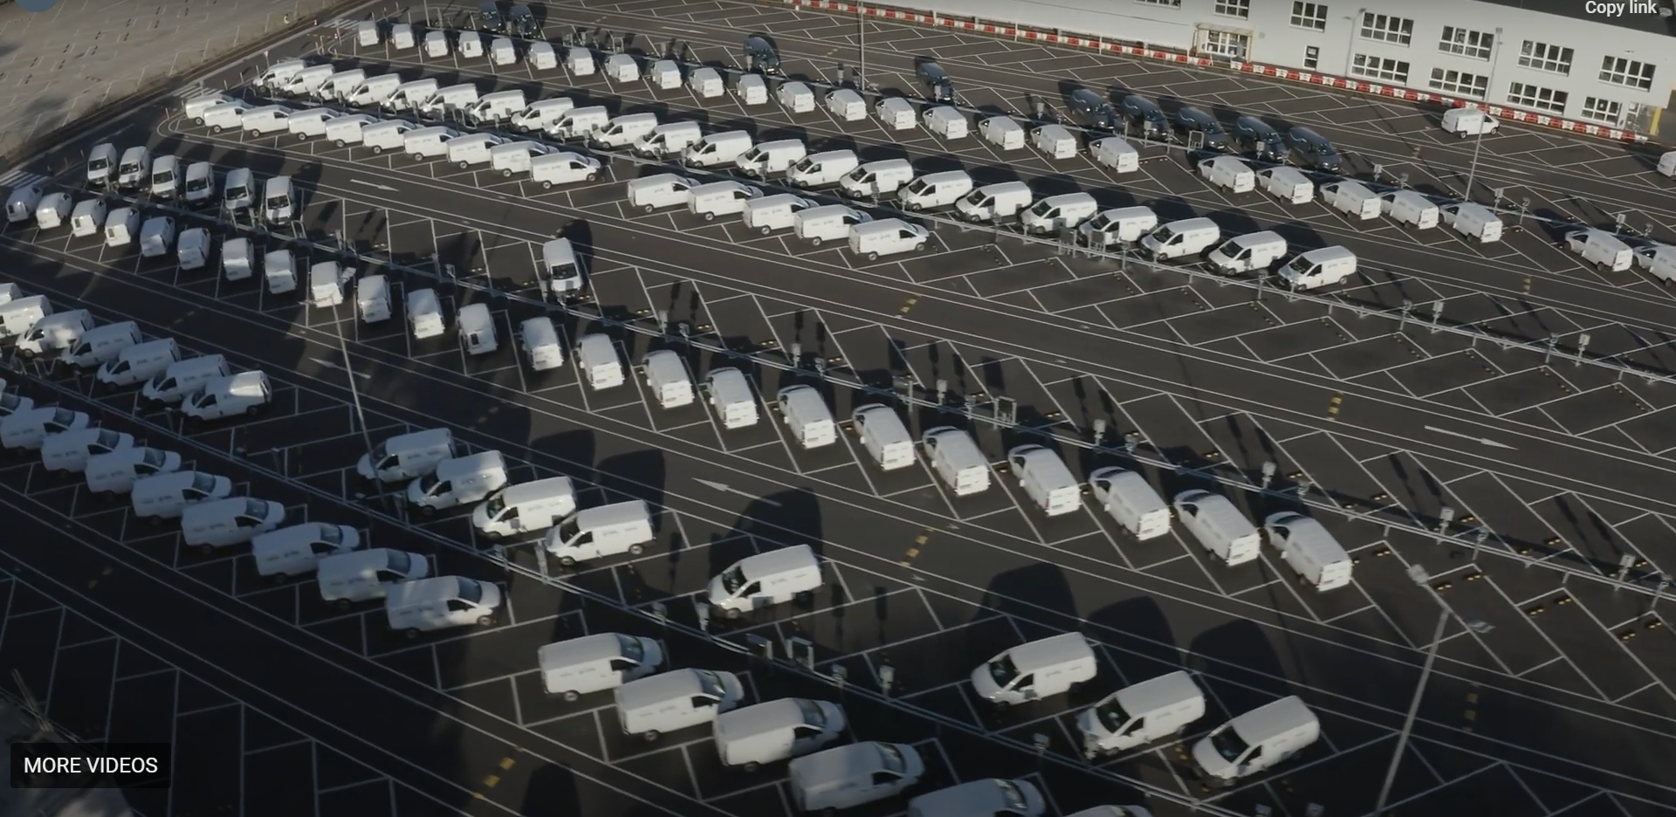

Slide 10


Slide 11


Notes:
Under Implications, detail what will happen in 6-12 months as a result of their response to COVID-19 and a pending recession. Consider:
How did the market react to the recession in 2008?
What strategies were implement in 2009 and what was the result?
What unintended consequences could you predict?
Under Opportunities determine if McKinstry is in a position to benefit from their response. Consider:
Strategic hires
New Partnerships
Project support
Competitive account capture
This slide is reserved for you to explain the competitive landscape. Use this space to share what is unique about your competitors and if there is anything that stands out as important to capture, track or share with other regions.

Slide 12
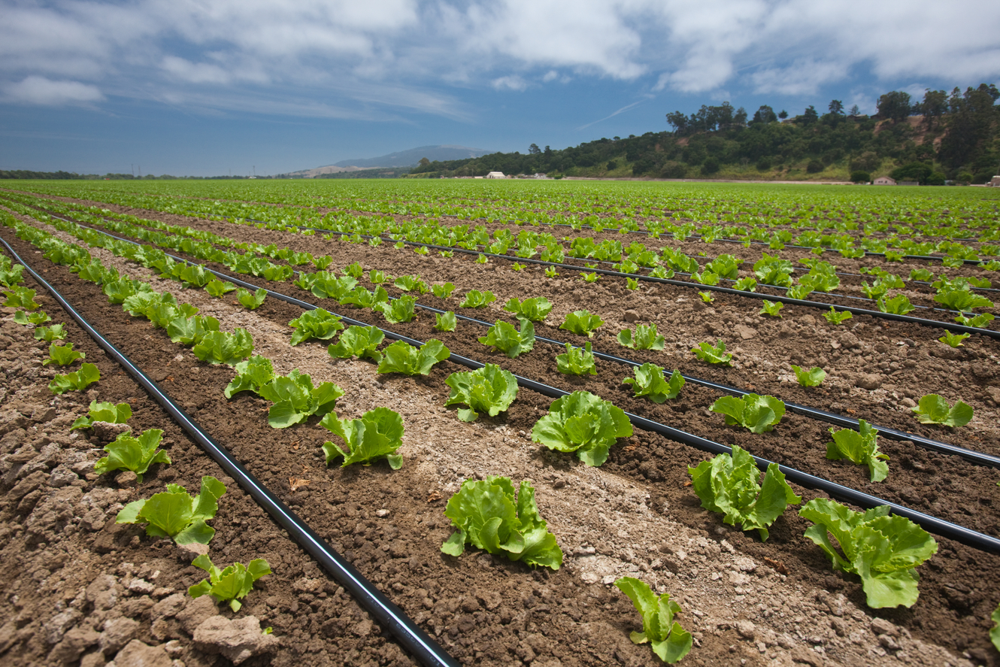
Notes:
Under Implications, detail what will happen in 6-12 months as a result of their response to COVID-19 and a pending recession. Consider:
How did the market react to the recession in 2008?
What strategies were implement in 2009 and what was the result?
What unintended consequences could you predict?
Under Opportunities determine if McKinstry is in a position to benefit from their response. Consider:
Strategic hires
New Partnerships
Project support
Competitive account capture
This slide is reserved for you to explain the competitive landscape. Use this space to share what is unique about your competitors and if there is anything that stands out as important to capture, track or share with other regions.

Slide 13
Power is expensive
Chargers are cheap
You need less than you think
Notes:
Under Implications, detail what will happen in 6-12 months as a result of their response to COVID-19 and a pending recession. Consider:
How did the market react to the recession in 2008?
What strategies were implement in 2009 and what was the result?
What unintended consequences could you predict?
Under Opportunities determine if McKinstry is in a position to benefit from their response. Consider:
Strategic hires
New Partnerships
Project support
Competitive account capture
This slide is reserved for you to explain the competitive landscape. Use this space to share what is unique about your competitors and if there is anything that stands out as important to capture, track or share with other regions.

Slide 14
Power
Focus on ENERGY requirements of vehicle operations now and tomorrow
    Work backwards to POWER site requirements
Size the system so that all vehicles can be charger over entire dwell period
  Much lower than the peak rating of the charger
Understand and use load management systems
    Work with engineer that load management + NEC.

Slide 15
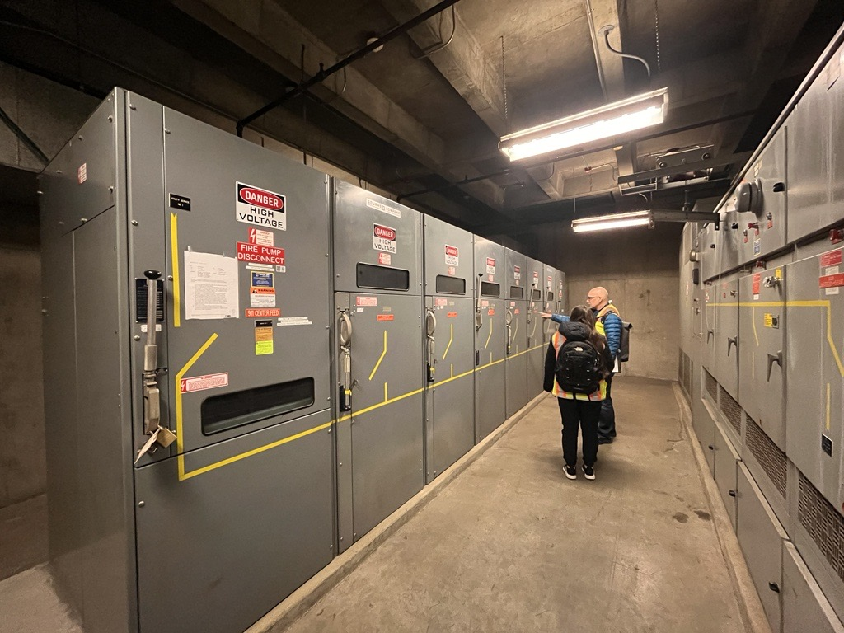
Notes:
Under Implications, detail what will happen in 6-12 months as a result of their response to COVID-19 and a pending recession. Consider:
How did the market react to the recession in 2008?
What strategies were implement in 2009 and what was the result?
What unintended consequences could you predict?
Under Opportunities determine if McKinstry is in a position to benefit from their response. Consider:
Strategic hires
New Partnerships
Project support
Competitive account capture
This slide is reserved for you to explain the competitive landscape. Use this space to share what is unique about your competitors and if there is anything that stands out as important to capture, track or share with other regions.

Slide 16


Slide 17
Make tech decisions that let your fleet learn and iterate
Don’t walk through one way doors!
Notes:
Under Implications, detail what will happen in 6-12 months as a result of their response to COVID-19 and a pending recession. Consider:
How did the market react to the recession in 2008?
What strategies were implement in 2009 and what was the result?
What unintended consequences could you predict?
Under Opportunities determine if McKinstry is in a position to benefit from their response. Consider:
Strategic hires
New Partnerships
Project support
Competitive account capture
This slide is reserved for you to explain the competitive landscape. Use this space to share what is unique about your competitors and if there is anything that stands out as important to capture, track or share with other regions.

Slide 18
Technology
Charging technology is a discrete choice
  Vertically integrated or interoperable
Move customers towards interoperable providers
  Lets you learn and iterate over time
Use chargers that are fit for purpose based on your site

Slide 19
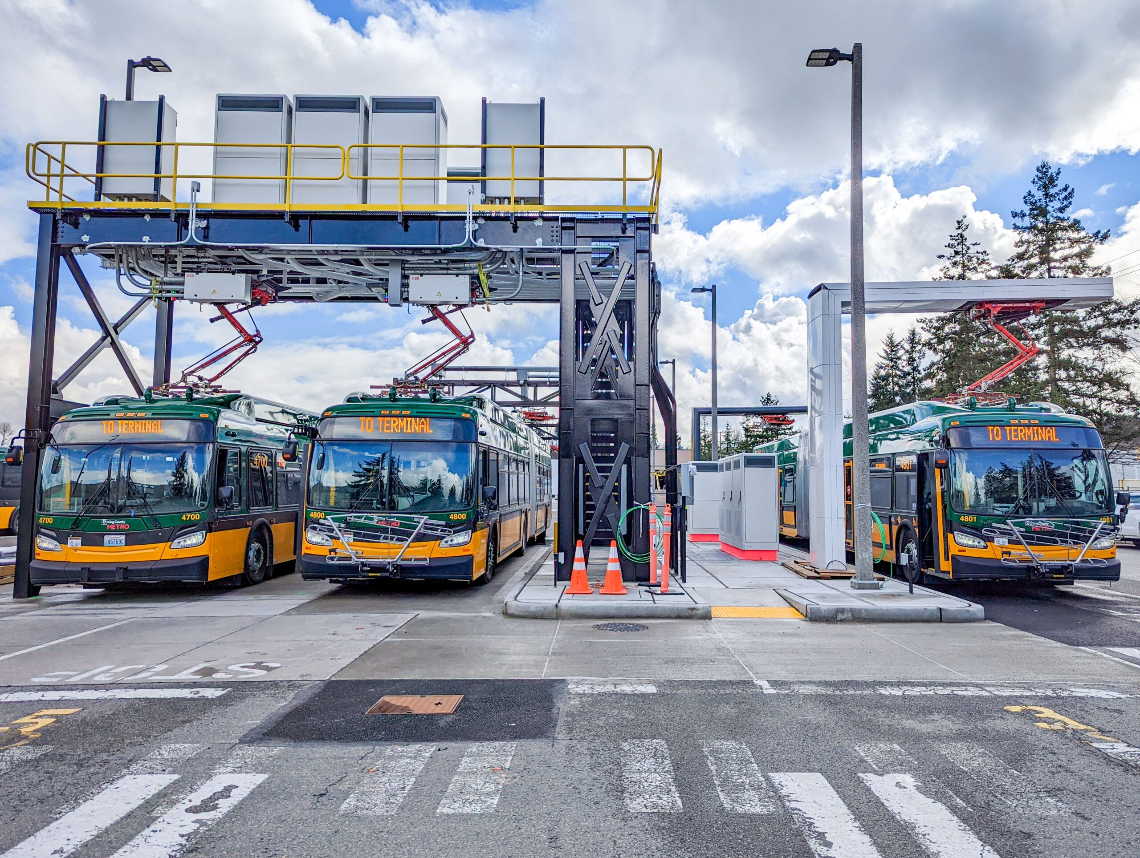

Slide 21
Plan for chargers to break
Think about the service experience you want NOW
Notes:
Under Implications, detail what will happen in 6-12 months as a result of their response to COVID-19 and a pending recession. Consider:
How did the market react to the recession in 2008?
What strategies were implement in 2009 and what was the result?
What unintended consequences could you predict?
Under Opportunities determine if McKinstry is in a position to benefit from their response. Consider:
Strategic hires
New Partnerships
Project support
Competitive account capture
This slide is reserved for you to explain the competitive landscape. Use this space to share what is unique about your competitors and if there is anything that stands out as important to capture, track or share with other regions.

Slide 22
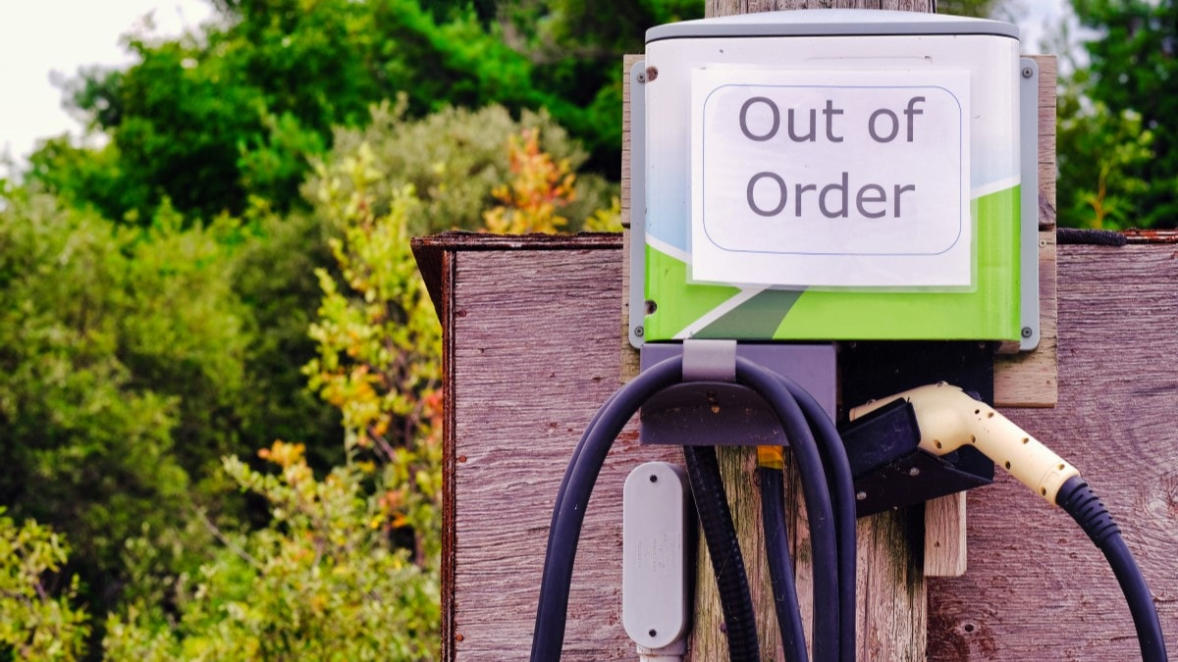

Slide 23
Service
Think about repair and maintenance up front
  SLA is much more important than uptime
    Define response times and service coverage
  Budget correctly
  Determine who pays

