Slide 1
September 17th, 2024
Lesson Learned from Electrification Retrofits
A Practical Look from Salt Lake City School District and McKinstry

Slide 2


Michael Reynolds, PE, CEM
Energy Program Manager
McKinstry
Energy Services Provider
for
Salt Lake City School District

Slide 3
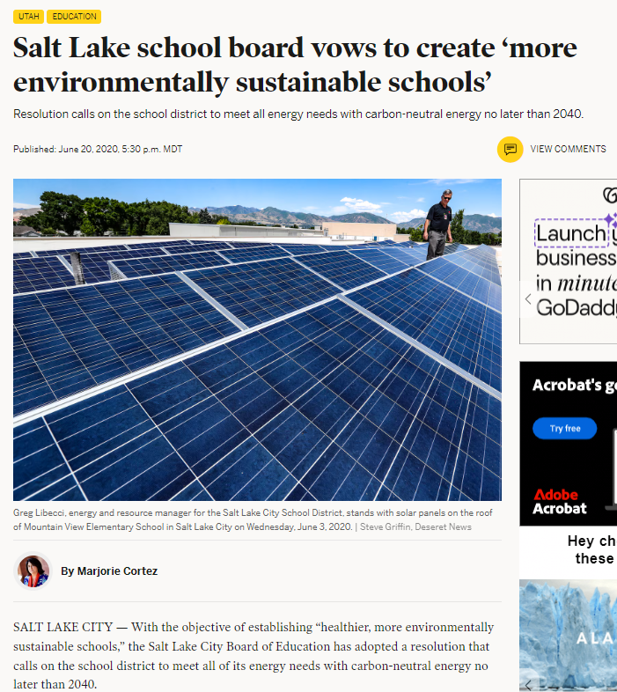

SLCSD 2020 Sustainability Resolution
To use 100 percent clean, renewable energy in SLCSD’s electricity sector by 2030.
To meet 100% of all District operations energy needs with carbon neutral energy by 2040.
Unanimous Board Approval June 2, 2020

Slide 4
What We Expected When We Started
Notes:
Why was Uintah selected?
Final Design: Heating-only ASHP
Air-source heat pump sized for full heating load (10 modules)
2x Electric Resistance boilers
Retain existing water-cooled chiller
All new coils and VAVs
Other Designs Explored:
Ground-source heat pump
Full heating and cooling ASHP
Hybrid ASHP sized for 30% heating load

Slide 5
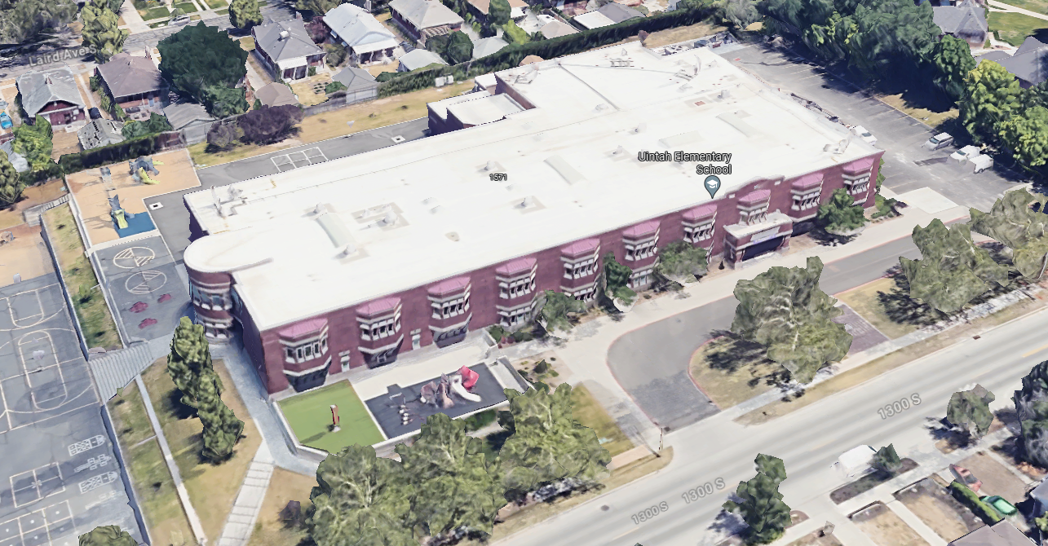
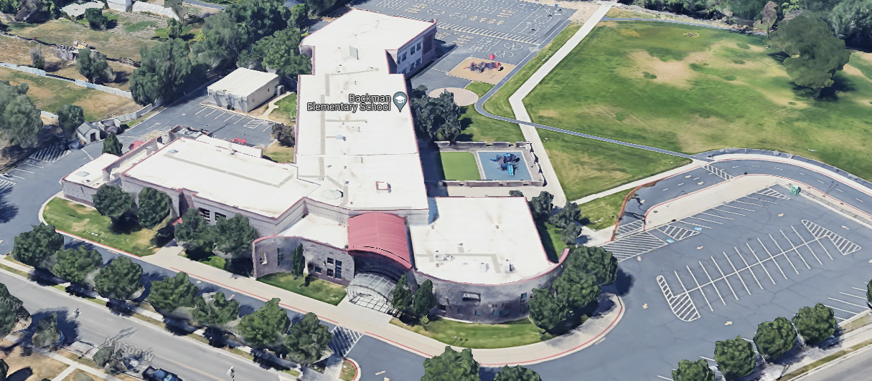
Two Schools: End-Of-Life HVAC Equipment
Uintah Elementary
59,000 ft²
Boiler: End of Life
Water-cooled Chiller: ~10 more years
Controls: Pneumatic, obsolete
Efficiency (EUI): 73
Plus LED upgrade, water conservation, & 3-yr MBCx program
Backman Elementary
72,000 ft²
Boiler: ~10 more years
No chiller – Evaporative cooling
Controls: Old
Efficiency (EUI): 66
Plus LED upgrade, water conservation, & 3-yr MBCx program

Slide 6
Full vs. Hybrid Electrification
Uintah Elementary: Full Electrification
10-module Multistack ASHP for heating
  100% of peak heating load
Chiller stays for cooling
New electric boiler for heating assist
Replacement of all VAVs and controls (pneumatic to DDC)
Solar PV planned for 2026
Backman Elementary: Hybrid Electrification
6-module Multistack ASHP for heating
  30% of peak heating load
Evap cooling unit stays for cooling
Gas boiler stays for heating assist
Replacement of all VAVs and controls (pneumatic to DDC)
Solar PV planned for 2026

Slide 7
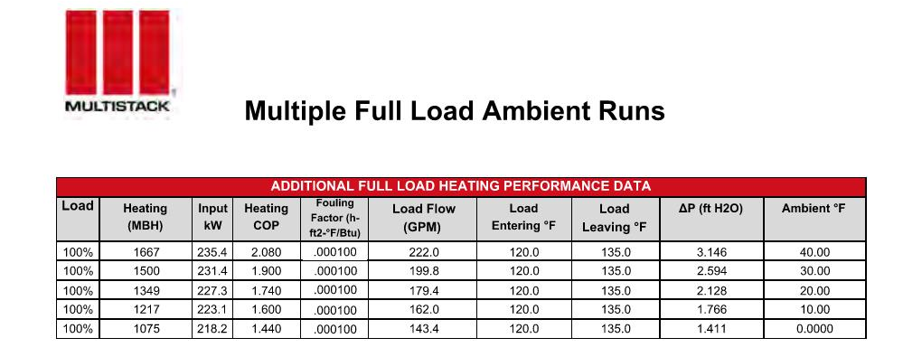
Do Air Source Heat Pumps work in cold temps?
15°F ΔT
At 0°F, capacity reduced by 36% and efficiency by 31%

Slide 8
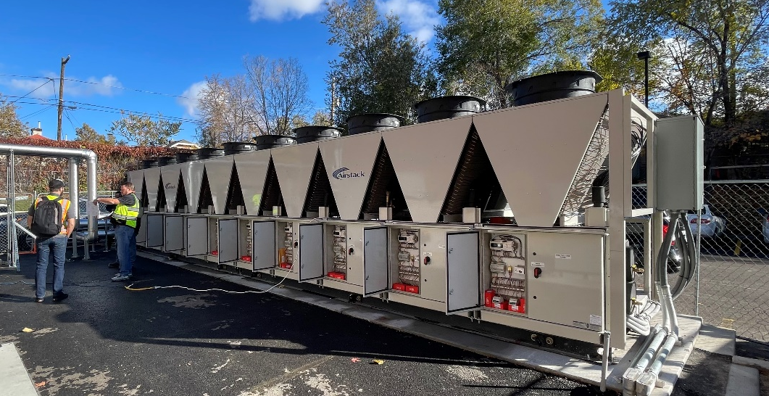
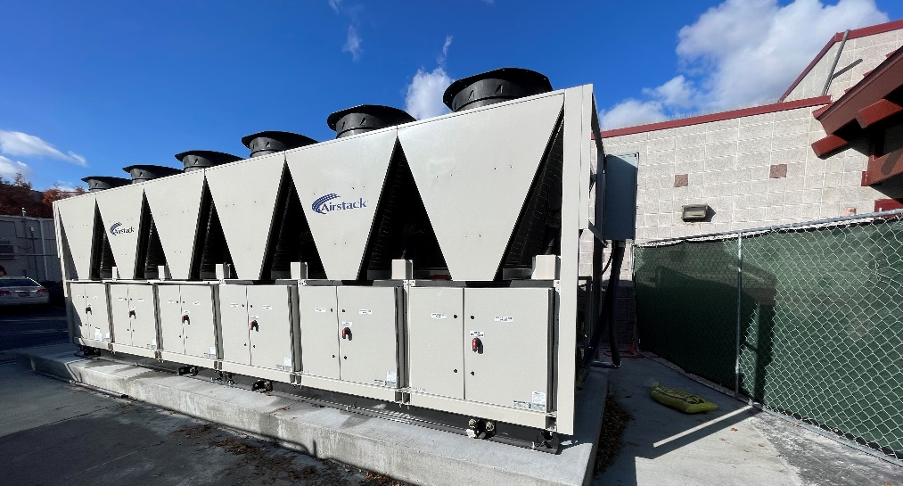
Full vs. Hybrid Performance
Uintah Elementary (Full)
Came online late winter 2024 (Feb-Mar)
Predicted 43% electricity increase
100% natural gas reduction (to zero)
Predicted efficiency (EUI): 39
  47% improvement
Backman Elementary (Hybrid)
Came online late winter 2024 (Jan-Feb)
Predicted 25% electricity increase
Predicted 80% natural gas reduction
Predicted efficiency (EUI): 42
  34% improvement

Slide 9
Heat Pump First Cost Comparison
Retrofit !
 | Uintah Elementary School | Backman Elementary School
Total Electrification Cost: | $3,930,000 | $3,070,000
School square feet: | 59,000 | 72,000
Electrification $ / Sq Ft: | $66.25 | $42.62
Equivalent Like-for-like Replacement Cost: | $3,225,000 | $2,875,000
Electrification First Cost Premium: | 21.8% | 6.7%
Total installation costs based on bids in 2022
Includes all design, installation, material, CM, Cx

Slide 10
Does Electrification really reduce carbon emissions?
Carbon analysis performed on these schools with only electrification considered:
 | Tons CO2 eq
Facility | Baseline Carbon from Electricity | Baseline Carbon from Natural Gas | Electricity Carbon savings | Gas Carbon savings | Total Carbon Savings | CO2 Savings %
Backman Elementary School | 378 | 237 | -180 | 202 | 22 | 3.7%
Uintah Elementary School | 291 | 246 | -192 | 246 | 54 | 10.1%
TOTALS: | 668 | 483 | -372 | 449 | 77 | 6.7%
Carbon intensity of RMP’s electricity = 1.235 lb CO2eq / kWh
Emissions Factors submitted to Utah Public Service Commission in 2021
2. Carbon intensity of gas = 18 lb CO2eq / therm
From ASHRAE Standard 189.1 – 2017

Slide 11
ASHP and Solar Life Cycle Savings
Solar + Electrification delivers a net benefit on a 25-yr life cycle analysis
 | Uintah + Backman
Electrification Construction Cost | $6,997,000
Avoided L4L Replacement Costs | $6,100,000
Solar PV Net Construction Cost | $2,325,400
Net Construction Cost | $3,223,000
Delivers on SLCSD Goals:
  Minimize early retirement of equipment
  Financially prudent long-term investment
Lifetime Utility Savings | $3,509,000
Net Project Cost (Benefit) | ($286,000)
  Advancement towards Sustainability Resolution goals
Renewable Electricity % | 96.5%
Carbon Reduction % | 93.7%

Slide 12
What We Learned Along the Way
Notes:
Why was Uintah selected?
Final Design: Heating-only ASHP
Air-source heat pump sized for full heating load (10 modules)
2x Electric Resistance boilers
Retain existing water-cooled chiller
All new coils and VAVs
Other Designs Explored:
Ground-source heat pump
Full heating and cooling ASHP
Hybrid ASHP sized for 30% heating load

Slide 13

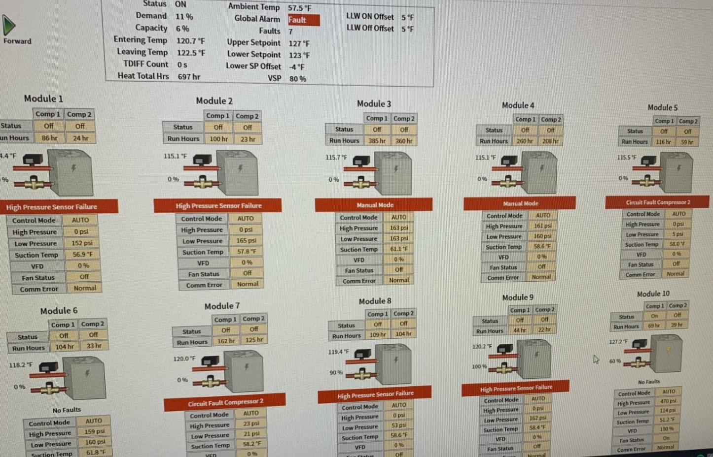
Challenges with new technology
Mechanical Room piping
Circuit setters
Temp sensor installation
Squirrels!
Supply Water temperature controls logic
De-superheater setpoints
Refrigerant pipe bracing
Sound material
We had to revert to electric boilers for portions of the winter while resolving issues ☹

Slide 14
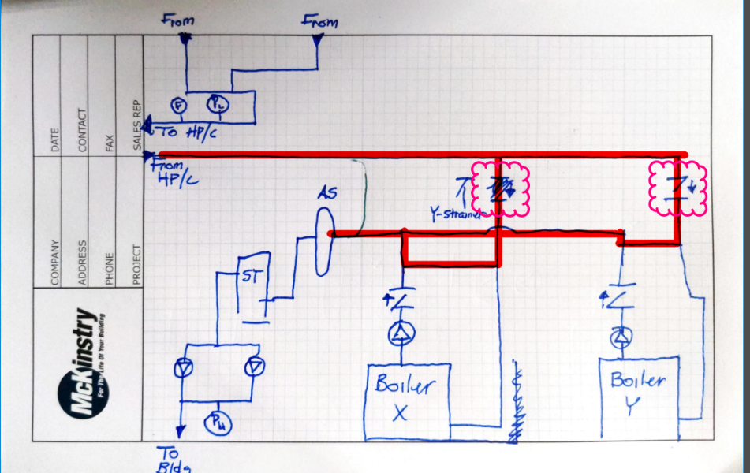
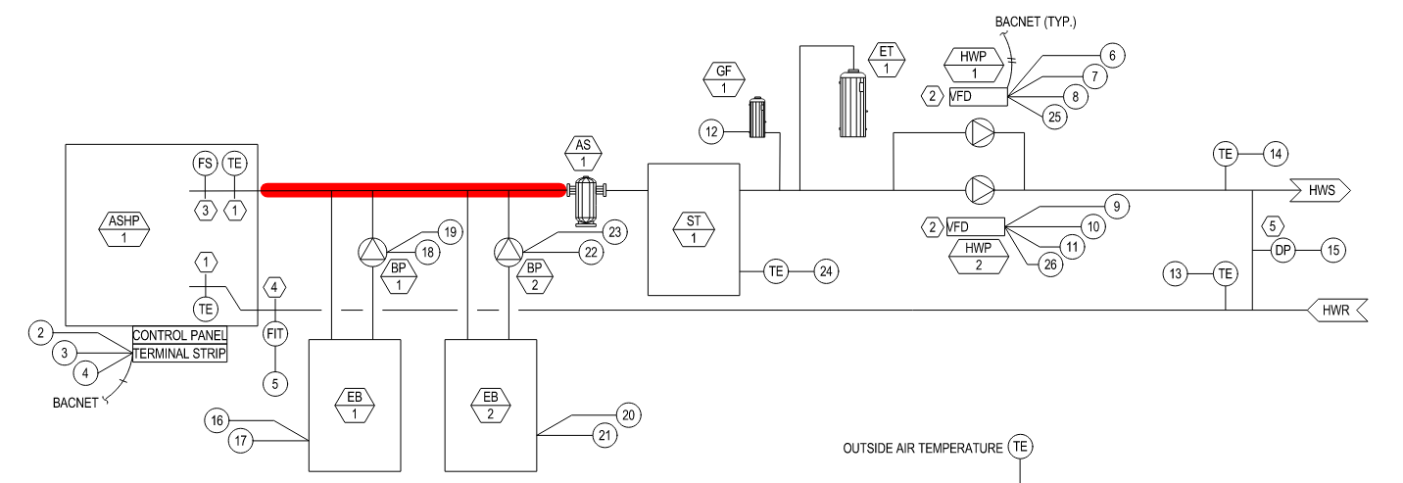
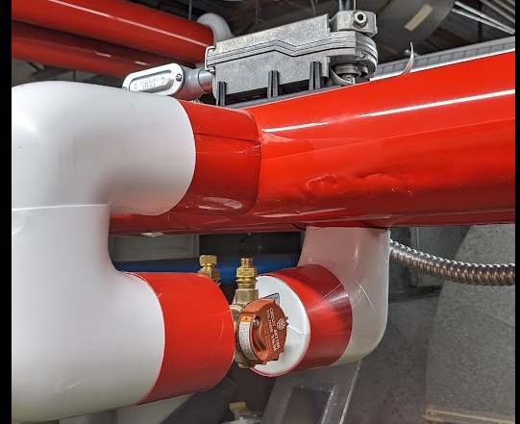
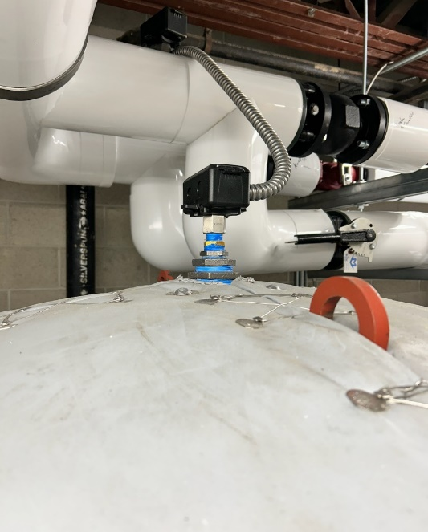
Mechanical Installation Issues
Electric Boilers were initially piped incorrectly:
“Closely Spaces Ts” were not closely spaced!
Circuit setters were too small and prevented minimum flow through ASHPs
Temperature sensor in storage tank installed on top of vessel – reading the air pocket, not the water

Slide 15
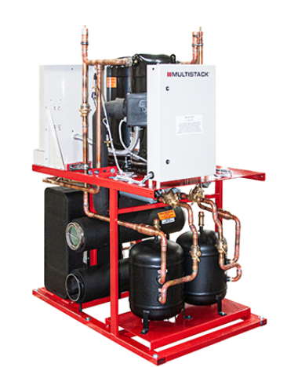
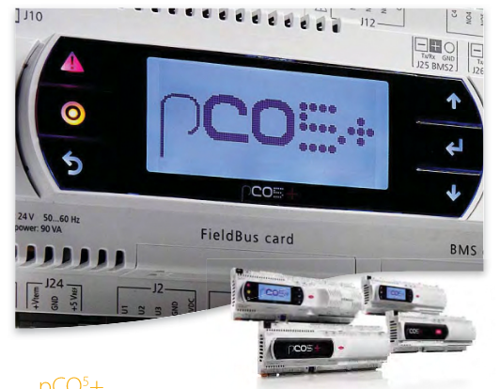
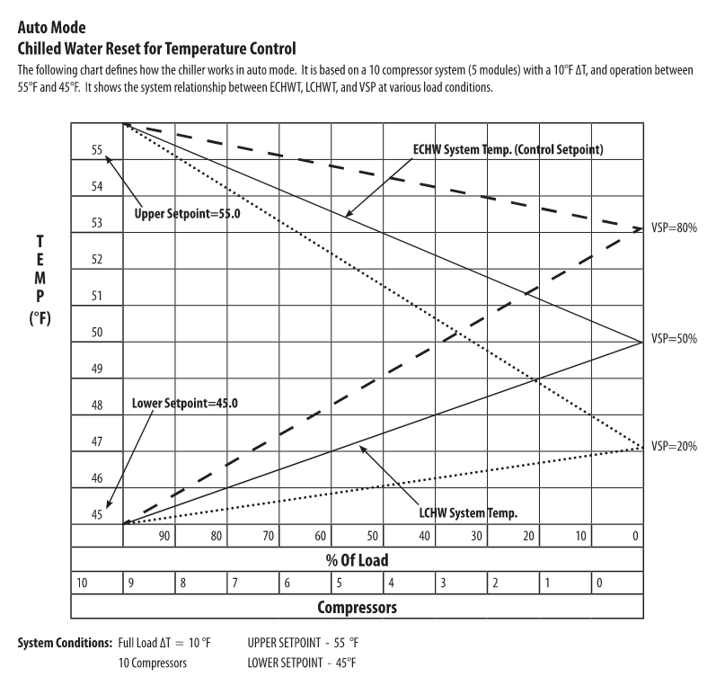
Controls Issues
Desuperheater setpoint was set at the factory to a sea level condition instead of 4,200’ elevation, leading to liquid in the line, vibrations, and refrigerant leaks
Complicated controls settings for supply temperatures

Slide 16
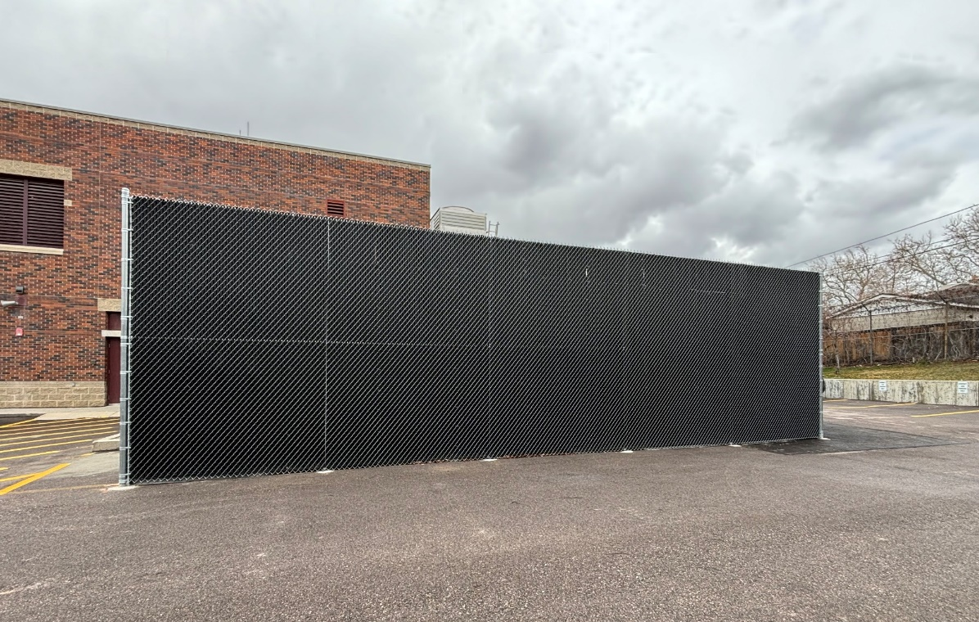



Environmental Issues
Noise complaints! Led to installation of soundproof barrier around ASHP
A nosy squirrel chewed on some copper and got fried. Tripped the breaker, but no damage to ASHP!

Slide 17
Does peak heating load really coincide with lowest OAT?
Design Conditions for Salt Lake City:
Design temperature: 10°F
Total hours beneath 10°F ambient: 6 (.03%/ year)
Total hours beneath 20°F ambient: 159 (1.82%/ year)
Total hours beneath 30°F ambient: 1,038 (11.85%/ year)

Slide 18
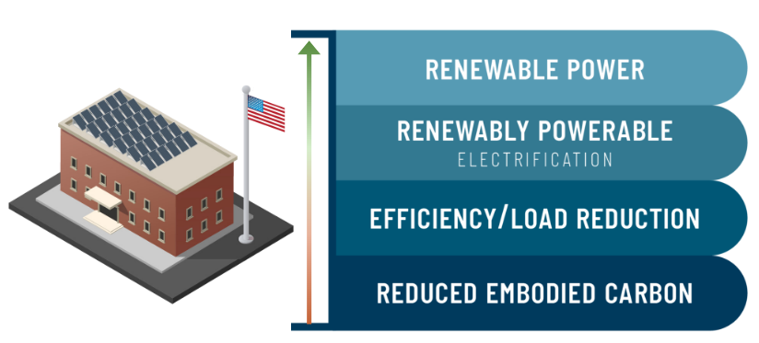
Treat Electrification As Step #3 of 4
Start with efficiency. Grow to zero carbon as equipment ages out.
Increase total building efficiency through
  Retro-commissioning
  Reducing ventilation to code minimums using occupancy-based Demand Controlled Ventilation (DCV)
  Implement ASHRAE Guideline 36 sequences in air handling systems (VAVs and AHUs)
  Weatherize and air seal
  Reduce the replacement heating plant size and save money every day.

Slide 19
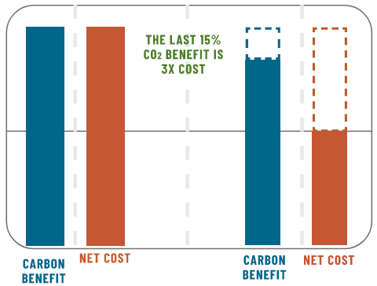
Hybrid Electrification (for now)
Uintah Elementary (Full)
Backman Elementary (Hybrid)
Natural Gas Reduction: -100%
Electricity Increase: +40%
+36% more cost on a normalized basis
Natural gas reduction: -80%
Electricity Increase: +25%

Slide 20

Thank you!
Questions?

Slide 21
Carbon Neutral Pilot Schools
Salt Lake City School District
Electrifying existing buildings through retrofits

Slide 22
Difficulties and Delays with Heat Pumps
Mechanical Room piping
Circuit setters
Temp sensor installation
Squirrels!
Supply Water temperature controls logic
De-superheater setpoints
Refrigerant pipe bracing
Sound material

Slide 23
Applying Lessons Learned
Issue | Lesson learned and/or process change
Mechanical Room piping | Earlier and more frequent mechanical engineer site visits. Assign one site superintendent per electrification.
Circuit setters | Conduct submittal take off and establish submittal requirements during each subcontractor kickoff meeting.
Temp Sensor installation | Earlier and more frequent mechanical engineer site visits. Focus site supers on one electrification at a time.
Squirrels! | Sometimes crazy things happen. Be ready to respond when they do.
Supply Water temp logic | Change unit setpoints to control to an actual setpoint
De-superheater setpoints | This is now a factory default setting for MultiStack cold climate installs.
Refrigerant pipe bracing | This is now a standard with MultiStack heat pumps.
Sound material | Require subcontractors to submit sound plan when heat pumps are ordered. Require subcontractors to treat sound material as long lead item and install sound material before heat pumps commissioned. Consider ground source heat pumps that avoid significant outside noise production.

Slide 24
Electrification is a Value Judgement
Equipment end of life +
Energy Efficiency +
Current Utility Costs +
Future Utility Costs +
Operation/Maintenance Cost +
Incentives & Grants +
Carbon & Emissions Reduction
=
Total Cost of Ownership

Slide 25
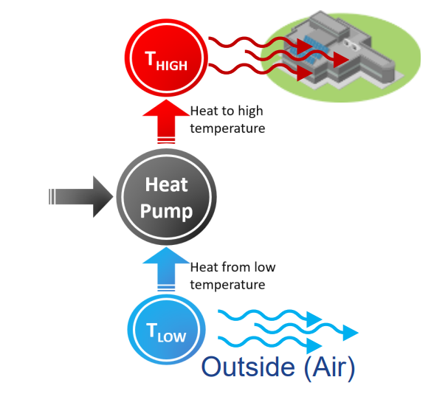
Electrification Basics
Remove fossil fuel from buildings for heating, hot water, cooking, etc.
Substitute boilers & furnaces with heat pumps (air source, water source, VRF, etc)
Heat pump water heater for gas storage water heaters

Slide 26
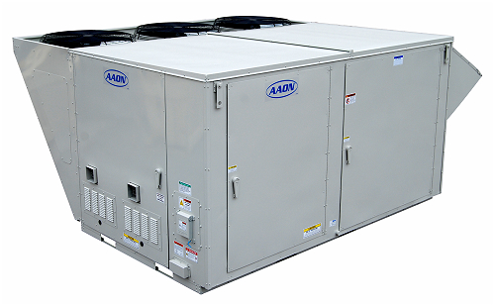
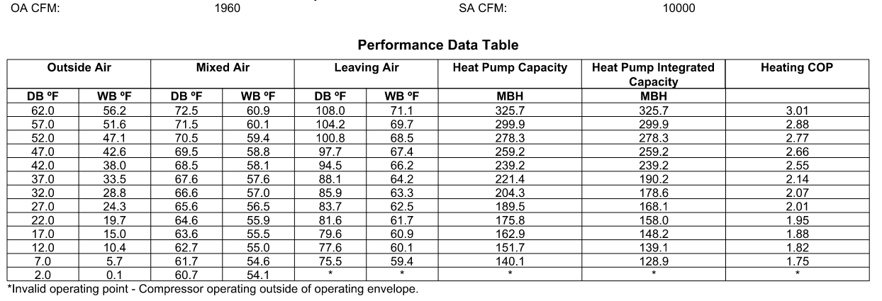
Bonus: Great performance from heat pump RTUs!
25 ton Aaon heat pump RTU with heat pump heating and 40 kW electric resistance emergency heating:

Slide 27
Electrification Tips

Slide 28
Many Stakeholders, Many Lenses
First Cost?
Total Cost of Ownership?
Operation/Maintenance Cost?
Today’s Electricity/Natural Gas Costs?
Future Electricity/Natural Gas Costs?
Polluted Air Costs?

Slide 29
Different Stakeholders, Different Lens Values
First Cost
Total Cost of Ownership
Operation/Maintenance Cost
Today’s Electricity/Natural Gas Costs
Future Electricity/Natural Gas Costs
Polluted Air Costs

Slide 30
Questions?

Slide 31
How Often Will Heat Pumps Require Supplemental Heat?
Design Conditions for Salt Lake City:
Design temperature: 10°F
Total hours beneath 10°F ambient: 6 (.03%/ year)
Total hours beneath 20°F ambient: 159 (1.82%/ year)
Total hours beneath 30°F ambient: 1,038 (11.85%/ year)

Slide 32
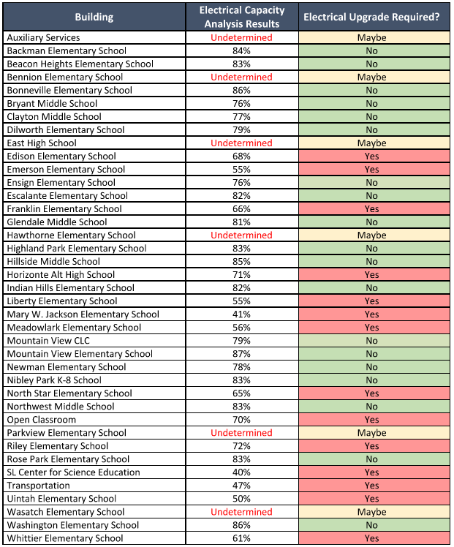
Efficiency First Reduces Electrical Upgrade Costs
Avoid electric service upgrades when you can!
After LED lighting upgrades, HVAC controls optimization, and weatherization,
19 / 39 schools likely only require minor electrical work
14 / 39 schools will likely require major electrical upgrades
6 / 39 are yet to be determined

Slide 33
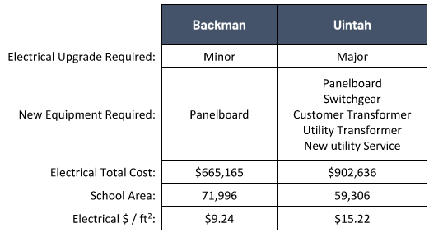
Electrical Impact to Project
Uintah and Backman Normalized Electrical Costs:
(Bid in 2022)
Electrification at Uintah included a major electrical upgrade which accounted for 23% of the total project cost.
The cost of the upgrade at Uintah was about 40% greater per square foot than at Backman.

Slide 38


Power Point Template – Links & Notes
Please keep all content within the slide margins.
Typography
DELETE THIS SLIDE
Use Barlow for Headlines and emphasis copy.
And use the column grid lines to align your content
Use Calibri for all body copy.
Access guides by clicking on “View” > “Guides”
Or PC quick key: Alt+F9 on PC
Link to McKinstry Approved Logos and Fonts
Link to About McKinstry Deck, Maps, and Additional Graphics
Default Line weight = .75”
Please use updated icon set which you can find here
Image Sizes:
Title Slide = 7.5”h x 5”w @150 dpi
Quarter Page Images = 7.5”h x 3.54” w @150dpi
Circle Images = 4.5” square @150 dpi
-- When replacing a Master Slide image please crop to proper size/dpi and insert into a duplicated version of the Master Slide.
Default text box
*To access linked material above, enter into Presentation Mode

