Slide 1
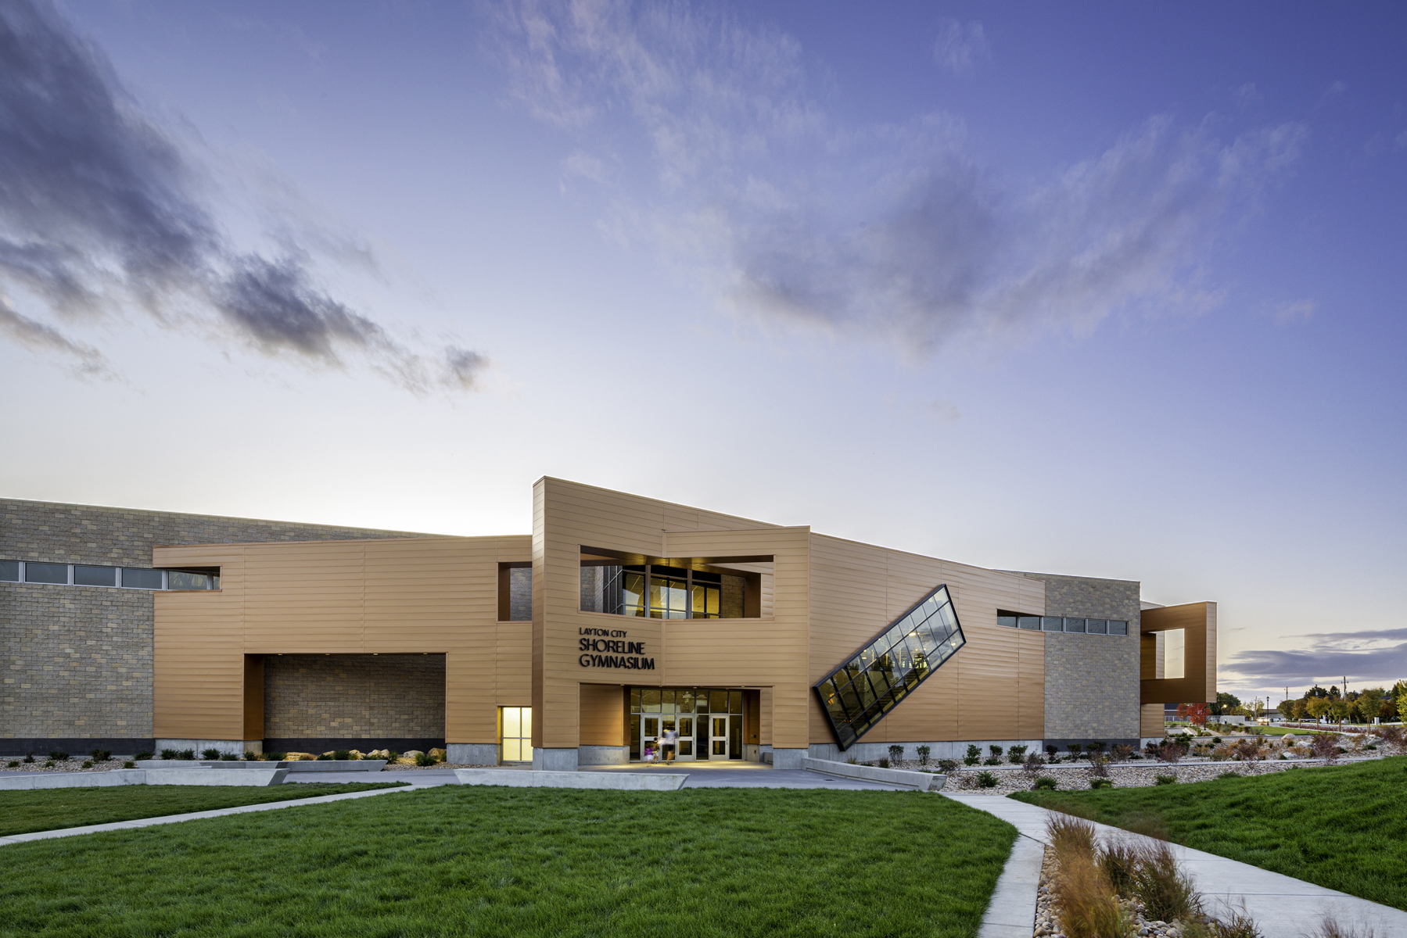
Davis School District
Employees 8,000+
Students 71,000+
Elementary Schools 62
Junior High Schools 17
High Schools 10
Alternative Schools 3
Support Services 22
Total Buildings 114
Portable Classrooms 350
Average Energy Cost sf $0.87
Average kBtu sf 34.93
Schools and Support Building sf 11,377,881

Slide 2
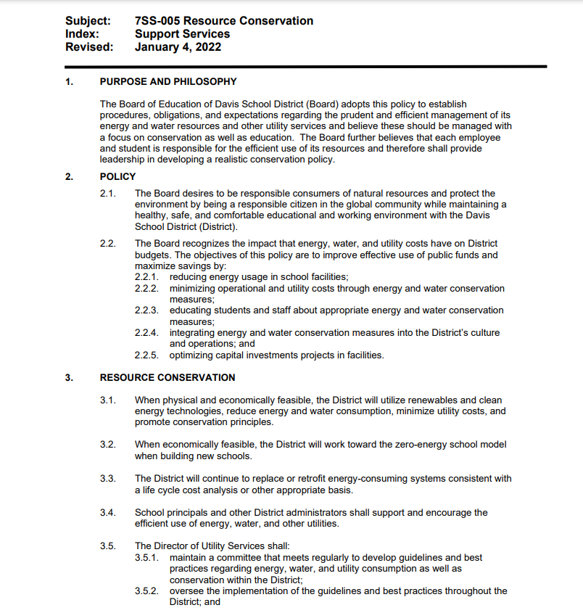
Board Policy 7SS-005 Resource Conservation

Slide 4
District Statistics
  2005/06 2023/24
  Square Footage 8,283,742 11,474,905
  MBtu Consumed 478,653 397,463
  MBtu Cost $7,206,829 $9,920,441
  Electricity Consumed 54,681,960 55,169,761
  Natural Gas Consumed 292,078 209,224
  Renewable Power Generated 0 2,435,565
  Tons of CO2 Emitted 64,291 50,532

Slide 5
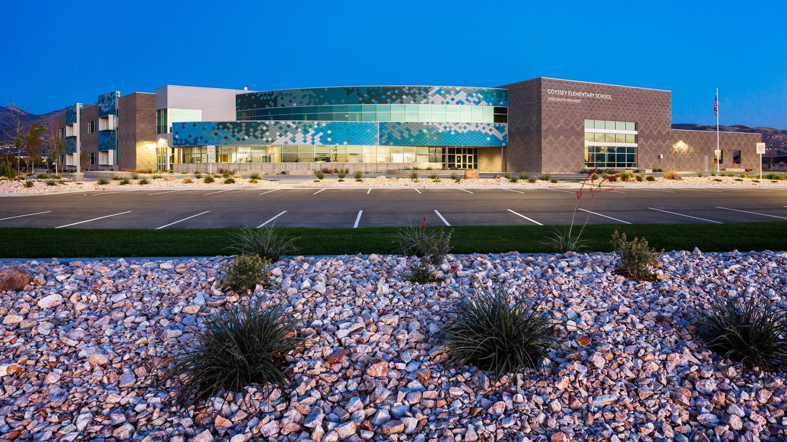
Odyssey Elementary

Slide 6
Odyssey Conservation Measures (Zero Energy Building)
Thermal Displacement Air Distribution
Improved Envelope
Ground Source Heat
Heat Recovery of Ventilation Air
Economizer Cooling
Ground Loop Free Cooling
IDEC Cooling
Demand-Limiting Boiler
Demand-Control Ventilation
LED Lighting .6 W/SF
Natural Light
Lighting Controls
Task Tunning
Plug Load Switching
Commissioning Retro-Commissioning
Daylight Controls
Photovoltaic Panels

Slide 7
2014 Zero Energy Certified 2016 LEED Gold
84,785 sf
15 Site EUI
-2.6 Net Site EUI
42 Source EUI
-5 Net Source EUI
-2 zEPI Score
Notes:
zEPI zero energy performance index

Slide 8
Energy Data Analysis
Energy Model Baseline
43.8 Site EUI
$0.77 Energy Cost/ft
Energy Model Design Building
21.8 Site EUI
$0.48 Energy Cost/ft
Actual Usage
15 Site EUI
$0.23 Energy Cost/ft

Slide 9
Odyssey Numbers 2014 - 2023
Year | EUI | Cost/sf
2014 | 15 | $0.23
2023 | 11.8 | $0.33

Slide 10
Comparison of 7 Elementary Schools
School | EUI | Cost/sf
Odyssey | 12 | $0.33
Kay's Creek* | 27 | $0.46
Canyon Creek | 14 | $0.41
Sunburst | 14 | $0.40
West Bountiful | 11 | $0.36
South Clearfield | 13 | $0.33
Island View | N/A | N/A

Slide 11
Comparison of High Schools
School | EUI | Cost/sf | System
Farmgington High | 19 | $0.54 | ZEB Design
Davis High | 30 | $0.74 | AHU/Vav/Evap/Boiler
Syracuse High | 27 | $0.77 | Ground Source/RTU’s
Woods Cross High | 35 | $0.82 | Heat Pump/Tower/Boiler
Layton High | 34 | $0.84 | A Little of Everything

Slide 12
2010 Vs 2014 Builds
2014 Odyssey Ele 84,758sf
kWh | 201,785 | Cost | $23,846
kW | 0 | Cost | $0.00
Dth | 317 | Cost | $3,914
Mbtu | 1006 | Cost | $27,760
kBtu/sf | 11.86 | Cost/sf | $0.33
 |  | Total Cost | $27,760
 |  | 40 Years Cost | $1,110,400
2010 Endeavour Ele 78903sf
kWh | 426,708 | Cost | $64,988
High kW | 226 | Cost | $0.00
Dth | 127 | Cost | $2,192
Mbtu | 1583 | Cost | $67,181
kBtu/sf | 20.06 | Cost/sf | $0.85
 |  | Total Cost | $67,181
 |  | 40 Years Cost | $2,687,240

Slide 13
Elementary School Comparisons
Notes:
Canyon Creek 2015, Eagle Bay 2003, Kaysville 1967 and 1984, Cook 1978

Slide 14
Questions?
Notes:
Sequence of operation for new buildings

