Slide 1
Resource Planning for the Future
AEE Utah 2024 Fall Symposium

Slide 2
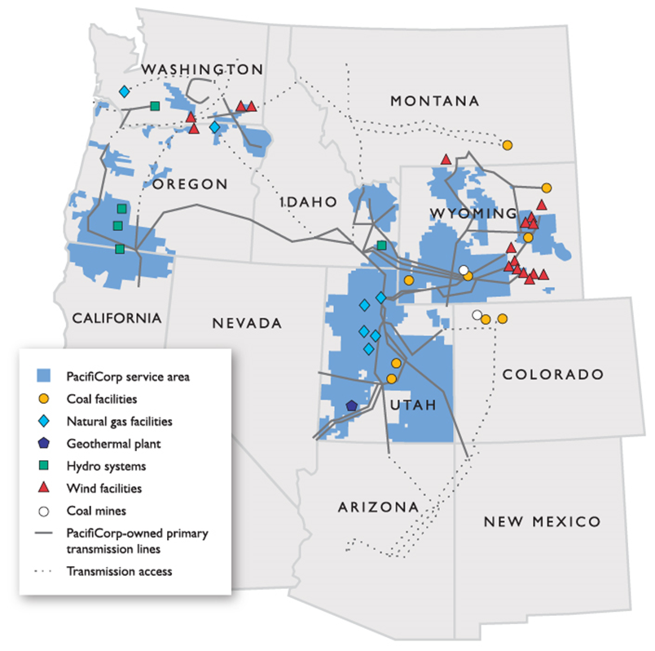
PacifiCorp Overview
Two divisions – Rocky Mountain Power and Pacific Power
Approximately 4,800 Employees
2 million electricity customers
141,503 square miles of service territory in six states
17,770 miles of transmission
11,597 MW owned generation capacity
13,195 MW 2022 peak system load

Slide 3
Integrated Resource Planning
Roadmap for how the company will provide electric service to its customers over a 20-year planning horizon
IRP compares forecast customer demand with existing generation resources and identifies gaps
Does not select specific projects.
Proposes a portfolio of resource types, such as power plants, transmission projects, long-term and short-term market purchases of electricity, demand-side efficiency programs for customers and efficiency measures
Notes:
Every two years, PacifiCorp produces an Integrated Resource Plan that serves as a roadmap for how the company will provide electric service to its customers over a 20-year planning horizon. In the off year, the company publishes an update to the IRP which captures any changes to planning conditions that occurred after the IRP was finalized. The company published an off-year update to the IRP in April 2024.
As part of the IRP process, the company forecasts customer demand over this planning horizon. The IRP compares forecast customer demand with existing generation resources and identifies gaps, which represent generation resources that need to be acquired to meet customer demand. The plan does not select specific projects. Rather, it proposes a portfolio of resource types, such as power plants, transmission projects, long-term and short-term market purchases of electricity, demand-side efficiency programs for customers and efficiency measures that the utility itself can take. The final preferred portfolio is based on a detailed evaluation of both costs and risks in the best interests of utility customers.

Slide 4
Actual Emissions Reductions
PacifiCorp has continually reduced emissions associated with electricity provided to end-users.
Notes:
PacifiCorp has continually reduced HB 2021-relevant emissions associated with electricity provided to end-users in Oregon since at least 2019.

Slide 5
Meeting customer needs
21.4% over the next 10 years
  Customer growth
  Data centers
  Robust economic growth
  EV charging increased EV adoption
Notes:
Forecast of system load growth over next 10 years – provides base line of what we need to be prepared to serve –use IRP load forecasts – high and base case. Use the high case to show what could happen to our system with large EV and data center loads (will see whether IRP team forecasts include data center possible increases, etc

Slide 6
2023 Integrated Resource
Plan Update

Slide 7
2023 Integrated Resource Plan Update
The scope of the main resource acquisitions include:
  9,818 megawatts of new wind resources.
  4,016 megawatts of storage resources, including batteries collocated with solar generation, standalone batteries, and pumped hydro storage resources.
  3,763 megawatts of new solar resources (most paired with battery storage).
  4,326 megawatts of capacity saved through energy efficiency programs.
  1,123 megawatts of capacity saved through demand response programs.
  500 megawatts of advanced nuclear (Natrium reactor demonstration project) in 2030.
  5,385 megawatts of natural gas convertible peaking resources that meet high-demand energy needs.
  Installation of carbon capture technology on Jim Bridger Units 3 and 4.

Slide 8
2023 Integrated Resource Plan Update
Significant Changes from 2023 to 2024
A federal court’s stay of the U.S. Environmental Protection Agency’s proposed ozone transport rule, which significantly changed the analysis of the preferred portfolio.
Need to maintain the financial health of the utility for the benefit of its customers and communities, while fulfilling the company’s obligation to meet customer energy needs with safe, reliable service at fair and reasonable prices.

Slide 9
2023 Integrated Resource Plan Update
Continued acquisition of wind and solar resources with integrated battery storage.
Extensions to the assumed operational life of certain thermal generating resources, as well as adjustments to the company’s energy storage acquisition strategy, customer demand forecasts and general resource pricing updates.
The assumed operational life of new combustion turbine resources has been extended to reflect the capability of those resources to convert to non-carbon-emitting renewable fuel in later years.
The NatriumTM demonstration project located in Kemmerer, Wyoming, continues to provide anticipated benefits to customers due to significant U.S. Department of Energy grant opportunities and support from TerraPower.

Slide 10
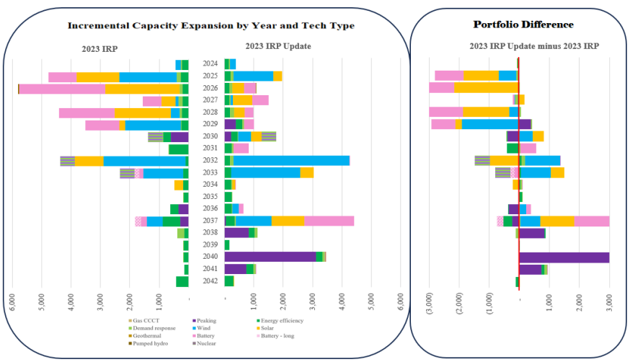
Incremental Capacity Compare and Delta: 2023 IRP Update and 2023 IRP
Notes:
The 2023 IRP update delivers customers significant near-term cost savings by accounting for recent regulatory policy changes and deferring portions of previously anticipated resource acquisitions. Additionally, PacifiCorp’s longstanding commitment to ensuring reliable service to customers will require continued investment in all major resource types.
A recent federal court stay of the proposed ozone transport rule avoids accelerated closures of thermal resources, resulting in changes to the wind, solar and battery capacity anticipated in the 2023 IRP.
While renewable resource acquisitions will continue, much of the capacity previously anticipated will be delayed until later years. Acquisition of these resources will continue at lower levels over the next five years, and then increase in 2032.

Slide 11
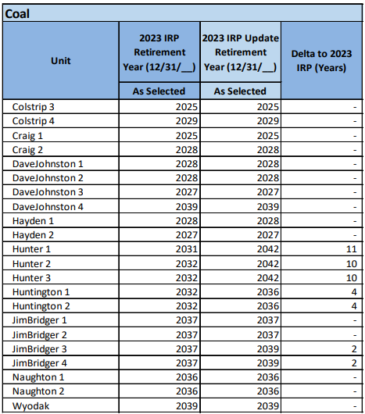
Coal Retirements: 2023 IRP Update and 2023 IRP

Slide 12
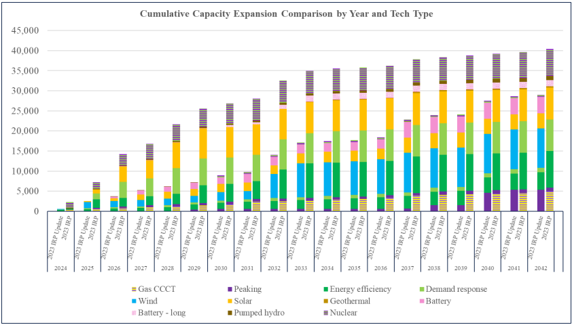
Cumulative Capacity Compare: 2023 IRP Update and 2023 IRP
Notes:
Choose from different slide layouts by selecting “New Slide”

Slide 13
Energy Resource Programs

Slide 14

Positioning for the Future
Cool Keeper Program
Wattsmart Battery Program
Wattsmart Drive
Wattsmart Business Program
  New Construction & Retrofit
Notes:
Choose from different slide layouts by selecting “New Slide”

Slide 15
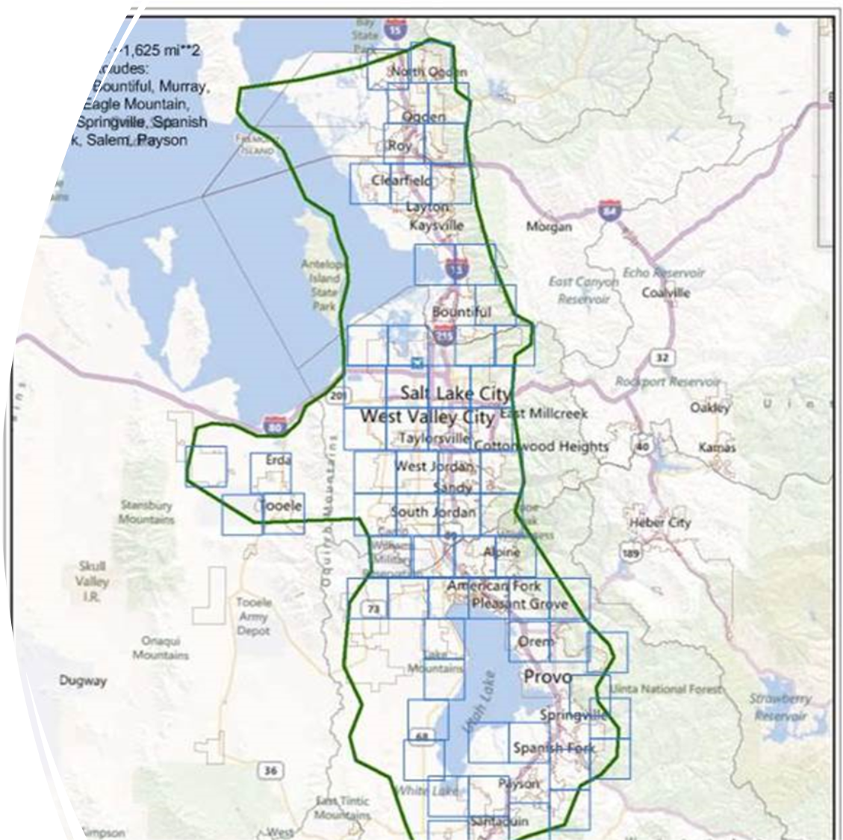
Cool Keeper Program
Approximately 119,000 AC units currently enrolled.
Up to 300 MW of load during peak periods.
Approximately 900,000 residential customers in Utah.
Tremendous potential to grow program along the Wasatch Front and throughout the state.
Potential growth opportunity 30,000 – 50,000 units within 5 years (75 - 125 MW).

Slide 16
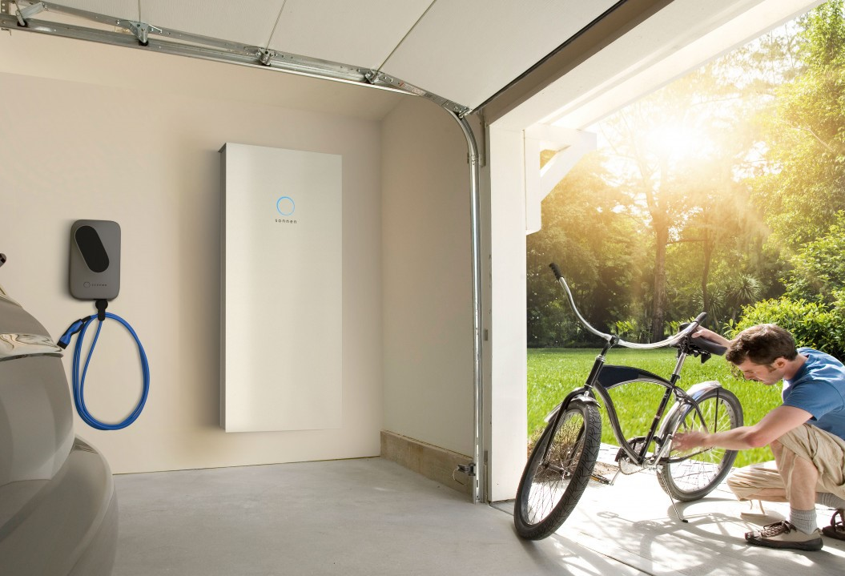
Wattsmart Battery Program
Utility grade batteries with a minimum of 4 kW/10kWh
Ability to charge/discharge multiple times a day
Full Dispatch control by PacifiCorp
Over 4,000 batteries integrated with RMP grid management system
Notes:
How does it work?
The program uses renewable energy stored in customer-owned battery systems. The battery will be made available to Rocky Mountain Power to help manage energy on the electric grid.
The battery storage system may serve as back-up electricity to the customers home or business.
2021 – 2024 battery enrollments
Utah – over 4,000 customers
Idaho – several hundred
Receive an upfront incentive and earn ongoing bill credits
$600 per kW with solar installed before 9/1/21 or $400 per kW after 9/1/21
$15 per kW on your monthly bill
Benefits
Helps create a healthier environment
Keeps electricity prices among the nation’s lowest
Eligible batteries must meet the following requirements
Ability to integrate with Rocky Mountain Power’s distributed battery grid management program, including 30 second interval data.
Utility grade batteries with a minimum of 4 kW/10kWh
Minimum of 10-year battery warranty
Minimum of 7,500 battery cycle life to accommodate for daily load cycling
Ability to charge/discharge multiple times a day
Full Dispatch control by PacifiCorp to meet the needs of the program
Proper UL or equivalent safe certification for residential and commercial applications

Slide 17
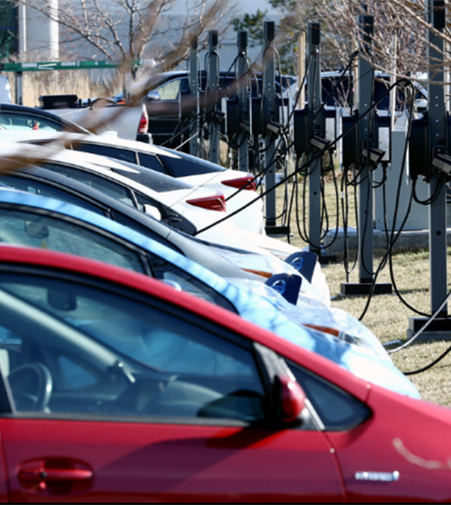
Wattsmart Drive Program
Electric Vehicle Demand Response
Program went live in July 2024.
Marketing program to customers who have participated in other EV programs.
Program has been successfully dispatched.
Actively marketing program to EV owners.

Slide 18

Wattsmart Business New Construction
Whole Building integrated energy efficient design
Adapts to design/construction cycle
Reward design improvements from code baseline
Reward delivery of high-performance energy use
  Two program paths
  Early Engagement Construction

Slide 19
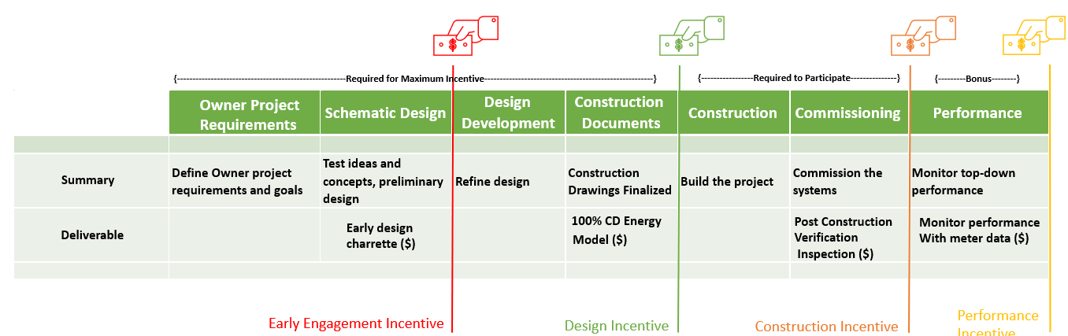
Wattsmart Business New Construction
Notes:
Eligible major renovation applies to gut-rehabs, defined as the replacement of the building’s interior except for framing, and where the applicable code requires a permit that invokes compliance with the energy code for the HVAC and Building Envelope System.
Comchecks will be requested for the HVAC and Envelope to document eligibility

Slide 20
Questions

