Slide 1

Thermal Energy Networks in Cold Climates
Utah Association of Energy Engineers Fall Symposium
9/17/24

Slide 2
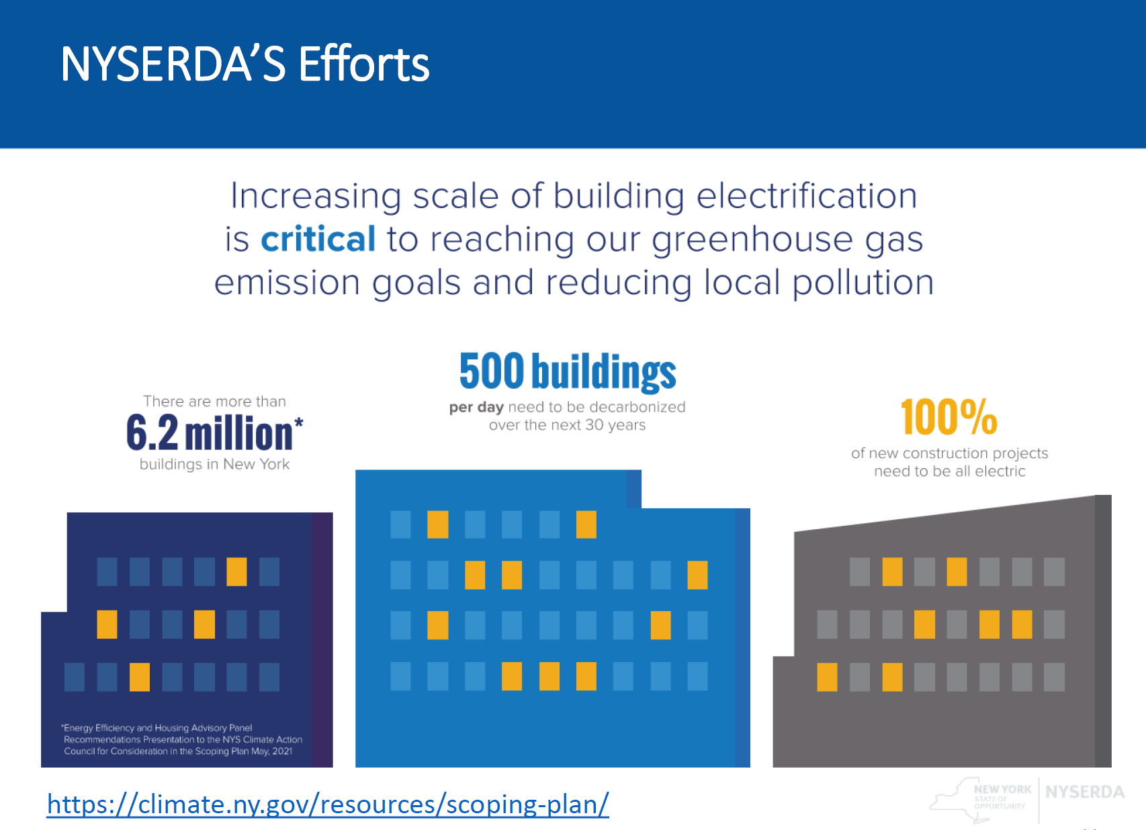

Understand the Problem
Thermal Energy Networks

Slide 3
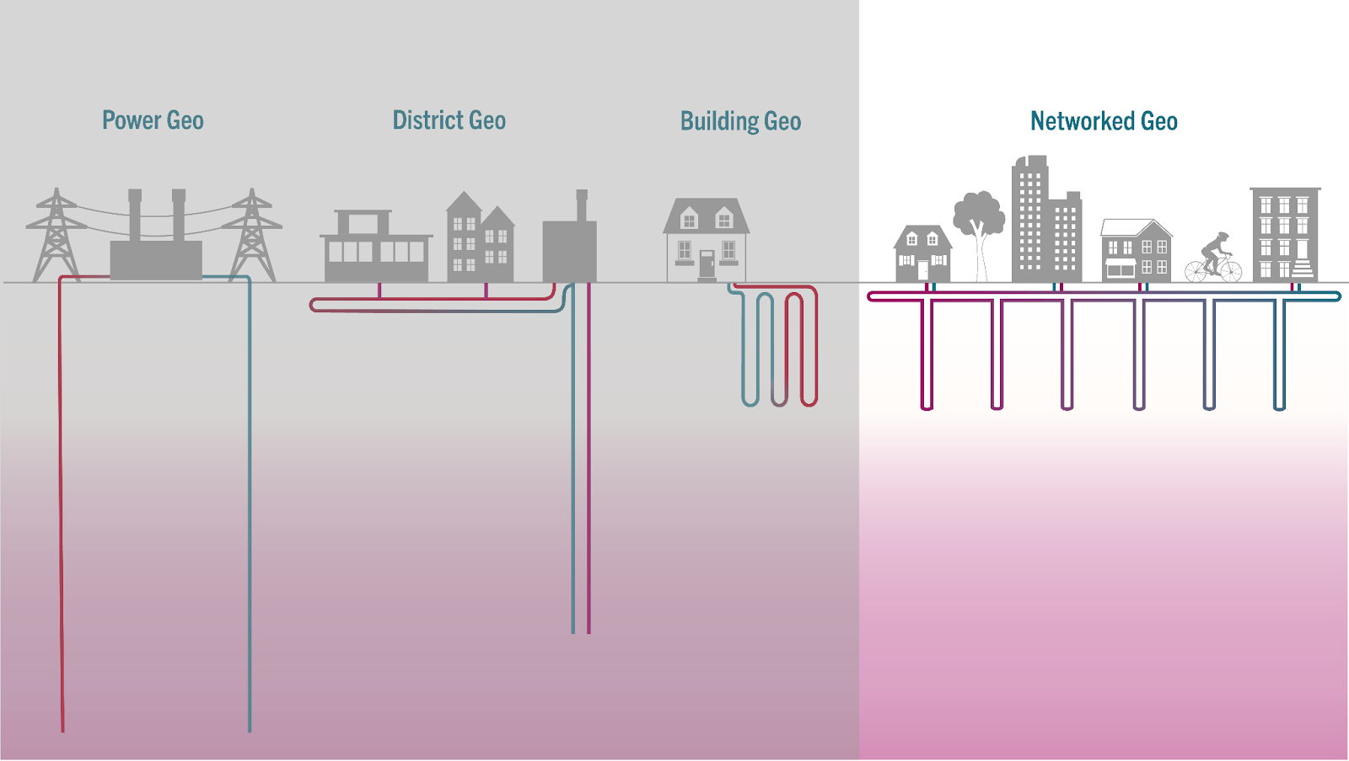
What is a Thermal Energy Network?
Thermal Energy Network
Thermal Energy Networks

Slide 4
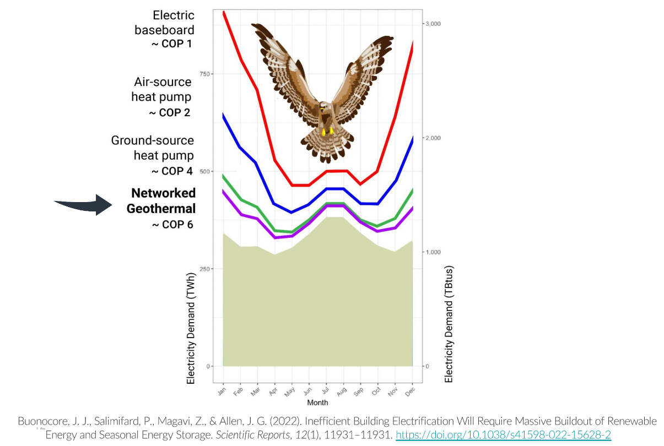
Thermal Energy Networks and the Grid
Thermal Energy Networks

Slide 5
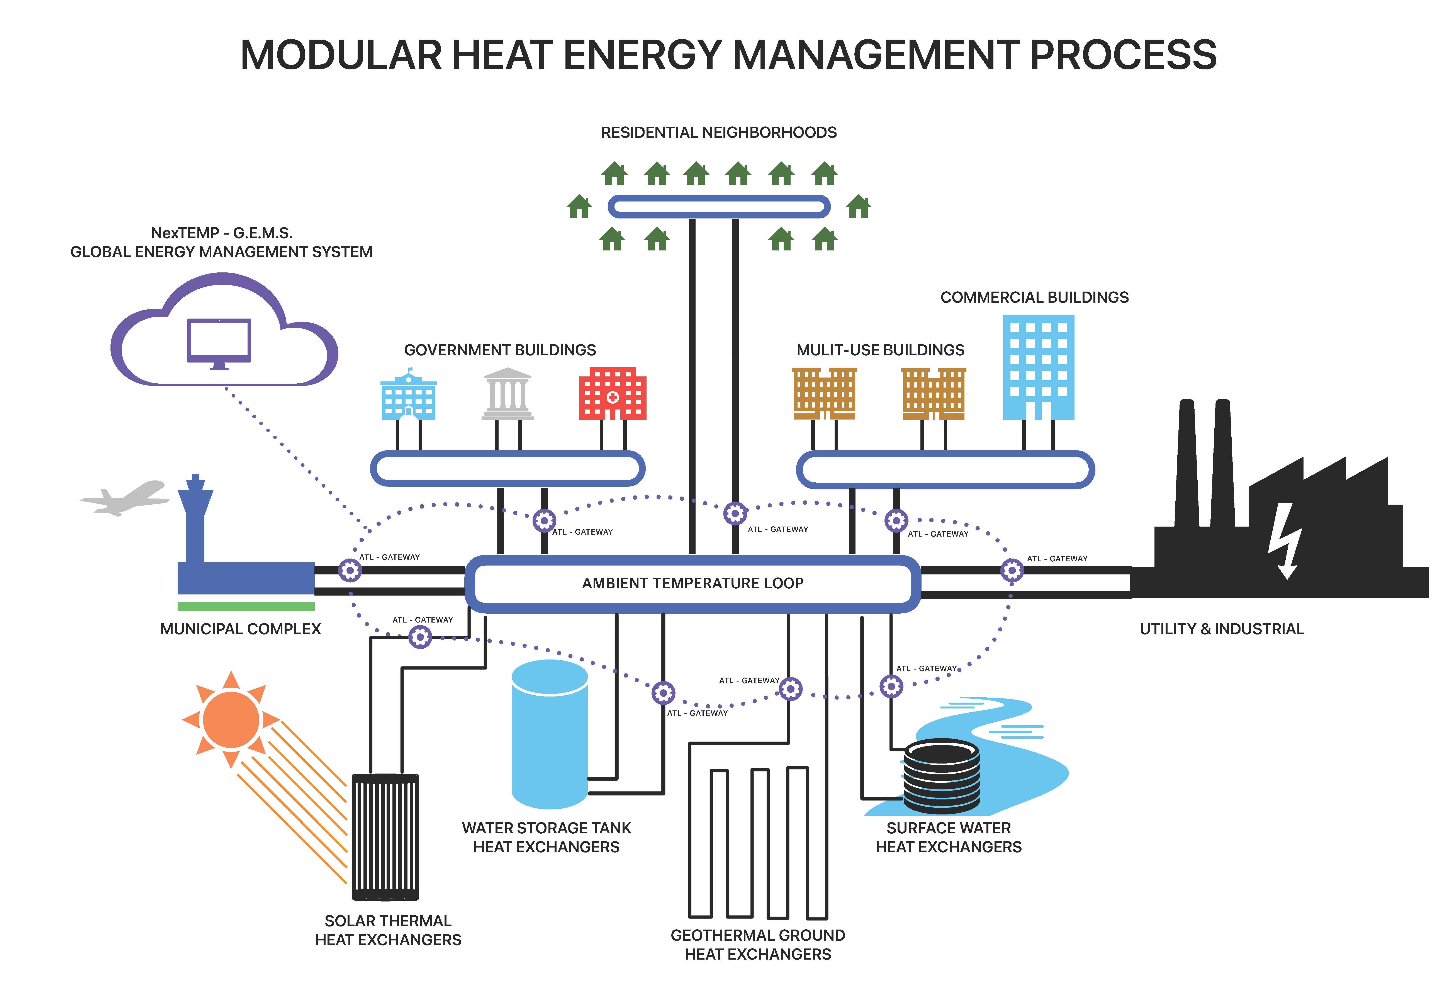
The Ambient Temperature Loop System
Thermal Energy Networks

Slide 6
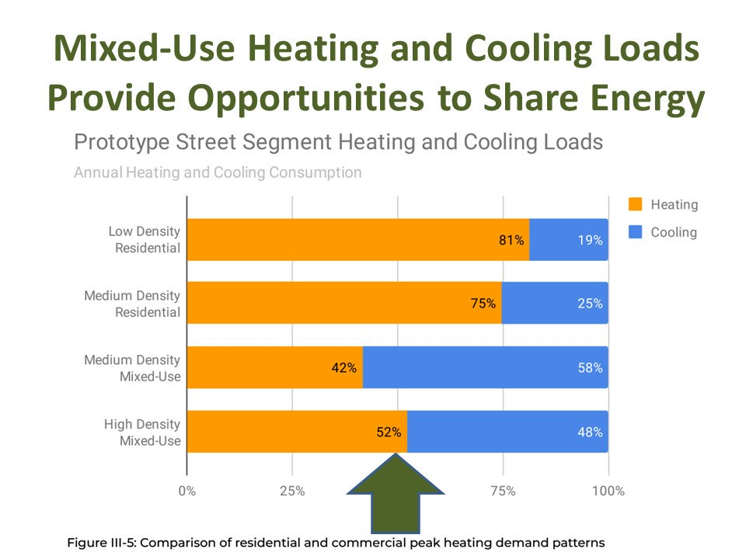
The Value of System Diversity
Thermal Energy Networks

Slide 7
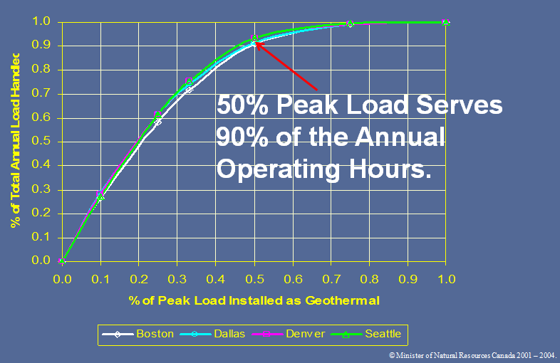
The 50/90 Rule and Hybrid Systems
Thermal Energy Networks

Slide 8
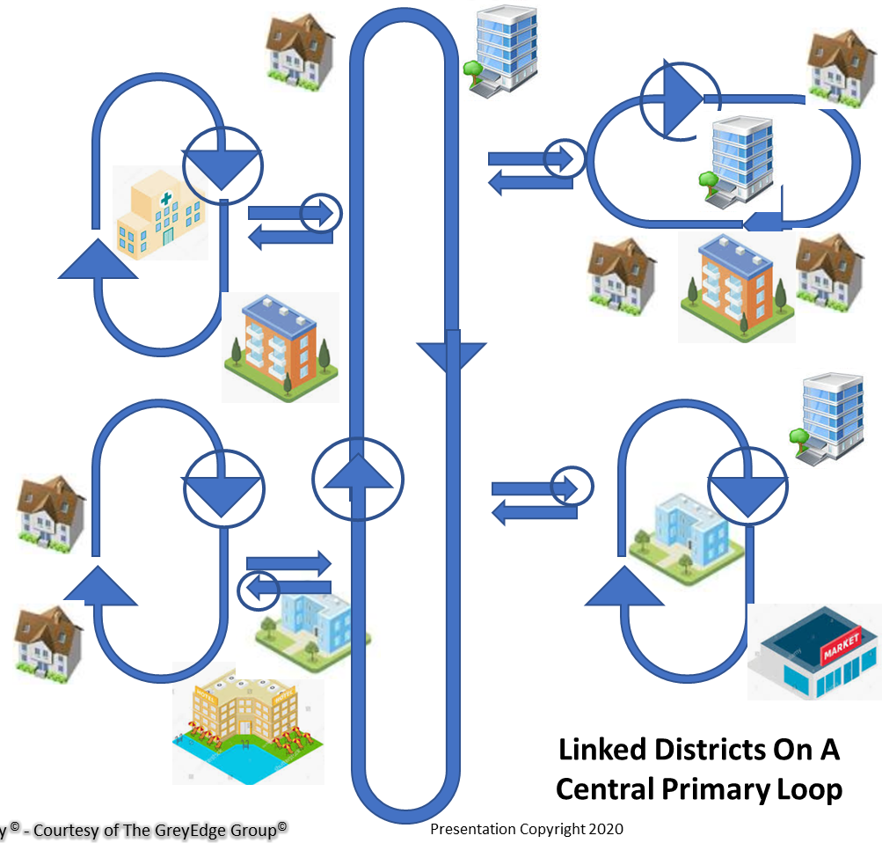
Modularity and Microgrids
Thermal Energy Networks

Slide 9
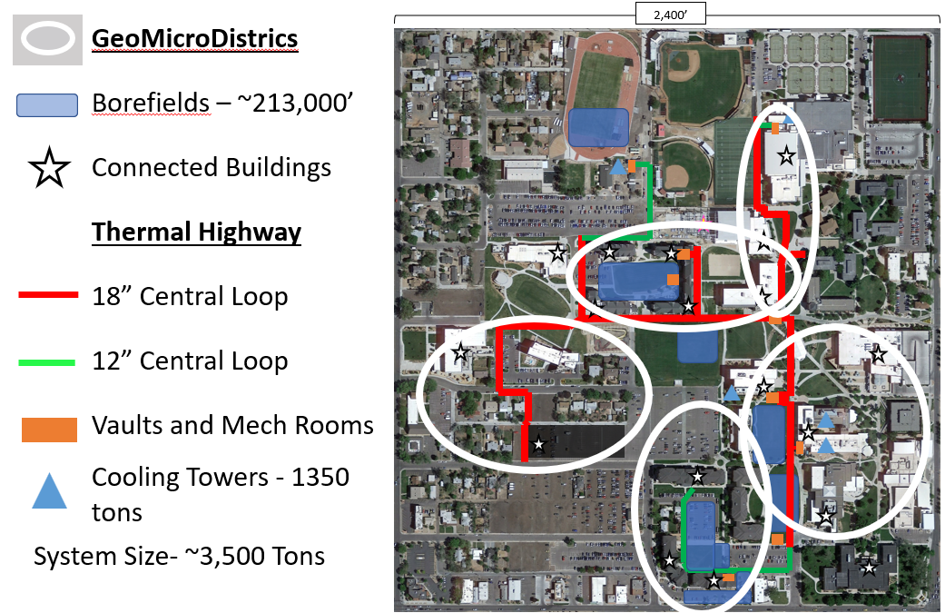
Case Studies- Colorado Mesa University
Thermal Energy Networks
Notes:
Cumulative System Load (1,213,572) SF
16 Buildings
Maximum flow 4,800 GPM
Minimum flow 850 GPM
Average flow 3,200 GPM
3500 Tons Capacity
Min temp (winter) 45; max temp (summer) 95
Speak to demand limiting button

Slide 10
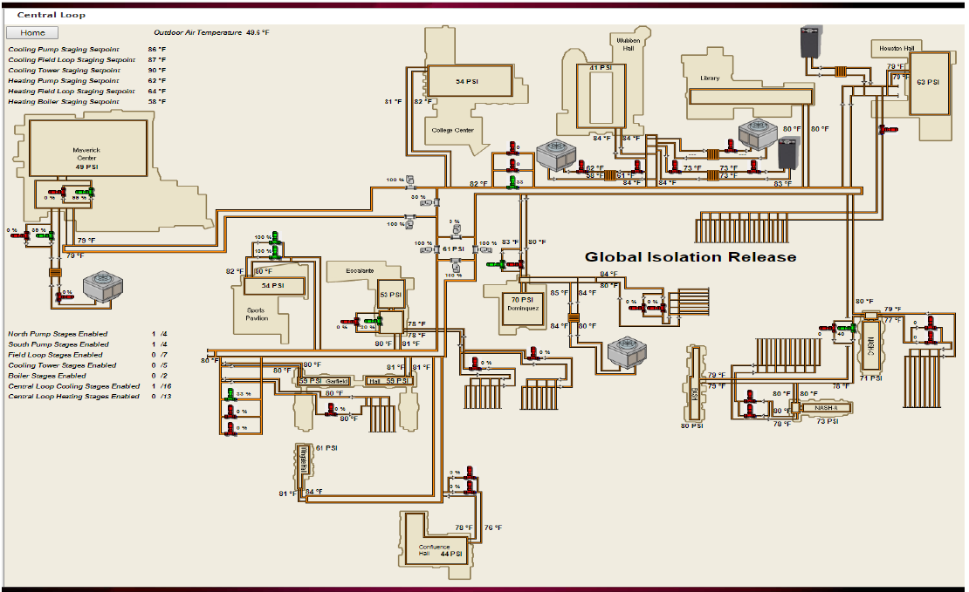
Case Studies- Colorado Mesa University
Thermal Energy Networks

Slide 11
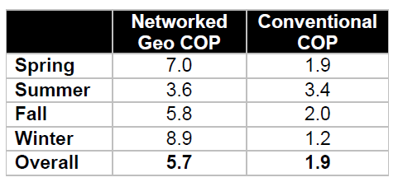
Case Studies- Colorado Mesa University
Thermal Energy Networks
With Standard Central Plant:
217 vertical feet of borehole per installed ton
Calculated water use: 14.5MM gallons/yr. (3,400 tons CT)
Electric Load 784 kW
With Ambient Temperature Loop:
84 vertical feet of borehole per installed ton
Estimated Water Use: 4.5MM gallons (705 tons CT)
Electric Load: 185 kW
>$2,000,000 in annual utility savings

Slide 12
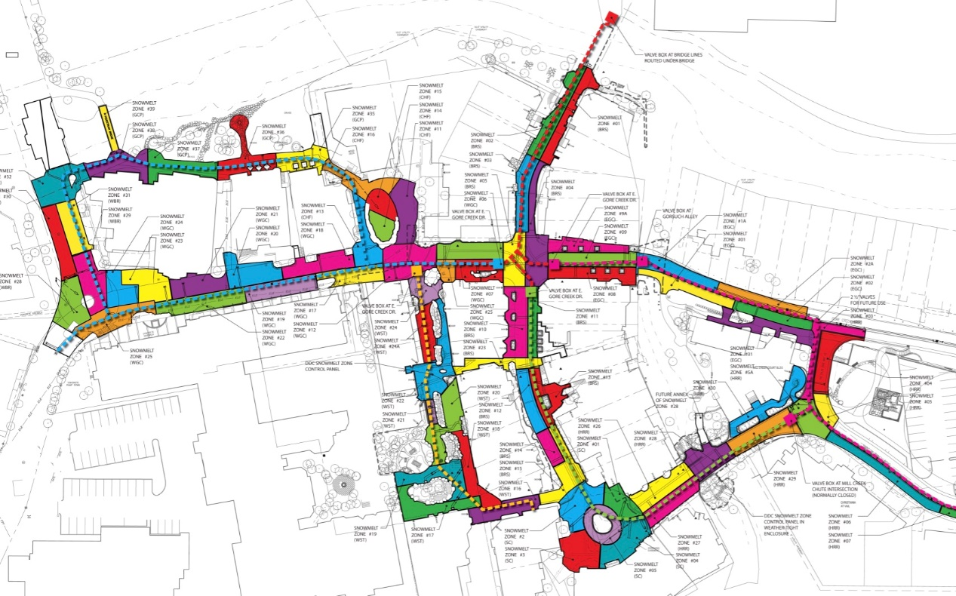
Case Studies- Vail
Thermal Energy Networks

Slide 13
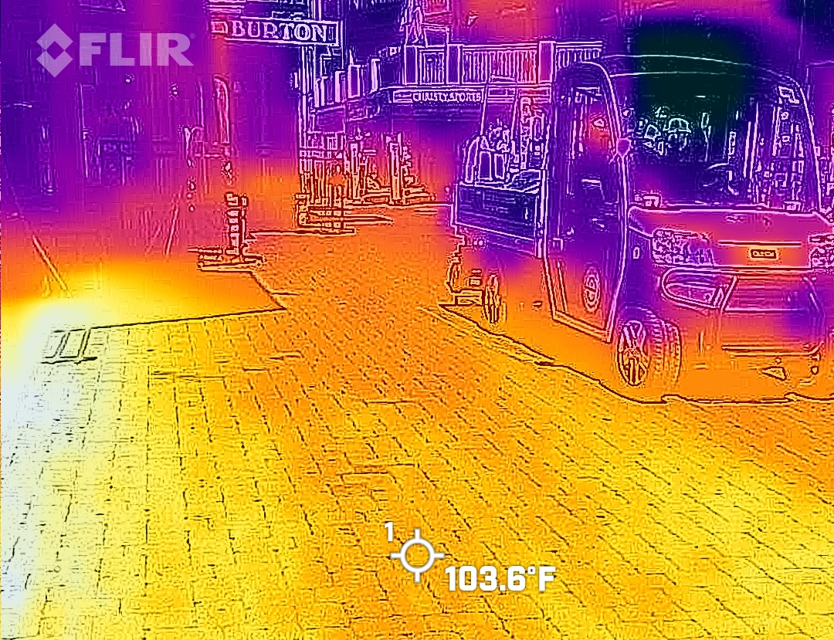
Energy Reduction Potential in Vail
Thermal Energy Networks

Slide 14
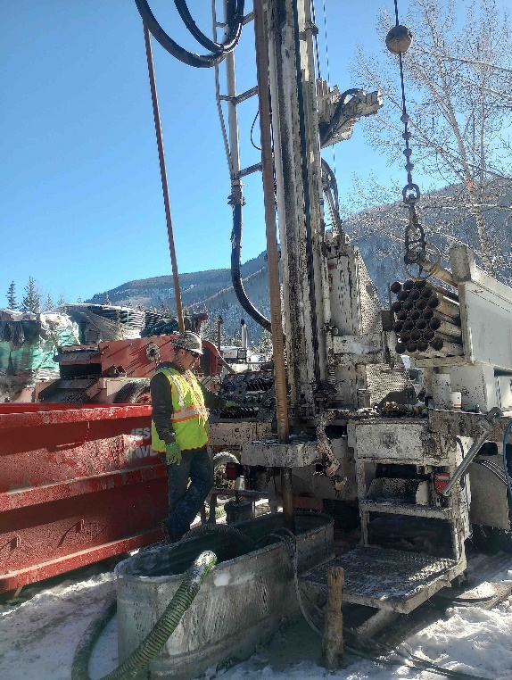
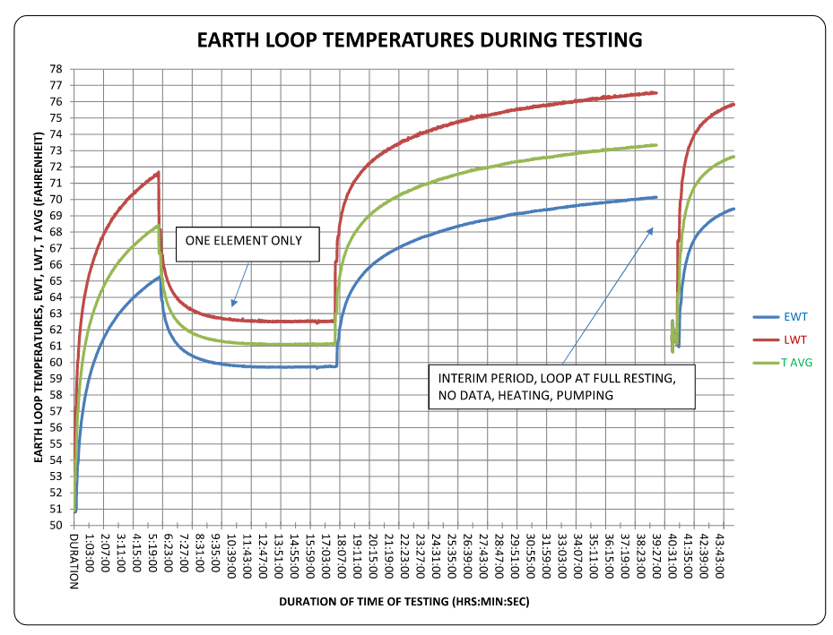
Vail TEN Study- Phase 1
Initial Feasibility Study
50/90 decarbonization rule
Hydrogeology
Test Borehole
Thermal sources
Thermal Energy Networks
Notes:
(ability to transfer and store heat easily)
Similar conditions throughout valley floor
Evaluation of sources of thermal energy
ATL 101: Heat pumps to Heat Pump Buildings
Heat Trading enabled
Can be connected to air, water, or ground
Networked buildings (the TEN)
Move heat from lab to classroom, from civic buildings to residential
(insert graphic)
3 components
Buildings
Loop
Thermal management devices

Slide 15
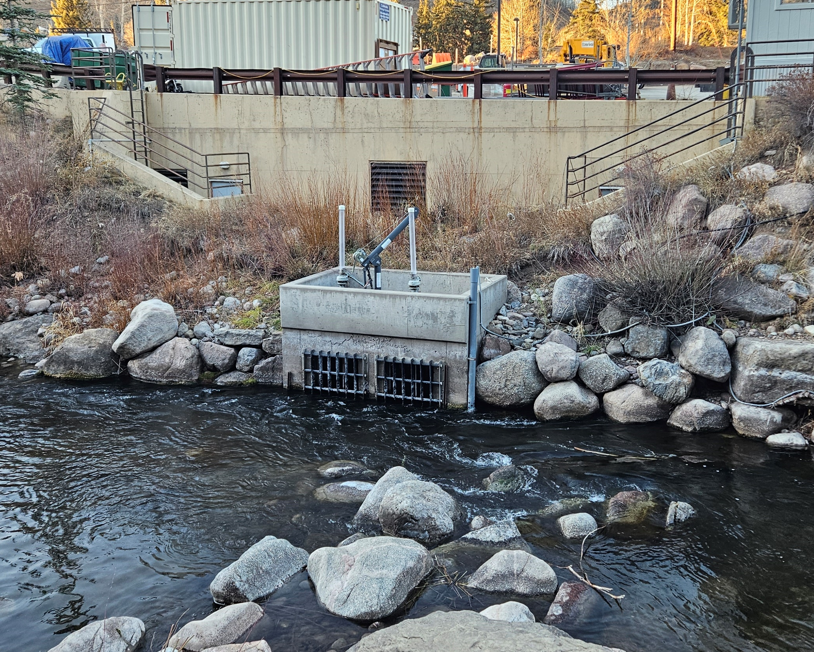
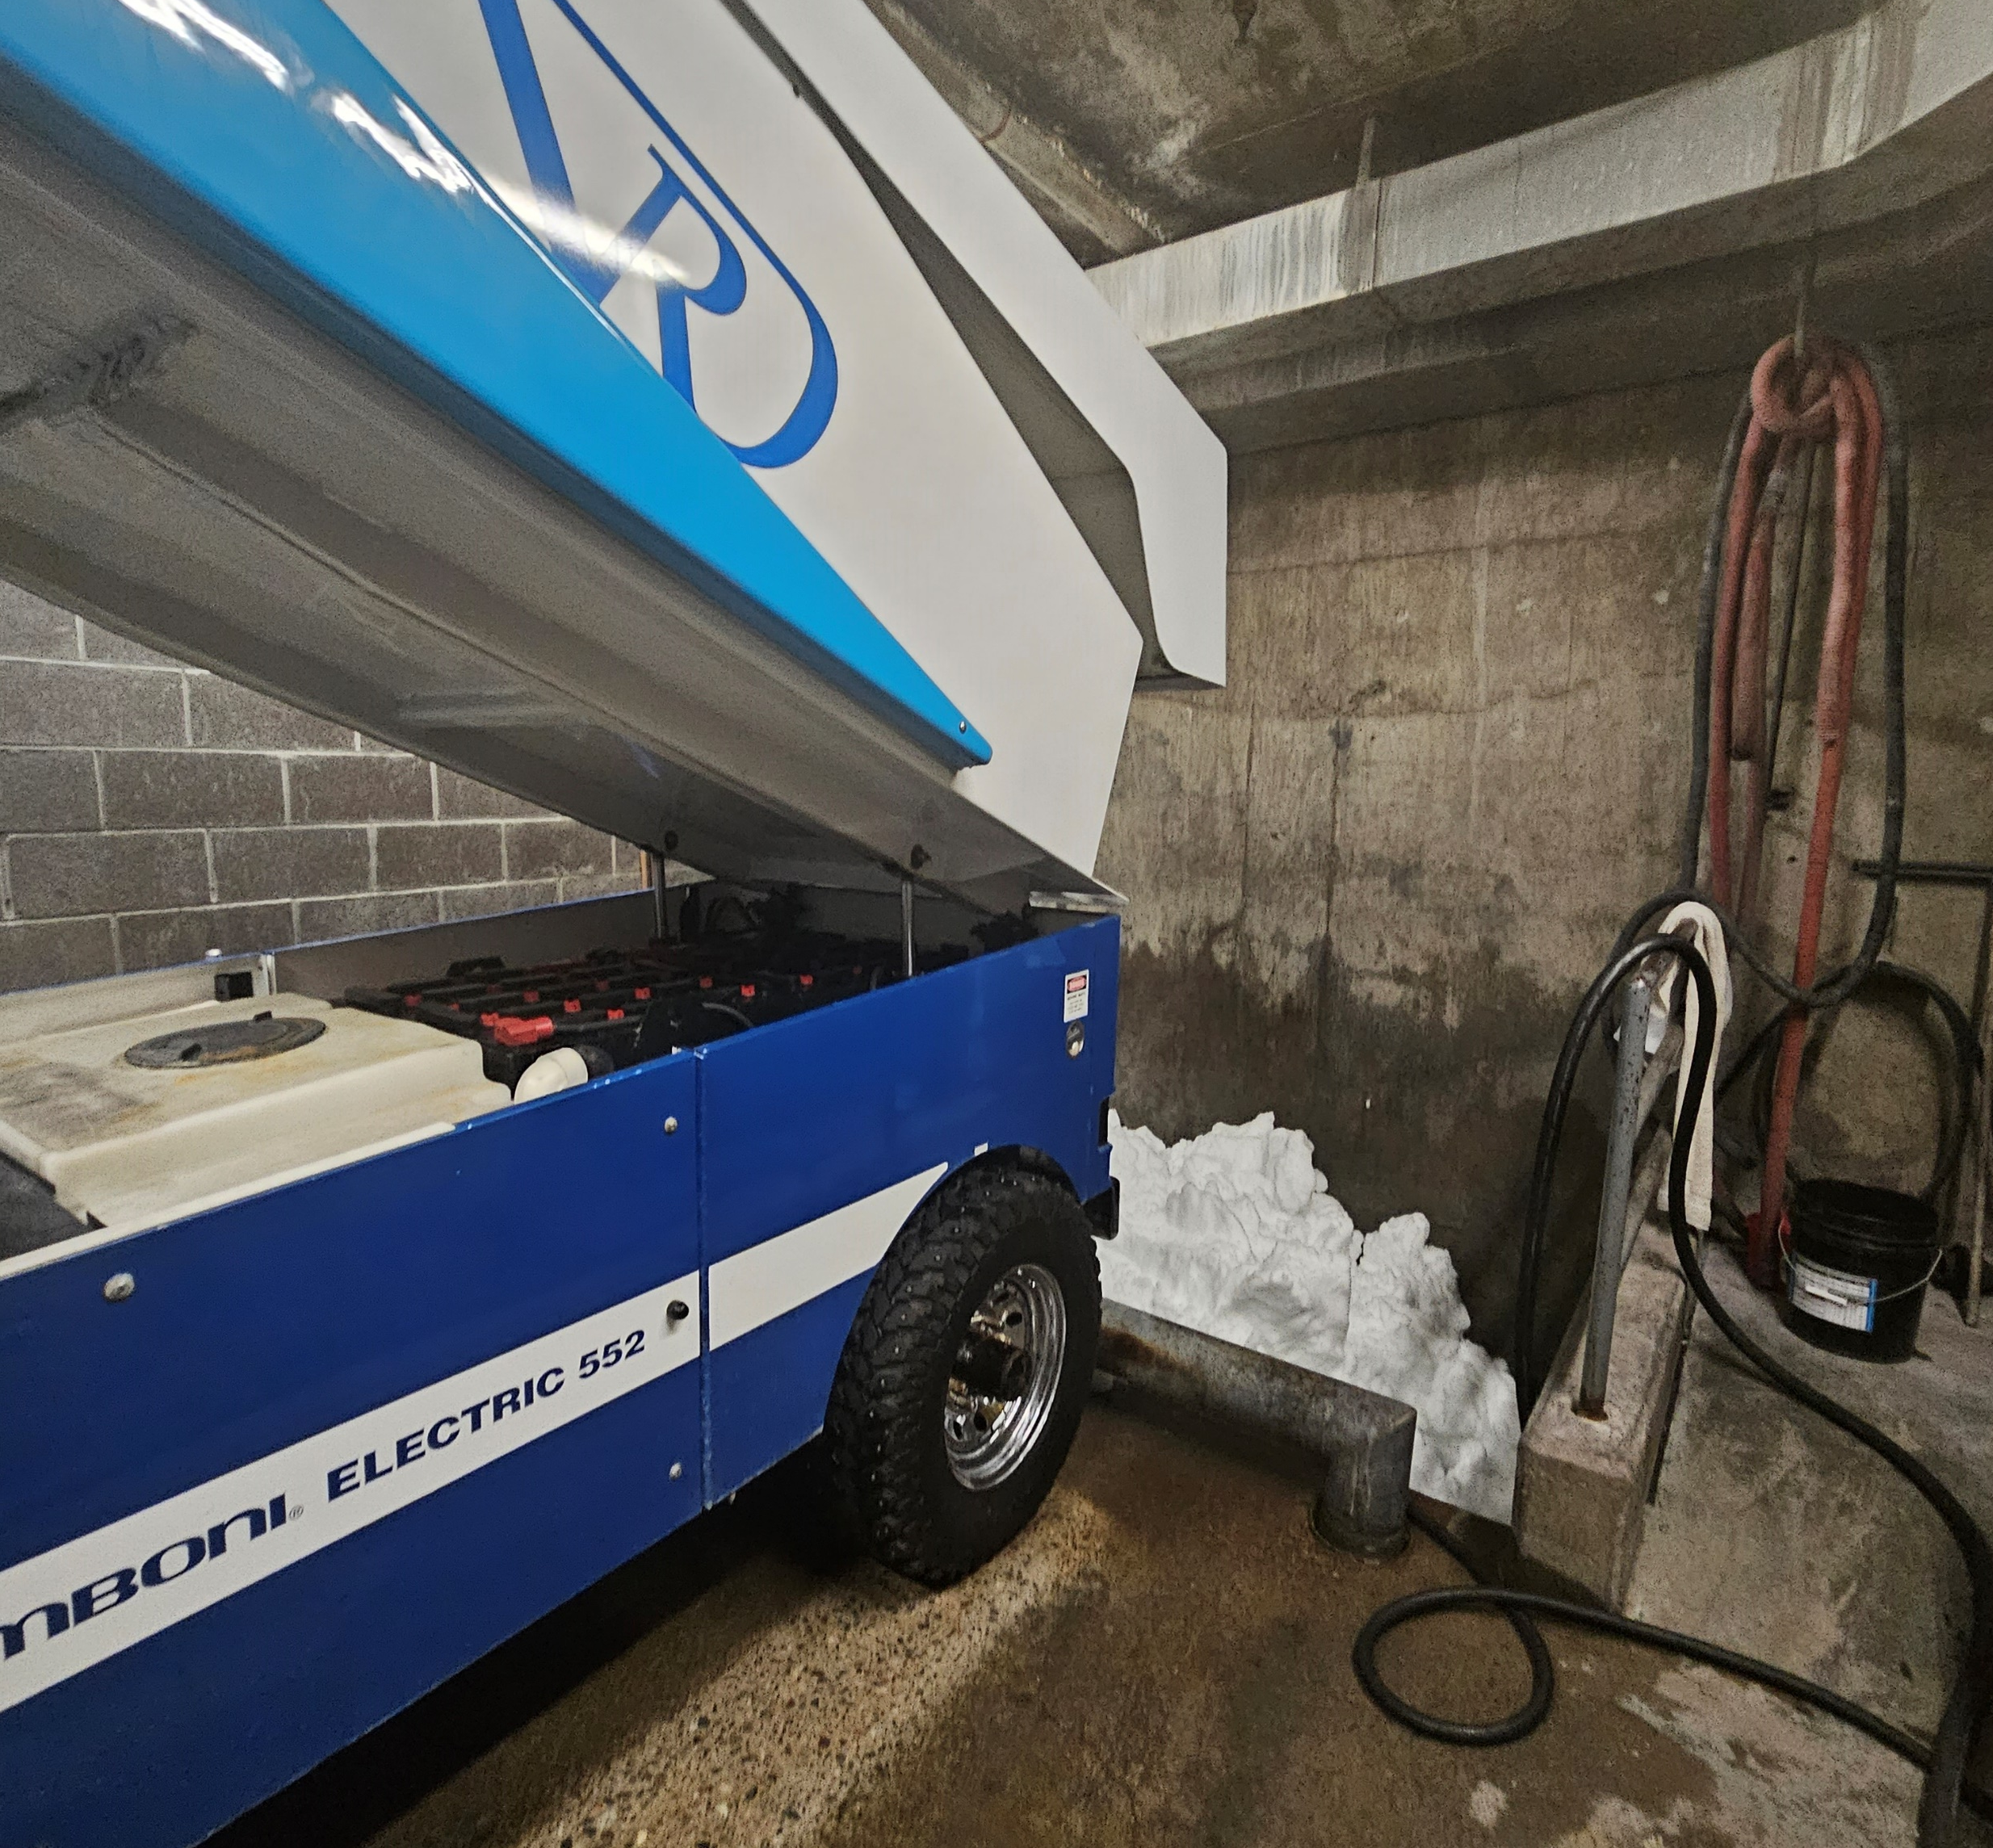
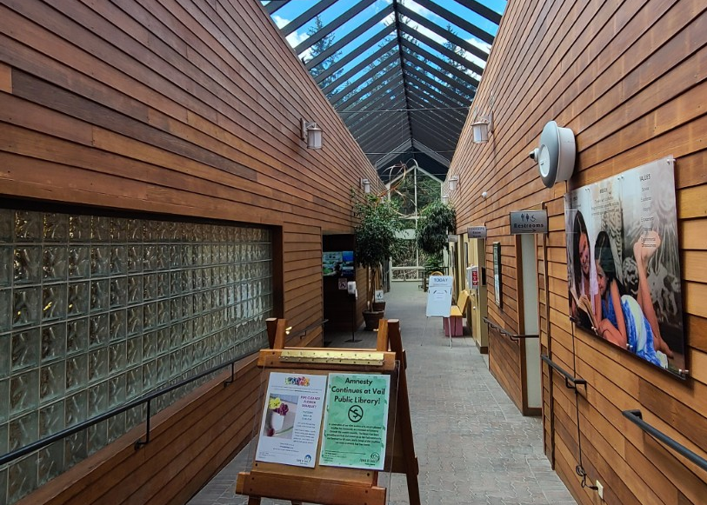
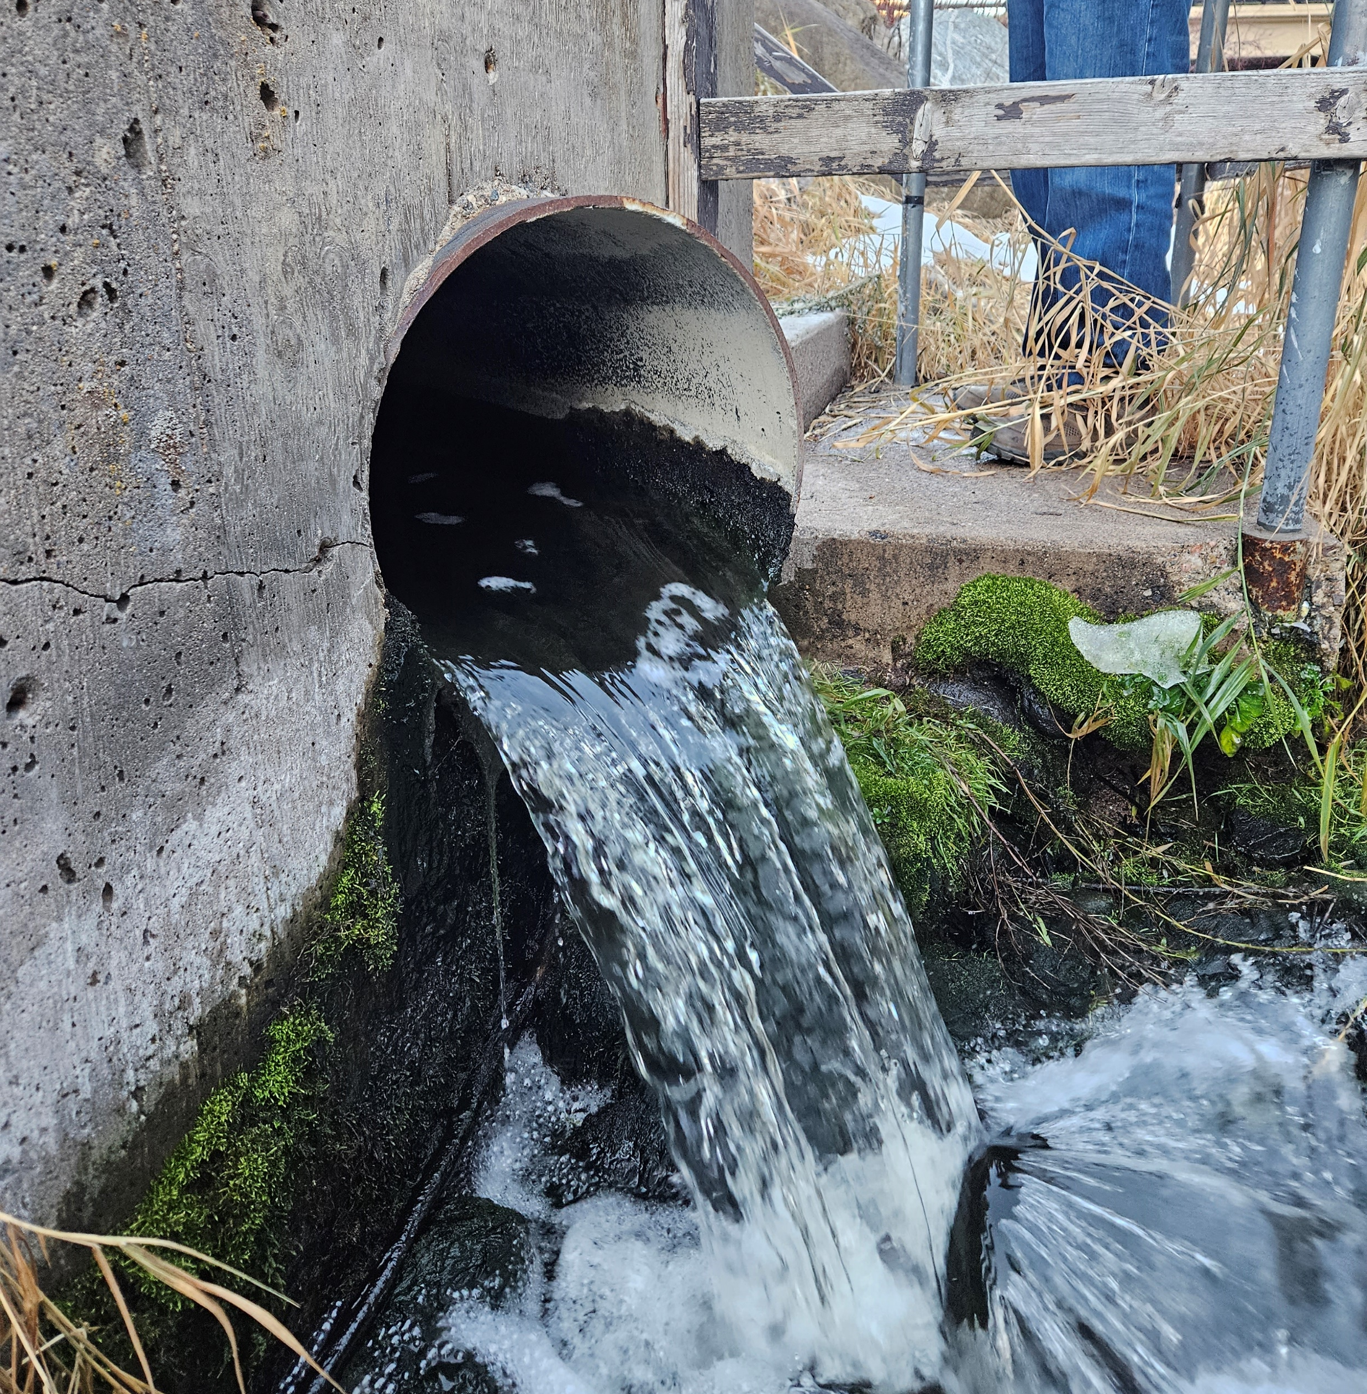
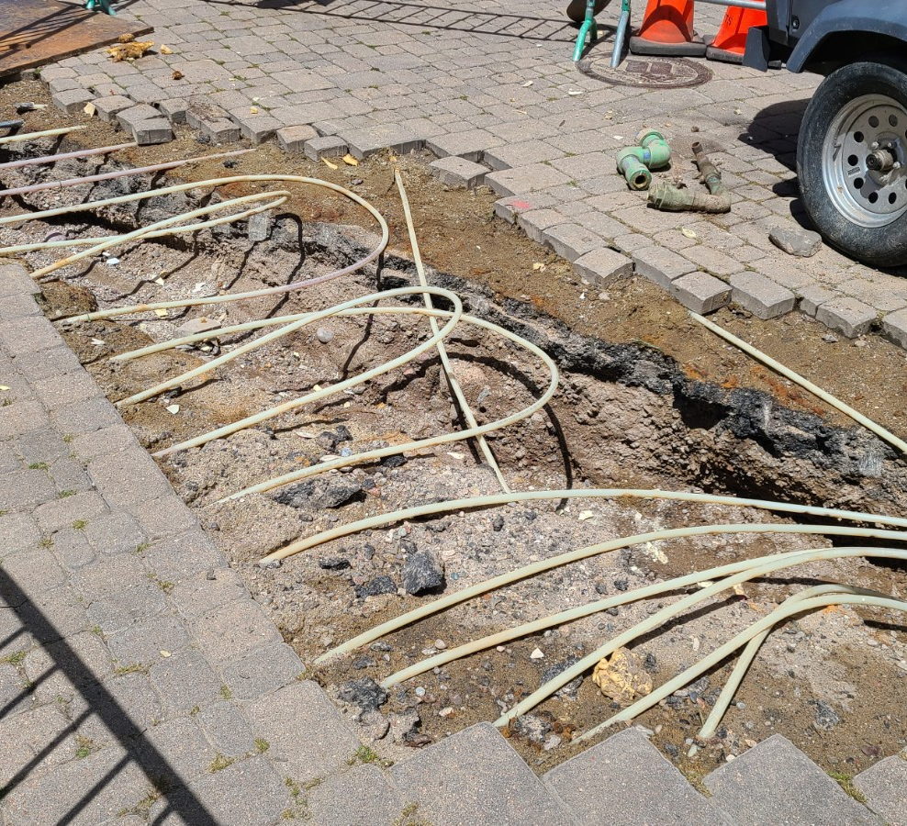
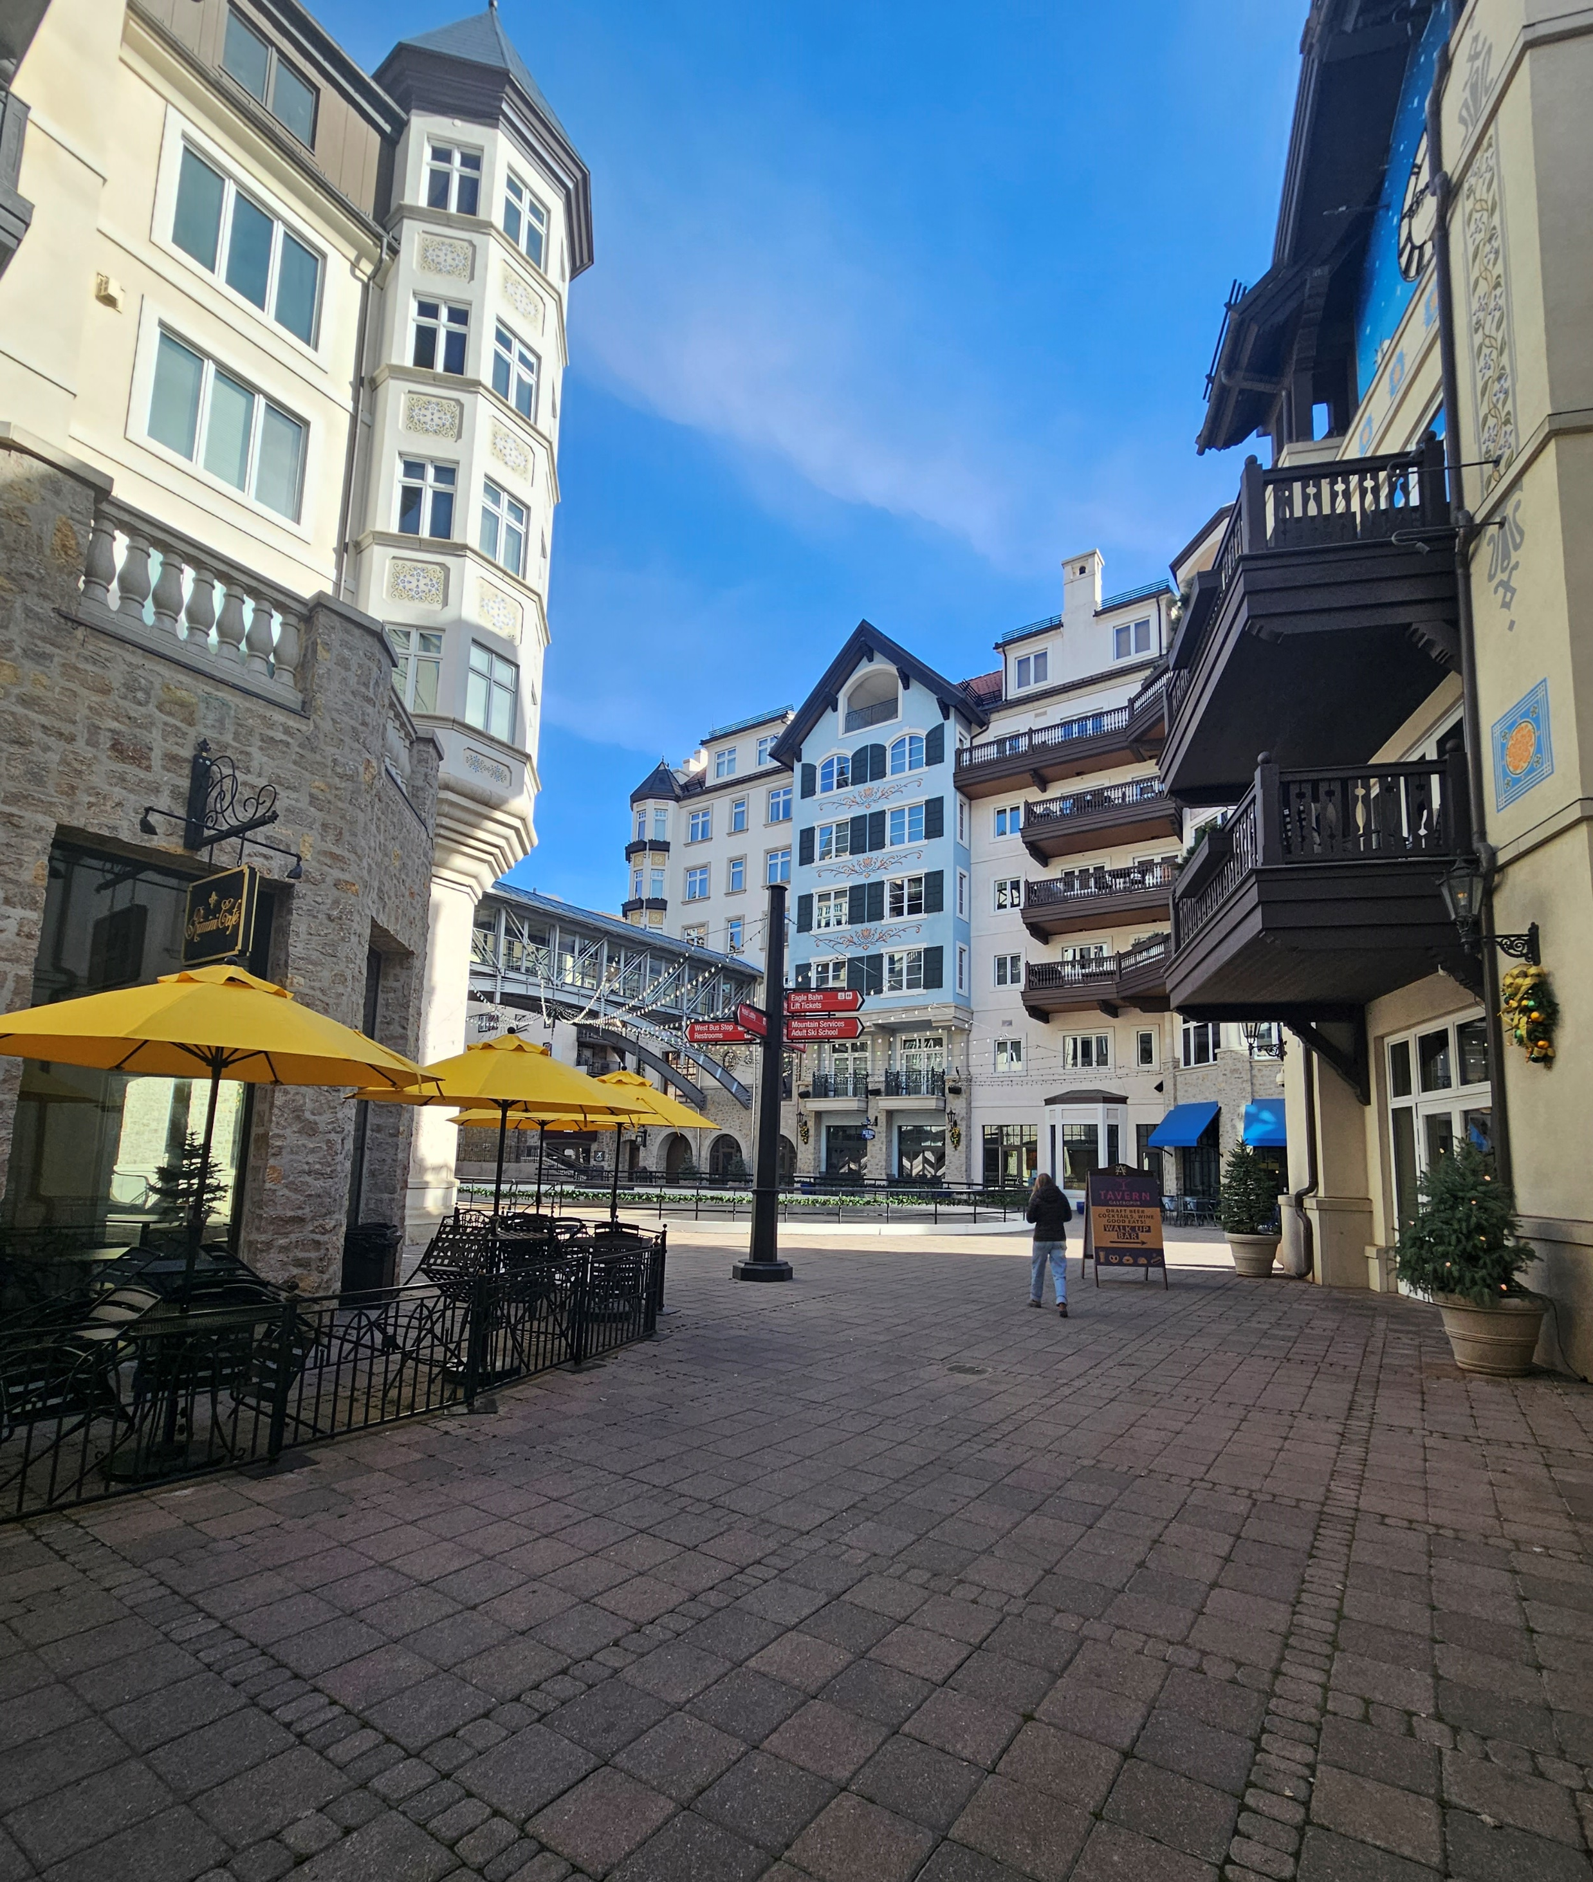
Potential Thermal Assets- Vail
Thermal Energy Networks

Slide 16
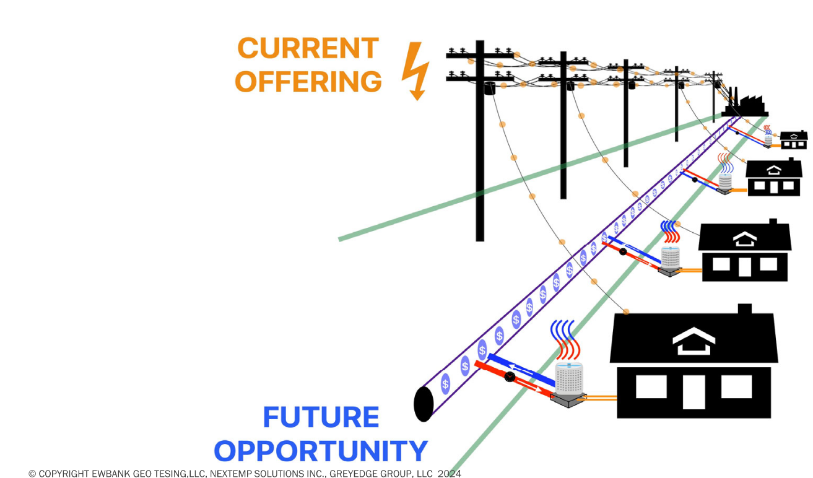
The Utility Thermal Energy Network (UTEN) Business Model
UTEN Conversation is Evolving Nationally
Who Finances, Owns, and Operates?
  Third Party
  Municipality or Customers
  Utility Company
Design, Commissioning and Controls Support
Billing and Customer Participation
Thermal Energy Networks

Slide 17
The Paradigm Shift
Beneficial Electrification is the challenge of our times-
  The last 10% is most difficult!
The TEN is a holistic tool to achieve decarbonization in the built environment
A TEN is a demand response tool that increases power factor of electrical grid
A TEN offers the highest possible COP for Heating and Cooling
The Big Idea: In a TEN, Liabilities can become Assets
Thermal Energy Networks
Notes:
Reiterate problem (evolving demands on electric grid + need to decarbonize thermal loads) – i.e. beneficial electrification
Decarbonizing 90%, last 10% is most difficult
A TEN is a holistic tool to manage the challenge of electrifying thermal loads at scale w/high penetration of renewables in energy supply
It is an interactive grid for heating and cooling
From liabilities to assets
Smoothing out demand curve
Higher COP for heat pumps
Higher efficiency
Stability
Coasting through demand events w/thermal mass
Reiterate problem (evolving demands on electric grid + need to decarbonize thermal loads) – i.e. beneficial electrification
Decarbonizing 90%, last 10% is most difficult
A TEN is a holistic tool to manage the challenge of electrifying thermal loads at scale w/high penetration of renewables in energy supply
It is an interactive grid for heating and cooling
From liabilities to assets
Smoothing out demand curve
Higher COP for heat pumps
Higher efficiency
Stability
Coasting through demand events w/thermal mass
Reiterate problem (evolving demands on electric grid + need to decarbonize thermal loads) – i.e. beneficial electrification
Decarbonizing 90%, last 10% is most difficult
A TEN is a holistic tool to manage the challenge of electrifying thermal loads at scale w/high penetration of renewables in energy supply
It is an interactive grid for heating and cooling
From liabilities to assets
Smoothing out demand curve
Higher COP for heat pumps
Higher efficiency
Stability
Coasting through demand events w/thermal mass

Slide 18
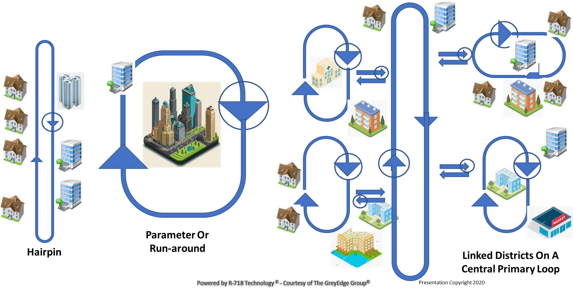
Discussion
Thermal Energy Networks
Matt Garlick
801-907-5654
mgarlick@thegreyedgegroup.com

