Slide 1
Batteries

Slide 2


Agenda
01
WHY NOW?
02
COMMERCIAL TECHNOLOGIES
03
OPERATIONS STRATEGIES
04
ECONOMIC ANALYSIS

Slide 3
Why
Now?

Slide 4
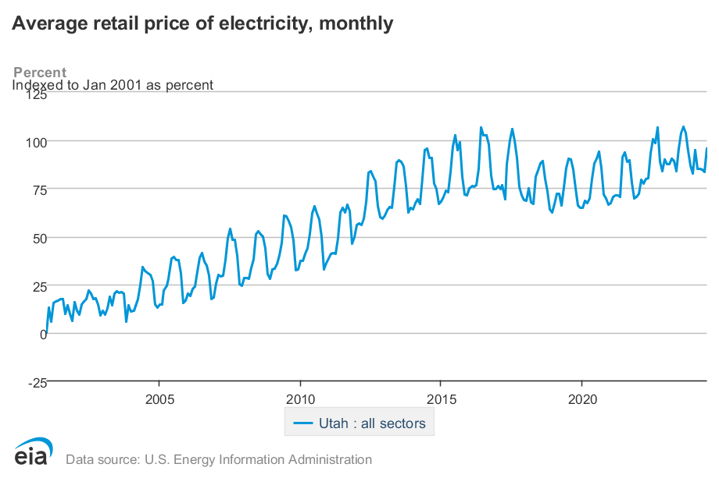
WHY NOW?
3.6% Annual electricity inflation over the past
20 years

Slide 5
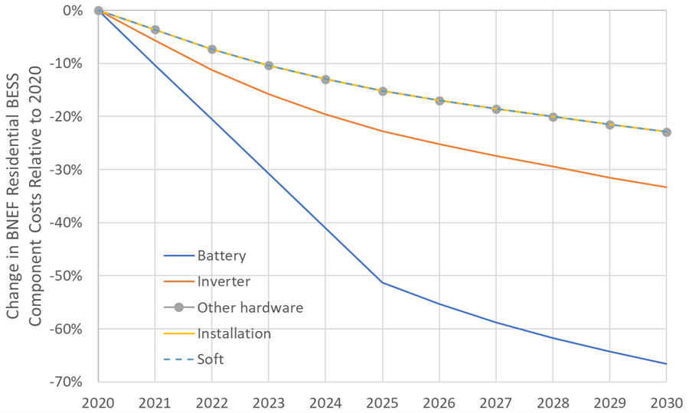
WHY NOW?
50% decrease in hardware cost over past 5 years

Slide 6
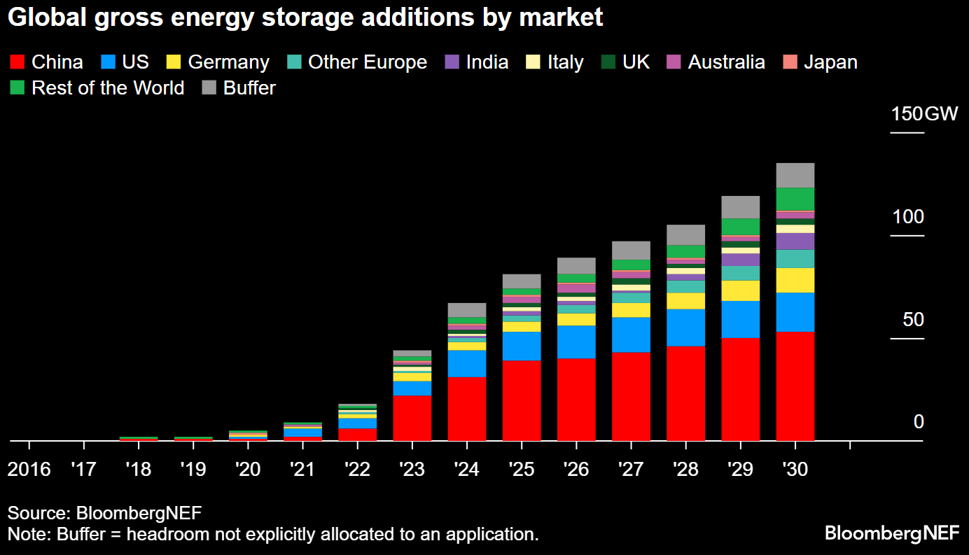
WHY NOW?
Increasing electricity pricing plus falling battery prices results in deployment
3x increase in battery deployment in a single year

Slide 7
COMMERCIAL TECHNOLOGIES

Slide 8
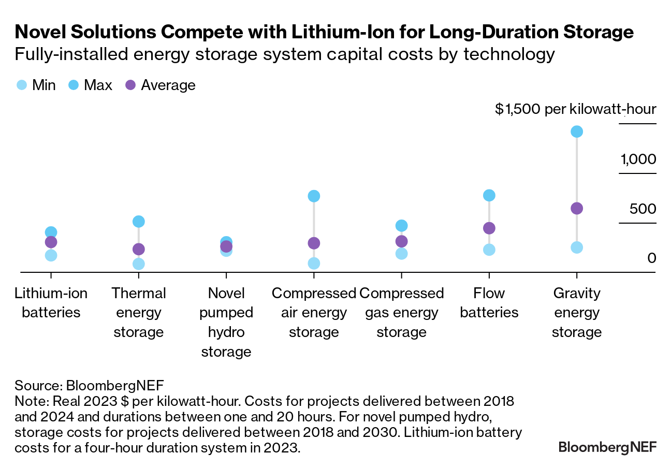
Market Overview + Economics
Bernhard has selected two types of batteries for projects since 2022
Lithium-Ion batteries are less expensive, and the costs are decreasing quickly
Flow batteries are more suited for long duration storage

Slide 9
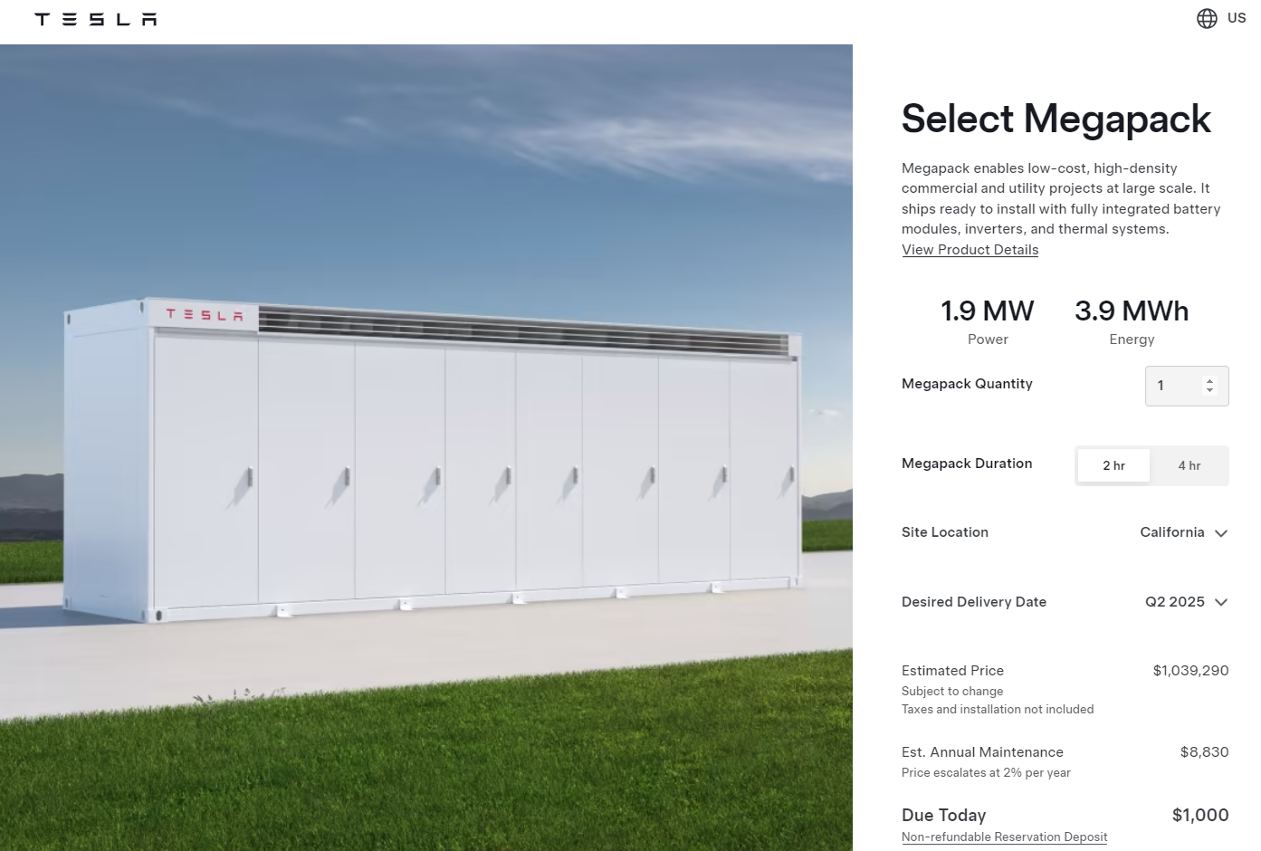
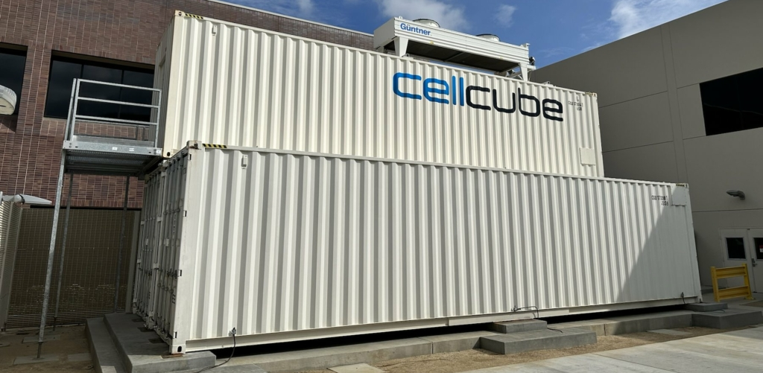
COMMERCIAL TECHNOLOGIES
Lithium Iron Phosphate (LFP)
Most common stationary storage chemistry
Ideally suited for 2 to 4-hour duration systems
Life expectancy of 10 to 15 years
5,000 to 10,000 cycles
Depth of Discharge (DOD) greatly impacts life expectancy
Potential for thermal runaway
Small footprint
$250 - $300 / kWh
Vanadium Redox Flow Battery (VRFB)
Stores energy in liquid vanadium electrolyte
Suited for 6+ hours of duration; Add duration by adding tanks
Life expectancy of 20 - 25 years
10,000-20,000 cycles
Depth of Discharge (DOD) does not affect life expectancy
Non-flammable chemistry
Large footprint
$500 - $600 / kWh; Electrolyte retains value

Slide 10
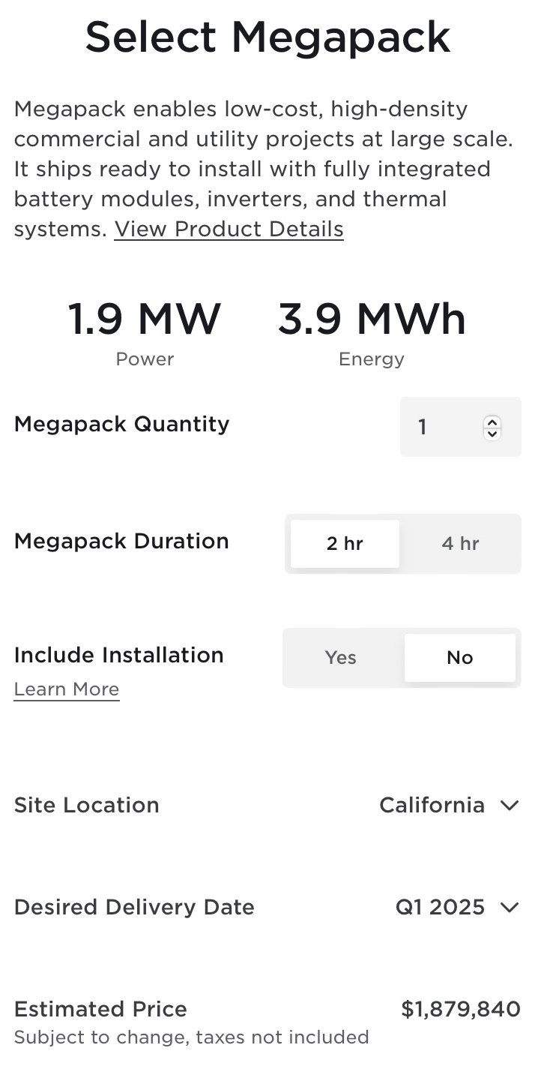
COMMERCIAL TECHNOLOGIES: Lithium-ION Pricing
May 2023 Price
August 2024 Price
Commercial Systems typically packaged in 4 MWh to 5 MWh units
Tesla decreased pricing by 45% in 15 months
VRFB’s are no longer able to compete on price
https://www.tesla.com/megapack/design

Slide 11
Operations strategies

Slide 12
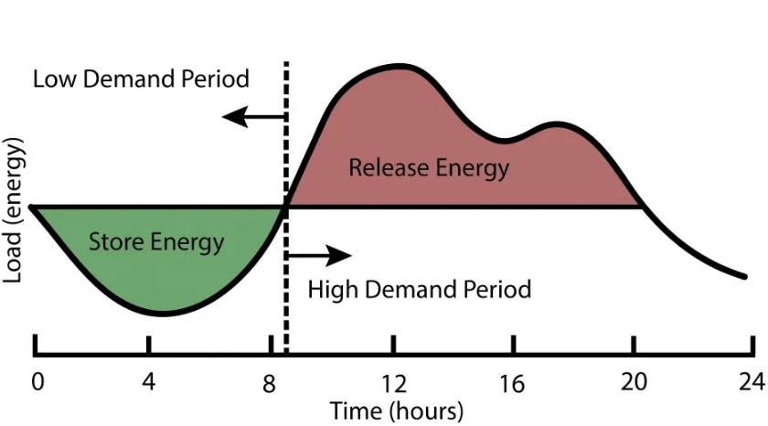
Operations Strategies: Energy Arbitrage
Strategy for customers on a Time-of-Use (TOU) rate
Battery is discharged during On-Peak times and Off-Peak time

Slide 13
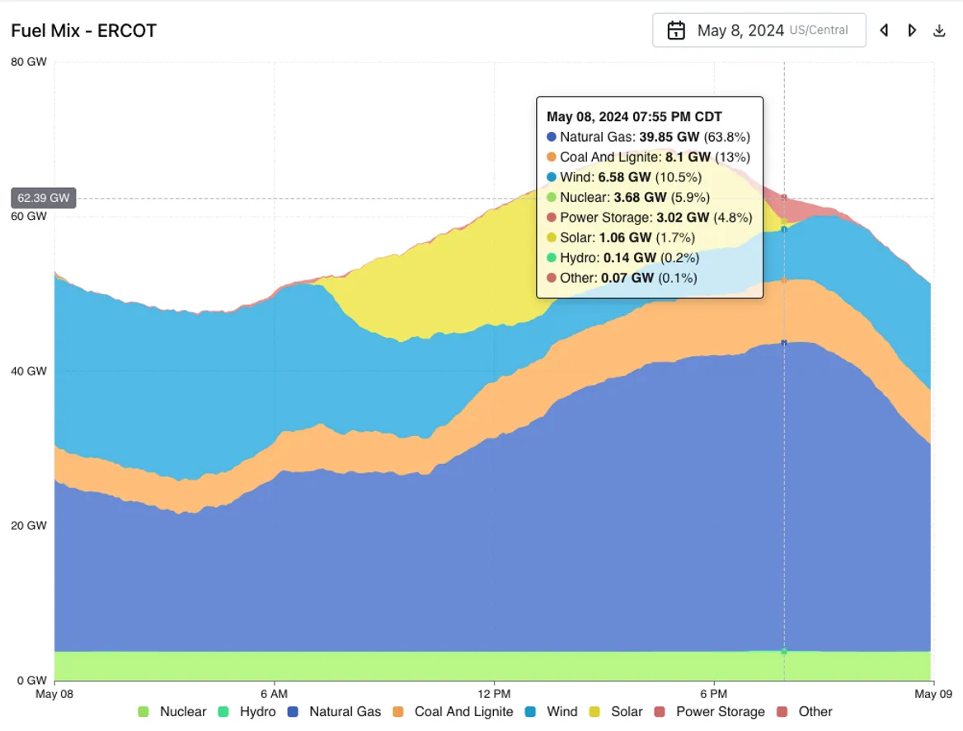
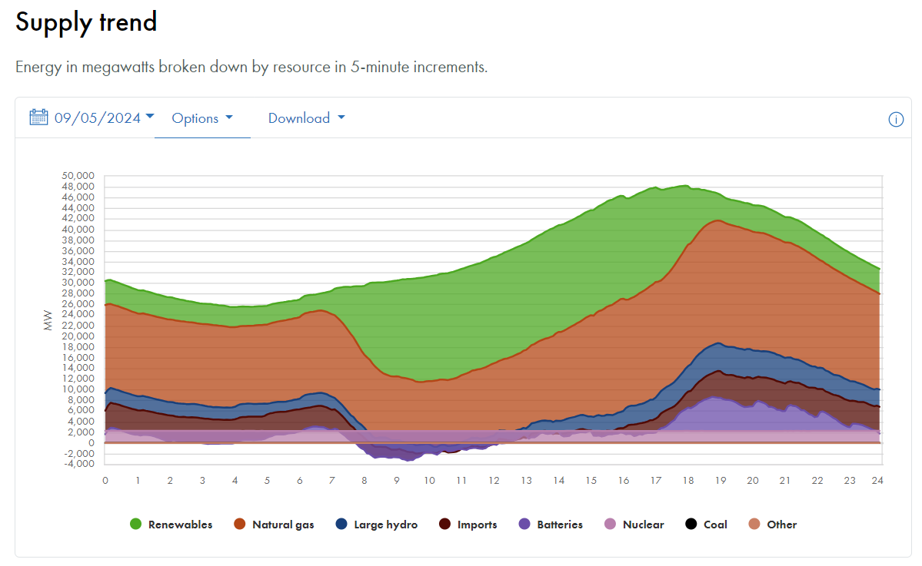
Operations Strategies: Demand Response
Battery enrolled in a utility program and discharged in time of peak grid need, not customer need.
ERCOT
CAISO
https://www.gridstatus.io/live/ercot?date=2024-05-08
Today's Outlook | Supply | California ISO (caiso.com)

Slide 14
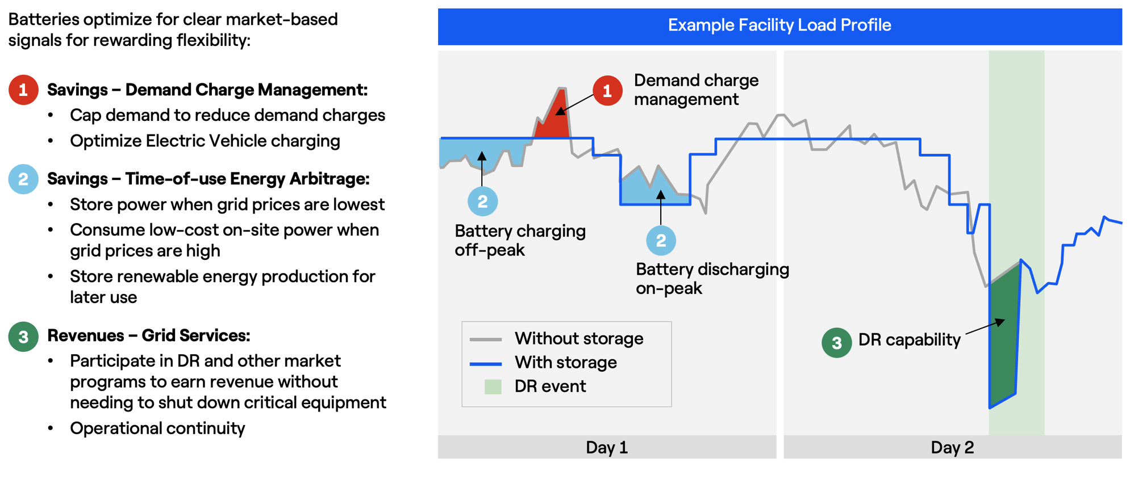
Operations Strategies: Combined
https://www.enelnorthamerica.com/insights/blogs/battery-storage-101-everything-you-need-to-know

Slide 15
Economic analysis

Slide 16
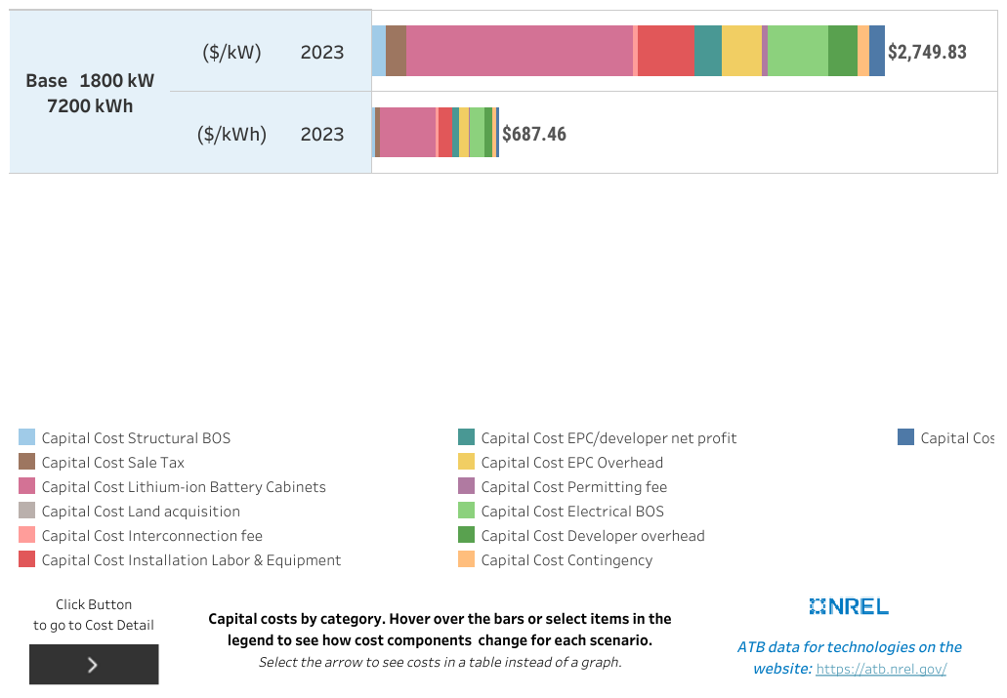
ECONOMIC ANALYSIS: System price
Analysis Assumptions
Four-hour storage battery
Appropriate for medium-sized hospital
$4.95M total installed cost

Slide 17
ECONOMIC ANALYSIS: energy arbitrage
Rocky Mountain Power General Service
Summer Demand
  On-Peak - $14.33/kW
  Off-Peak – None
Winter Demand
  On-Peak - $12.68/kW
  Off-Peak – None
Summer Energy
  On-Peak - $0.0515/kWh
  Off-Peak - $0.0232
Winter Energy
  On-Peak - $0.0456
  Off-Peak - $0.0236
Demand Savings: $168,683
Energy Savings: $37,480
Total Savings: $206,163
Annual Cycles: 260
Item | Value
Installation Cost ($) | $4,950,000
Investment Tax Credit ($) | $1,485,000
Annual Savings ($) | $206,163
O&M ($) | $23,400
Simple Payback | 18.95
Average savings per kW ($/kW) | $114.50

Slide 18
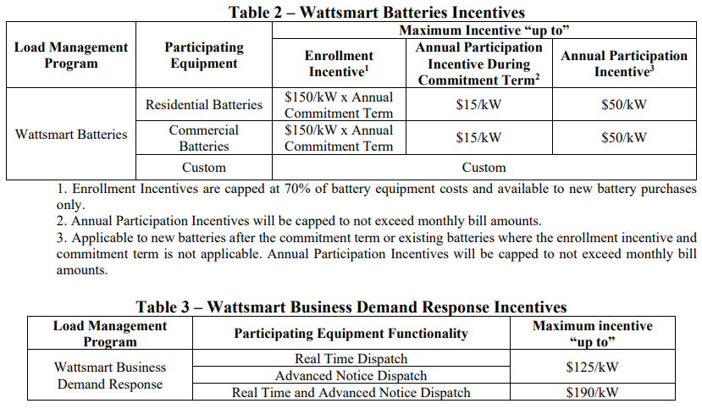
Economic analysis: Demand Response
Strategy for all customers
Battery enrolled in a utility program and discharged in time of peak grid need, not customer need.

Slide 19
Economic analysis: Demand Response
Rocky Mountain Power
Wattsmart Battery Program
$150/kW x 1800 x 4 years = $1,080,000
$15/kW x 1800 = $27,000 in years 1-4
$50/kW x 1800 = $90,000 afterwards
360 cycles per year
Rocky Mountain Power
Wattsmart Demand Response Program
$190/kW x 1800 = $342,000
Likely able to reduce demand charges in shoulder months when DR events are unlikely to be called.
Item | Wattsmart Battery | Wattsmart Demand Response
Installation Cost ($) | $4,950,000 | $4,950,000
Investment Tax Credit ($) | $1,485,000 | $1,485,000
Upfront Incentive ($) | $1,080,000 | -
Annual Incentive (years 1-4) ($) | $27,000 | $342,000
Annual Incentive (years 5+) ($) | $90,000 | $342,000
O&M ($) | $23,400 | $23,400
Simple Payback | 40.6 | 11.9

Slide 20







Economic analysis: REGIONAL ANALYSIS
 | ISO | UTILITY | SIMPLE PAYBACK
 | PJM | PSEG | 6.1
 |  |  | 5.3
 |  | AEP | 14.2
 | ISONE | WCMA | 9.8
 | NYISO | PSEGLI | 5.8
 | CAISO | PG&E | 15.4
 | ERCOT | ENCOR | 8.6

Slide 21
Questions + concluding remarks

